Slide 1
Chapter 13
Business Intelligence and Data Warehouses

Slide 2
Learning Objectives
After completing this chapter, you will be able to:
Describe the role of business intelligence in providing comprehensive business decision support
Describe the architecture, reporting styles, evolution, and benefits of business intelligence
Differentiate between operational data and decision support data
Identify the purpose, characteristics, and components of a data warehouse
Develop star and snowflake schemas for decision-making purposes
Describe the characteristics and capabilities of online analytical processing (OLAP)
Describe the role and functions of data analytics and data mining
Explain how SQL analytic functions are used to support data analytics
Define data visualization and explain how it supports business intelligence

Slide 3
The Need for Data Analysis
Organizations tend to grow and prosper as they gain a better understanding of their environment
Evaluate through tracking daily transactions and analyzing company data
Organizations are always looking for a competitive advantage
Product development, market positioning, sales promotions, and customer service
Companies and software vendors addressed these multilevel decision support needs by creating autonomous applications for particular groups of users
This more comprehensive and integrated decision support framework within organizations became known as business intelligence

Slide 4
Business Intelligence (1 of 2)
Comprehensive, cohesive, integrated set of tools and processes
Captures, collects, integrates, stores, and analyzes data
Generates and presents information to support business decision making
Allows transformation
Data into information
Information into knowledge
Knowledge into wisdom

Slide 5
Business Intelligence (2 of 2)
Concepts, practices, tools and techniques to help business
Understand core capabilities
Provide snapshots of the company situation
Identify key opportunities to create a competitive advantage
Provides a framework
Collecting and storing operational data and aggregating it into decision support data
Analyzing decision support data and presenting generated information to end users to support business decisions
Making business decisions which generate more data
Monitoring results to evaluate outcomes and predicting future outcomes with a high degree of accuracy

Slide 6
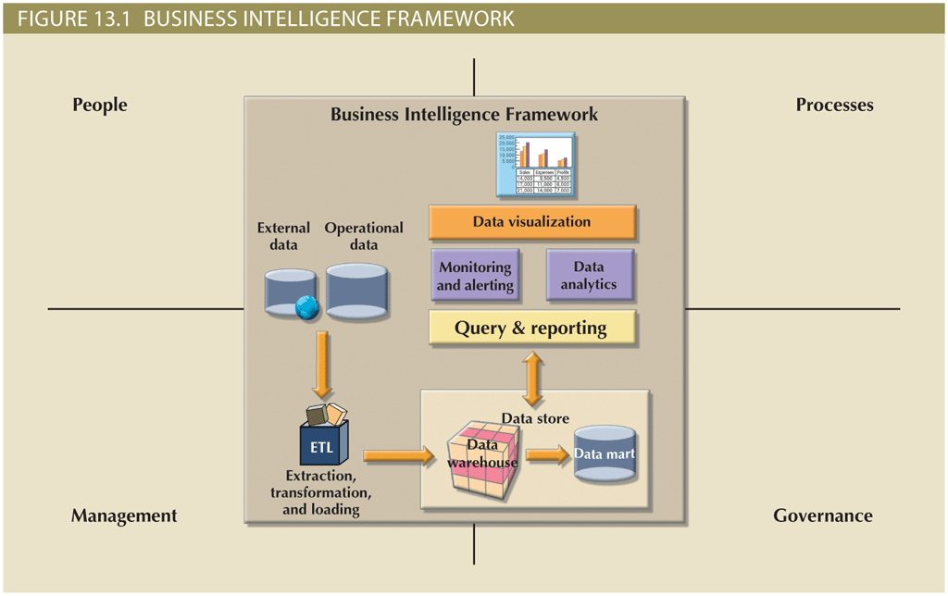
Business Intelligence Architecture (1 of 3)

Slide 7
Business Intelligence Architecture (2 of 3)
Table 13.2 Basic BI Architectural Components
Component | Description
ETL tools | Data extraction, transformation, and loading (ETL ) tools collect, filter, integrate, and aggregate internal and external data to be saved into a data store optimized for decision support.
Data store | The data store is optimized for decision support and is generally represented by a data warehouse or a data mart. The data is stored in structures that are optimized for data analysis and query speed.
Query and reporting | This component performs data selection and retrieval, and it is used by the data analyst to create queries that access the database and create the required reports.
Data visualization | This component presents data to the end user in a variety of meaningful and innovative ways. This tool helps the end user select the most appropriate presentation format, such as summary reports, maps, pie or bar graphs, mixed graphs, and static or interactive dashboards.
Data monitoring and alerting | This component allows real-time monitoring of business activities. The BI system will present concise information in a single integrated view. This integrated view could include specific metrics about the system performance or activities, such as number of orders placed in the last four hours, number of customer complaints by product by month, and total revenue by region. Alerts can be placed on a given metric; once the value of a metric goes below or above a certain baseline, the system will perform a given action, such as emailing shop floor managers, presenting visual alerts, or starting an application.
Data analytics | This component performs data analysis and data-mining tasks using the data in the data store. This tool advises the user as to which data analysis tool to select and how to build a reliable business data model. Business models are generated by special algorithms that identify and enhance the understanding of business situations and problems.

Slide 8
Business Intelligence Architecture (3 of 3)
Practices to manage data
Master data management (MDM): collection of concepts, techniques, and processes for identification, definition, and management of data elements
Governance: method of government for controlling business health and for consistent decision making
Key performance indicators (KPI): numeric or scale-based measurements that assess company’s effectiveness in reaching its goals
General
Finance
Human resources
Education
Modern BI reporting styles
Advanced reporting
Monitoring and alerting
Advanced data analytics

Slide 9
Business Intelligence Benefits
Improved decision making is the main goal of BI, but BI provides other benefits
Integrating architecture
Common user interface for data reporting and analysis
Common data repository fosters single version of company data
Improved organizational performance
Achieving all these benefits takes a lot of human, financial, technological resources, and time
BI benefits are not achieved overnight; are the result of a focused company-wide effort that could take a long time

Slide 10
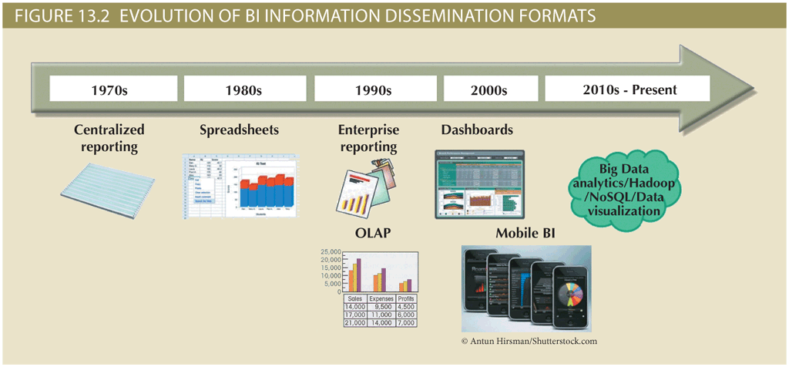
Business Intelligence Evolution (1 of 2)

Slide 11
Business Intelligence Evolution (2 of 2)
Decision support system (DSS) is an arrangement of computerized tools used to assist managerial decision making
Typically has a much narrower focus and reach than a BI solution
BI information technology has evolved from centralized reporting styles to the current, mobile BI and Big Data analytics style in the span of just a few years
The rate of technological change is not slowing down; technology advancements are accelerating the adoption of BI to new levels

Slide 12
Business Intelligence Technology Trends
Several technological advances are driving the growth of business intelligence technologies
Data storage improvements
Business intelligence appliances
Business intelligence as a service
Big Data analytics
Personal analytics

Slide 13
Decision Support Data
Although BI is used at the strategic and tactical managerial levels within organizations, its effectiveness depends on the quality of data gathered at the operational level
Operational data is seldom well suited to decision support tasks

Slide 14
Operational Data versus Decision Support Data (1 of 3)
Operational data and decision support data serve different purposes
Operational data is useful for capturing daily business transactions
Decision support data gives tactical and strategic business meaning to the operational data
Decision support data differs from operational data in three main areas
Time span
Granularity (level of aggregation)
Dimensionality

Slide 15
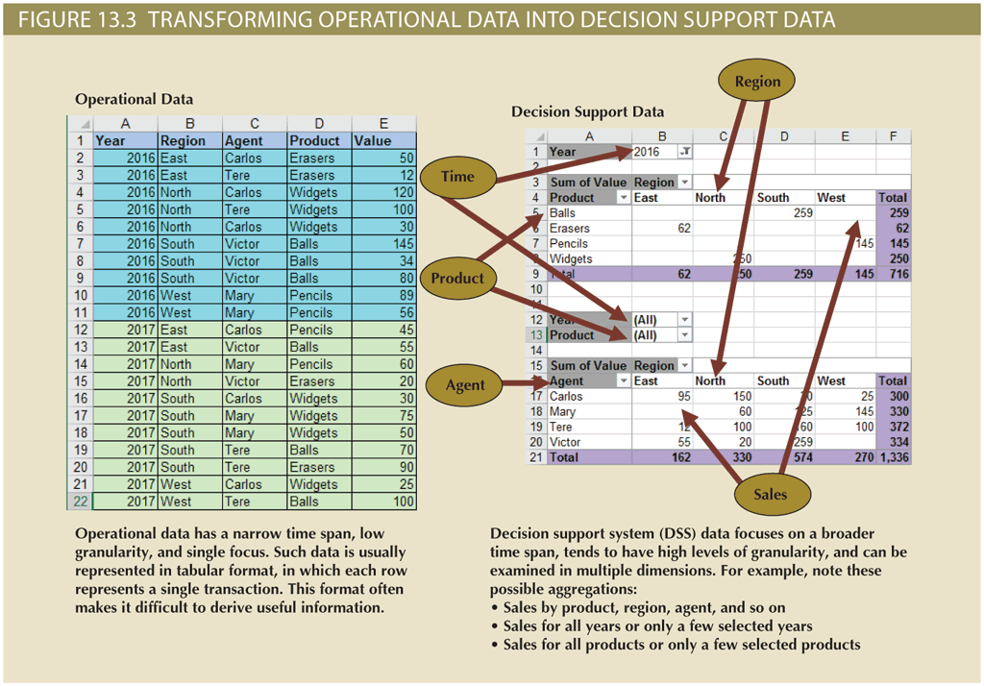
Operational Data versus Decision Support Data (2 of 3)

Slide 16
Operational Data versus Decision Support Data (3 of 3)
Table 13.5 Contrasting Operational and Decision Support Data Characteristics
Characteristic | Operational Data | Decision Support Data
Data currency | Current operations Real-time data | Historic data Snapshot of company data Time component (week/month/year)
Granularity | Atomic-detailed data | Summarized data
Summarization level | Low; some aggregate yields | High; many aggregation levels
Data model | Highly normalized Mostly relational DBMSs | Non-normalized Complex structures Some relational, but mostly multidimensional DBMSs
Transaction type | Mostly updates | Mostly query
Transaction volumes | High-update volumes | Periodic loads and summary calculations
Transaction speed | Updates are critical | Retrievals are critical
Query activity | Low to medium | High
Query scope | Narrow range | Broad range
Query complexity | Simple to medium | Very complex
Data volumes | Hundreds of gigabytes | Terabytes to petabytes

Slide 17
Decision Support Database Requirements
Database schema
Must support complex, non-normalized data representations
Data must be aggregated and summarized
Queries must be able to extract multidimensional time slices
Data extraction and filtering
Allow batch and scheduled data extraction
Support different data sources and check for inconsistent data or data validation rules
Encourage advanced integration, aggregation, and classification
Database size
Very large databases (VLDBs)
Advanced storage technologies
Multiple-processor technologies

Slide 18
The Data Warehouse (1 of 3)
Collection of data
Provides support for decision making
Components
Integrated
Subject-oriented
Time-variant
Nonvolatile

Slide 19
The Data Warehouse (2 of 3)
Table 13.8 Characteristics of Data Warehouse Data and Operational Database Data
Characteristic | Operational Database Data | Data Warehouse Data
Integrated | Similar data can have different representations or meanings. For example, Social Security numbers may be stored as ###-##-#### or as #########, and a given condition may be labeled as T/F or 0/1 or Y/N. A sales value may be shown in thousands or in millions. | Provide a unified view of all data elements with a common definition and representation for all business units.
Subject-oriented | Data is stored with a functional, or process, orientation. For example, data may be stored for invoices, payments, and credit amounts. | Data is stored with a subject orientation that facilitates multiple views of the data and decision making. For example, sales may be recorded by product, division, manager, or region.
Time-variant | Data is recorded as current transactions. For example, the sales data may be the sale of a product on a given date, such as $342.78 on 12-MAY-2016. | Data is recorded with a historical perspective in mind. Therefore, a time dimension is added to facilitate data analysis and various time comparisons.
Nonvolatile | Data updates are frequent and common. For example, an inventory amount changes with each sale. Therefore, the data environment is fluid. | Data cannot be changed. Data is added only periodically from historical systems. Once the data is properly stored, no changes are allowed. Therefore, the data environment is relatively static.

Slide 20
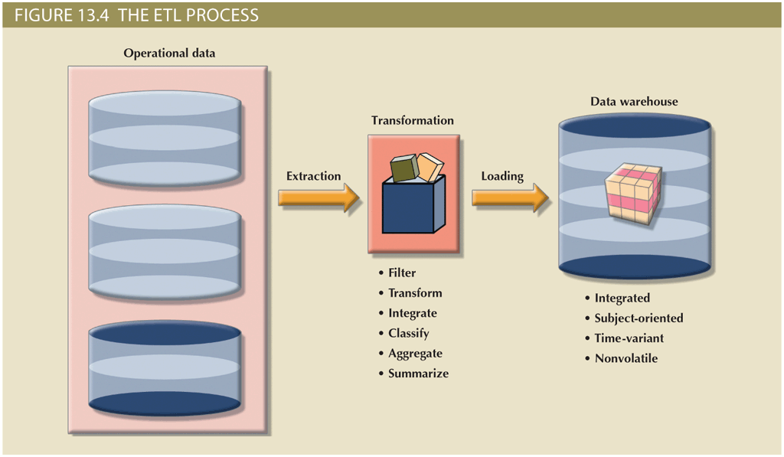
The Data Warehouse (3 of 3)

Slide 21
Data Marts
Small, single-subject data warehouse subset
Provides decision support to a small group of people
Benefits over data warehouses
Lower cost and shorter implementation time
Technologically advanced
Inevitable “people issues”

Slide 22
Twelve Rules That Define a Data Warehouse
Table 13.9 | Twelve Rules for a Data Warehouse
Rule No. | Description
1 | The data warehouse and operational environments are separated.
2 | The data warehouse data is integrated.
3 | The data warehouse contains historical data over a long time.
4 | The data warehouse data is snapshot data captured at a given point in time.
5 | The data warehouse data is subject oriented.
6 | The data warehouse data is mainly read-only with periodic batch updates from operational data. No online updates are allowed.
7 | The data warehouse development life cycle differs from classical systems development. Data warehouse development is data-driven; the classical approach is process-driven.
8 | The data warehouse contains data with several levels of detail: current detail data, old detail data, lightly summarized data, and highly summarized data.
9 | The data warehouse environment is characterized by read-only transactions to very large data sets. The operational environment is characterized by numerous update transactions to a few data entities at a time.
10 | The data warehouse environment has a system that traces data sources, transformations, and storage.
11 | The data warehouse’s metadata is a critical component of this environment. The metadata identifies and defines all data elements. The metadata provides the source, transformation, integration, storage, usage, relationships, and history of each data element.
12 | The data warehouse contains a chargeback mechanism for resource usage that enforces optimal use of the data by end users.

Slide 23
Star Schemas (1 of 5)
Data-modeling technique
Maps multidimensional decision support data into a relational database
Creates the near equivalent of multidimensional database schema from existing relational database
Yields an easily implemented model for multidimensional data analysis

Slide 24
Star Schemas (2 of 5)
Basic star schema components
Facts: numeric values that represent a specific business aspect
Dimensions: qualifying characteristics that provide additional perspectives to a given fact
Attributes: used to search, filter, and classify facts
Slice and dice: ability to focus on slices of the data cube for more detailed analysis
Attribute hierarchies: provide a top-down data organization
Aggregation and drill-down/roll-up data analysis

Slide 25
Star Schemas (3 of 5)
Star schema representation
Facts and dimensions represented by physical tables in data warehouse database
Many-to-one (M:1) relationship between fact table and each dimension table
Fact and dimension tables
Related by foreign keys
Subject to primary and foreign key constraints
Primary key of a fact table
Composite primary key because the fact table is related to many dimension tables
Always formed by combining the foreign keys pointing to the related dimension tables

Slide 26
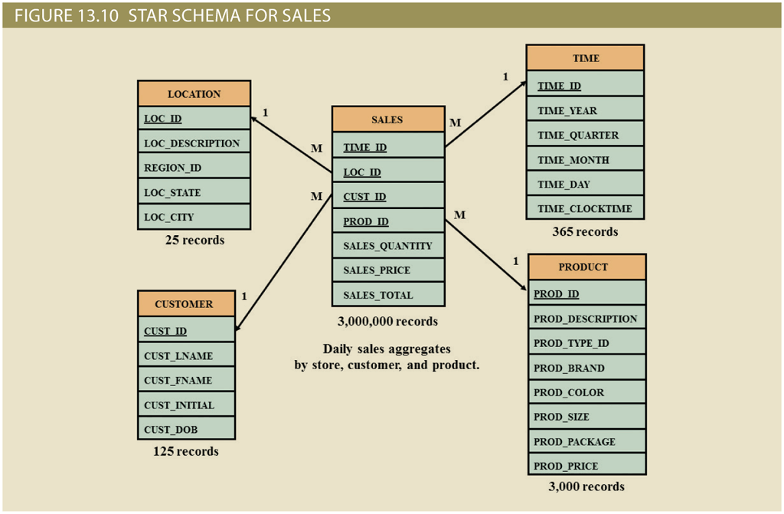
Star Schemas (4 of 5)

Slide 27
Star Schemas (5 of 5)
Performance-improving techniques for the star schema
Normalizing dimensional tables
Snowflake schema: dimension tables can have their own dimension tables
Maintaining multiple fact tables to represent different aggregation levels
Save processor cycles at run time, thereby speeding up data analysis
Denormalizing fact tables
Improves data access performance and saves data storage space
Partitioning and replicating tables
Partitioning: splits tables into subsets of rows or columns and places them close to the client computer
Replication: makes copy of table and places it in a different location
Periodicity: provides information about the time span of the data stored in the table

Slide 28
Online Analytical Processing (OLAP)
Online analytical processing (OLAP) is a BI style whose systems share three main characteristics
Multidimensional data analysis techniques
Advanced database support
Easy-to-use end-user interfaces

Slide 29
Multidimensional Data Analysis Techniques
Data are processed and viewed as part of a multidimensional structure
Particularly attractive to business decision makers who tend to view business data as being related to other business data
Augmented advanced functions
Data presentation
Data aggregation, consolidation, and classification
Computational
Data-modeling

Slide 30
Advanced Database Support
OLAP tools must have the following features to deliver efficient decision support:
Access to many different kinds of DBMSs, flat files, and internal and external data sources
Access to aggregated data warehouse data and operational database detail data
Advanced data navigation features
Rapid and consistent query response times
Ability to map end-user requests
Support for very large databases

Slide 31
Easy-to-Use End-User Interface
When proper implementation leads to simple navigation and accelerated decision making or data analysis
Advanced OLAP features are more useful when access is kept simple
Many interface features are borrowed from previous generations of data analysis tools

Slide 32
OLAP Architecture (1 of 2)
Designed to meet ease-of-use requirements while keeping the system flexible
Main architectural components
Graphical user interface (GUI)
Analytical processing logic
Data-processing logic

Slide 33
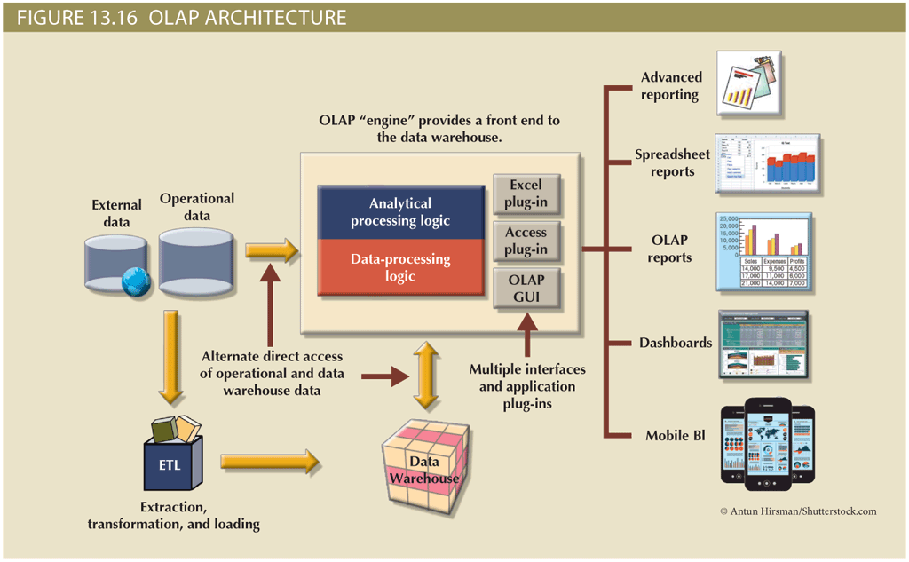
OLAP Architecture (2 of 2)

Slide 34
Relational OLAP
Relational online analytical processing (ROLAP)
Provides OLAP functionality using relational databases and familiar relational tools to store and analyze multidimensional data
Extensions added to traditional RDBMS technology
Multidimensional data schema support within the RDBMS
Data access language and query performance optimized for multidimensional data
Support for very large databases (VLDBs)

Slide 35
Multidimensional OLAP
Multidimensional online analytical processing (MOLAP)
Extends OLAP functionality to multidimensional database management systems (MDBMSs)
MDBMS uses proprietary techniques store data in matrix-like n-dimensional arrays
End users visualize stored data as a three dimensional data cube
Grow to n number dimensions, thus becoming hypercubes
Held in memory in a cube cache to speed access
Sparsity: measures density of data held in the data cube

Slide 36
Relational versus Multidimensional OLAP
Table 13.12 Relational vs. Multidimensional OLAP
Characteristic | ROLAP | MOLAP
Schema | Uses star schema Additional dimensions can be added dynamically | Uses data cubes Multidimensional arrays, row stores, column stores Additional dimensions require re-creation of the data cube
Database size | Medium to large | Large
Architecture | Client/server Standards-based | Client/server Open or proprietary, depending on vendor
Access | Supports ad hoc requests Unlimited dimensions | Limited to predefined dimensions Proprietary access languages
Speed | Good with small data sets; average for medium-sized to large data sets | Faster for large data sets with predefined dimensions

Slide 37
Data Analytics (1 of 4)
Subset of business intelligence (BI) functionality that encompasses a wide range of mathematical, statistical, and modeling techniques with the purpose of extracting knowledge from data
Explanatory analytics: focuses on discovering and explaining data characteristics and relationships based on existing data
Predictive analytics: focuses on predicting future data outcomes with a high degree of accuracy
Data mining focuses on the discovery and explanation stages of knowledge acquisition
Analyzing massive amounts of data to uncover hidden trends, patterns, and relationships; to form computer models to simulate and explain the findings; and to use such models to support business decision making

Slide 38
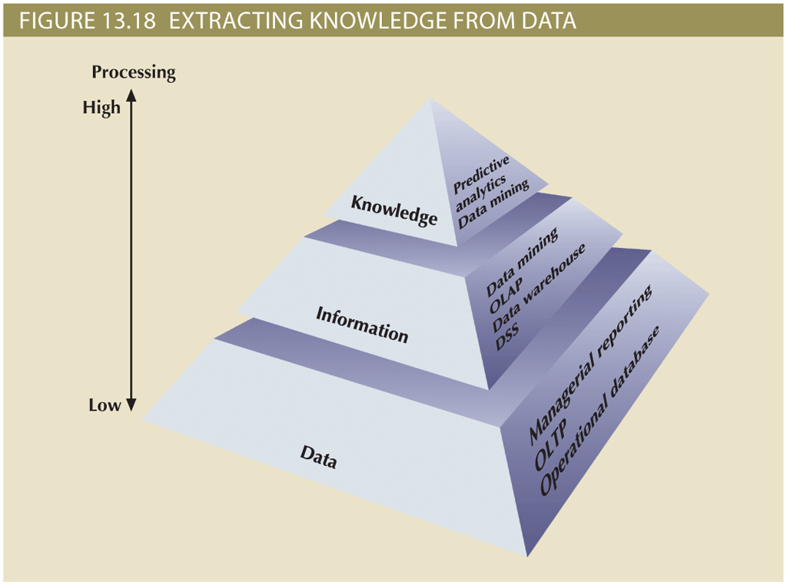
Data Analytics (2 of 4)

Slide 39
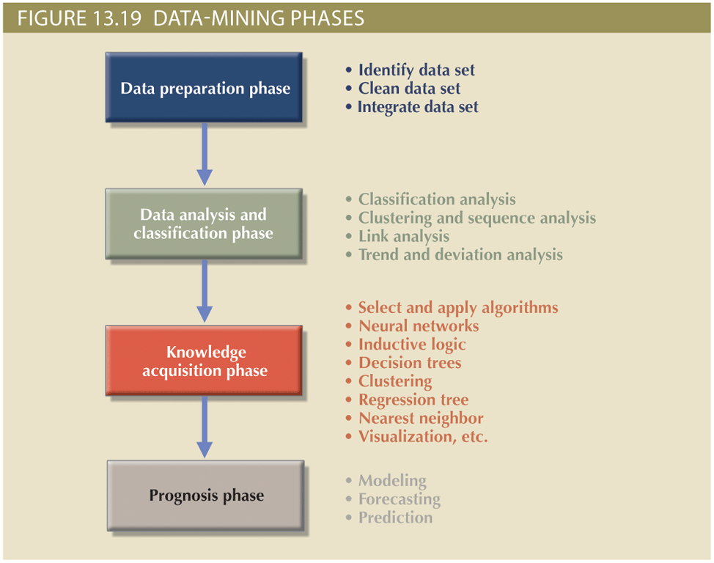
Data Analytics (3 of 4)

Slide 40
Data Analytics (4 of 4)
Predictive analytics focuses on creating actionable models to predict future behaviors and events
Employs mathematical and statistical algorithms, neural networks, artificial intelligence, and other advanced modeling tools to create actionable predictive models based on available data
Used in areas such as customer relationships, customer service, customer retention, fraud detection, targeted marketing, and optimized pricing

Slide 41
SQL Analytic Functions (1 of 2)
The ROLLUP extension
Used with GROUP BY clause to generate aggregates by different dimensions
Enables subtotal for each column listed except for the last one, which gets a grand total
The CUBE extension
Used with GROUP BY clause to generate aggregates by the listed columns
Enables you to get a subtotal for each column listed in the expression, in addition to a grand total for the last column listed

Slide 42
SQL Analytic Functions (2 of 2)
Materialized views
Dynamic table that contains SQL query command to generate rows and stores the actual rows
Created the first time query is run and summary rows are stored in the table
Automatically updated when base tables are updated
Requires specified privileges

Slide 43
Data Visualization (1 of 2)
Process of abstracting data to provide a visual data representation that enhances the user’s ability to comprehend the meaning of the data
Goal is to allow the user to quickly and efficiently see the data’s big picture by identifying trends, patterns, and relationships
The need for data visualization
Ability to zoom in and out, drill down and up, filter, etc. is one of the many advantages of current breed of data visualization tools
Makes it easier to understand data—in particular, large amounts of data
The science of data visualization
Roots in cognitive sciences: how the human brain receives, interprets, organizes, and processes information
Pattern recognition
Spatial awareness
Aesthetics

Slide 44
Data Visualization (2 of 2)
Understanding the data
The same data can be presented in multiple ways
In general, there are two types of data:
Qualitative: describes qualities of the data
Nominal or ordinal
Quantitative: describes numeric facts or measures of the data

Slide 45
Summary (1 of 2)
Business intelligence (BI) is a term for a comprehensive, cohesive, and integrated set of applications used to capture, collect, integrate, store, and analyze data with the purpose of generating and presenting information to support business decision making
Decision support systems (DSSs) refer to an arrangement of computerized tools used to assist managerial decision making within a business
Operational data is not well suited for decision support
The data warehouse is an integrated, subject-oriented, time-variant, nonvolatile collection of data that provides support for decision making
The star schema is a data-modeling technique used to map multidimensional decision support data into a relational database for advanced data analysis

Slide 46
Summary (2 of 2)
Online analytical processing (OLAP) refers to an advanced data analysis environment that supports decision making, business modeling, and operations research
Data analytics is a subset of BI functionality that provides advanced data analysis tools to extract knowledge from business data
Data mining automates the analysis of operational data to find previously unknown data characteristics, relationships, dependencies, and trends
SQL has been enhanced with analytic functions that support OLAP-type processing and data generation
Data visualization provides visual representations of data that enhance the user’s ability to comprehend the meaning of the data

Slide 47
Chapter 15
Database Connectivity and Web Technologies

Slide 48
Learning Objectives
After completing this chapter, you will be able to:
Explain the purpose of standard database connectivity interfaces
Describe the functionality and features of various database connectivity technologies: ODBC, OLE, ADO.NET, and JDBC
Describe how web-to-database middleware is used to integrate databases with the Internet
Identify the services provided by web application servers
Explain how Extensible Markup Language (XML) is used for web database development
Describe the advantages and disadvantages of using cloud computing for the database-as-a-service model

Slide 49
Database Connectivity
Mechanisms through which application programs connect and communicate with data repositories
Database middleware: provides an interface between the application program and the database
Data repository: data management application used to store data generated by an application program
Universal Data Access (UDA): collection of technologies used to access any type of data source and manage the data through a common interface
ODBC, OLE-DB, and ADO.NET form the backbone of MS UDA architecture

Slide 50
Native SQL Connectivity
Connection interface provided by database vendors, which is unique to each vendor
Interfaces are optimized for particular vendor’s DBMS
Maintenance is a burden for the programmer

Slide 51
ODBC, DAO, and RDO (1 of 3)
Open Database Connectivity (ODBC): Microsoft’s implementation of a superset of SQL Access Group Call Level Interface (CLI) standard for database access
Widely supported database connectivity interface
Allows Windows application to access relational data sources by using SQL via standard application programming interface (API)
Data Access Objects (DAO): object-oriented API used to access desktop databases such as MS Access and FileMaker Pro
Provides an optimized interface that expose functionality of Jet data engine to programmers
Remote Data Objects (RDO): higher-level object-oriented application interface used to access remote database servers
Optimized to deal with server-based databases
Dynamic-link libraries (DLLs): implements ODBC, DAO, and RDO as shared code that is dynamically linked to the Windows operating environment

Slide 52
ODBC, DAO, and RDO (2 of 3)
Components of ODBC architecture
High-level ODBC API through which application programs access ODBC functionality
Driver manager that is in charge of managing all database connections
ODBC driver that communicates directly to DBMS

Slide 53
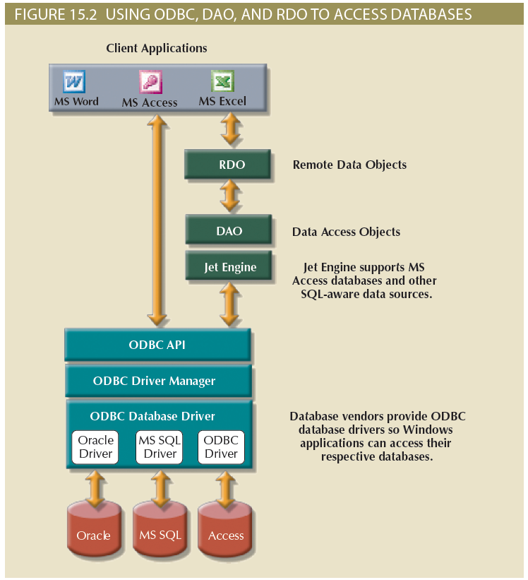
ODBC, DAO, and RDO (3 of 3)

Slide 54
OLE-DB (1 of 2)
Object Linking and Embedding for Database (OLE-DB)
Database middleware that adds object-oriented functionality for access to relational and nonrelational data
Series of COM objects provides low-level database connectivity for applications
Types of objects based on functionality
Consumers: applications or processes
Providers: data or service
Does not provide support for scripting languages
ActiveX Data Objects (ADO) provide:
High-level application-oriented interface to interact with OLE-DB, DAO, and RDO
Unified interface to access data from any programming language that uses the underlying OLE-DB objects

Slide 55
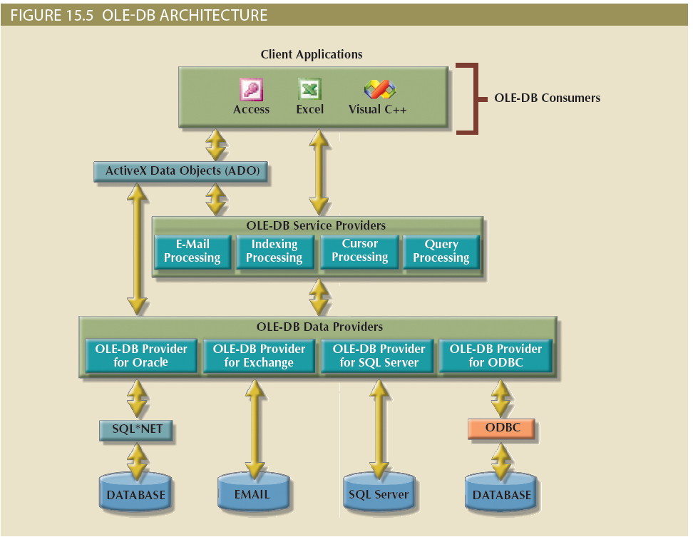
OLE-DB (2 of 2)

Slide 56
ADO.NET (1 of 2)
Data access component of Microsoft’s .NET application development framework
Microsoft’s .NET framework
Component-based platform for developing distributed, heterogeneous, interoperable applications
Manipulates any type of data using any combination of network, operating system, and programming language
Extends and enhances functionality critical for the development of distributed applications
DataSet: disconnected memory-resident representation of the database
Contains tables, columns, rows, relationships and constraints
Internally stored in XML format
Data in DataSet is made persistent as XML documents

Slide 57
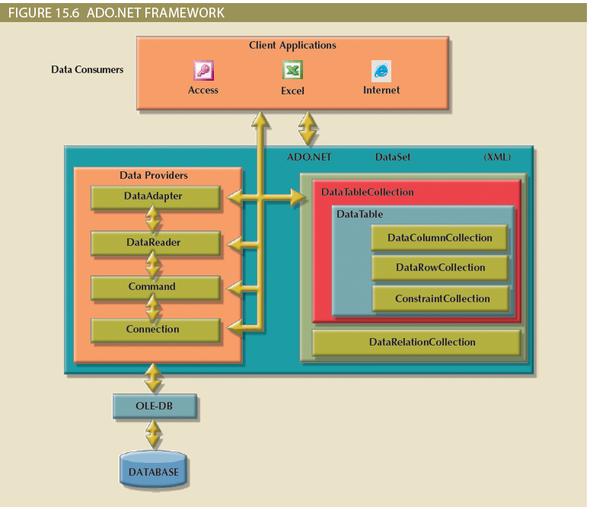
ADO.NET (2 of 2)

Slide 58
Java Database Connectivity (JDBC) (1 of 2)
Application programming interface that allows a Java program to interact with a wide range of data sources
Advantages of JDBC
Company can leverage existing technology and personnel training
Direct access to database server or access via database middleware
Programmers can use their SQL skills to manipulate the data in the company's databases
Provides a way to connect to databases through an ODBC driver

Slide 59
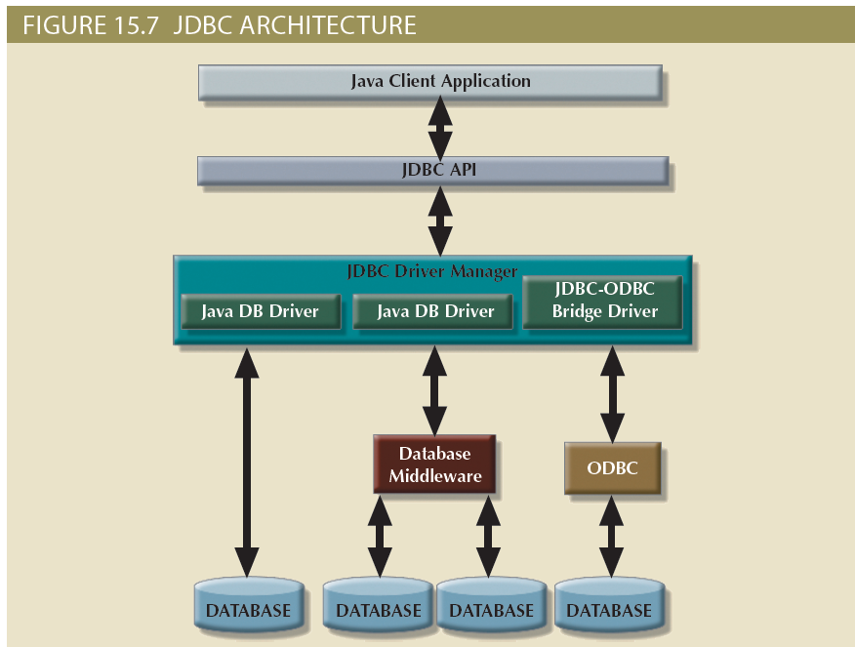
Java Database Connectivity (JDBC) (2 of 2)

Slide 60
Database Internet Connectivity (1 of 2)
Allows new innovative services
Permit rapid response by bringing new services and products to market quickly
Increase customer satisfaction through creation of innovative data services
Allow anywhere, anytime data access using mobile smart devices via the Internet
Yield fast and effective information dissemination through universal access

Slide 61
Database Internet Connectivity (2 of 2)
Table 15.3: Characteristics and Benefits of Internet Technologies
Internet Characteristic | Benefit
Hardware and software Independence | Savings in equipment and software acquisition Ability to run on most existing equipment Platform independence and portability No need for multiple platform development
Common and simple user interface | Reduced training time and cost Reduced end-user support cost No need for multiple platform development
Location independence | Global access through Internet infrastructure and mobile smart devices Creation of new location-aware services Reduced requirements (and costs!) for dedicated connections
Rapid development at manageable costs | Availability of multiple development tools Plug-and-play development tools (open standards) More interactive development Reduced development times Relatively inexpensive tools Free client access tools (web browsers) Low entry costs; frequent availability of free web servers Reduced costs of maintaining private networks Distributed processing and scalability using multiple servers

Slide 62
Web-to-Database Middleware: Server-Side Extensions (1 of 2)
Web server is the main hub through which Internet services are accessed
Server-side extension: program that interacts directly with the web server
Provides services to the web server in a way that is totally transparent to the client browser
Known as web-to-database middleware

Slide 63
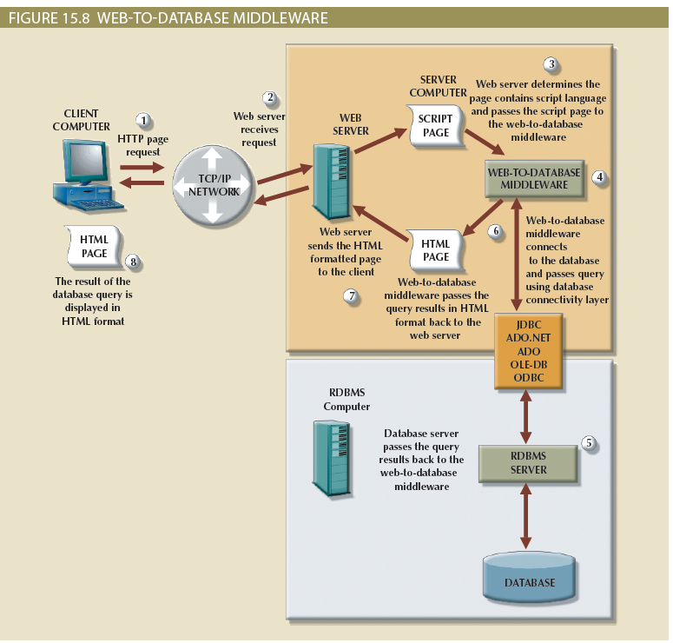
Web-to-Database Middleware: Server-Side Extensions (2 of 2)

Slide 64
Web Server Interfaces
Currently, there are two well-defined web server interfaces
Common Gateway Interface (CGI): uses script files that perform specific functions based on the client’s parameters that are passed to the web server
Application programming interface (API): implemented as shared code or as dynamic-link libraries; treated as part of the web server program that is dynamically invoked when needed

Slide 65
The Web Browser
Software that lets users navigate the web from their client computer
Interprets HTML code received from web server
Presents different page components in standard way
Web is a stateless system
Web server does not know the status of any clients

Slide 66
Client-Side Extensions
Add functionality to Web browser
Plug-in: external application automatically invoked by the browser when needed
Java and JavaScript: embedded in web page
Downloaded with the Web page and activated by an event
ActiveX and VBScript: embedded in web page
Downloaded with page and activated by event
Oriented to Windows applications

Slide 67
Web Application Servers (1 of 2)
Middleware application that expands the functionality of web servers by linking them to a wide range of services
Connects to and query database from web page
Presents database data in a webpage using various formats
Creates dynamic web search pages
Creates webpages to insert, update, and delete data
Enforces referential integrity
Uses simple and nested queries and program logic to represent business rules

Slide 68
Web Application Servers (2 of 2)
Web application server features
Integrated development environment
Security and user authentication
Computational languages
Automation generation of HTML pages
Performance and fault -tolerant features
Database access with transaction management capabilities
Access to multiple services

Slide 69
Web Database Development
Process of interfacing databases with the web browser
How to create webpages that access data in a database
Code examples
ColdFusion
PHP
ASP.NET

Slide 70
Extensible Markup Language (XML)
Meta-language used to represent and manipulate data elements
Facilitates the exchange of structured documents over the Internet
Allows definition of new tags
Case sensitive
Must be well-formed and properly nested
Indicates comments with <- and ->
XML and xml prefixes reserved for XML only

Slide 71
Document Type Definitions (DTD) and XML Schemas (1 of 2)
File with .dtd extension that describe XML elements
Provides composition of database’s logical model
Defines the syntax rules or valid tags for each type of XML document
Companies engaging in e-commerce transaction must develop and share DTDs
DTD referenced from inside XML document

Slide 72
Document Type Definitions (DTD) and XML Schemas (2 of 2)
XML schemas
Advanced data definition language
Describes the structure of XML data documents
More closely maps to database terminology and features
XML schema definition (XSD) file uses syntax similar to XML document

Slide 73
XML Presentation
XML separates data structure from presentation and processing
Extensible Style Language (XSL) displays XML data
Defines the rules by which XML data are formatted and displayed
Parts:
Extensible Style Language Transformations (XSLT)
XSL style sheets

Slide 74
XML Applications
Several applications lend themselves particularly well to XML
B2B exchanges
Legacy systems integration
Web page development
Database support
Database meta-dictionaries
XML databases
XML services

Slide 75
Cloud Computing Services (1 of 2)
Computing model that enables access to a shared pool of configurable computer resources
Can be rapidly provisioned and released with minimal management effort or service provider interaction
Potential to become a game changer; eliminates financial and technological barriers

Slide 76
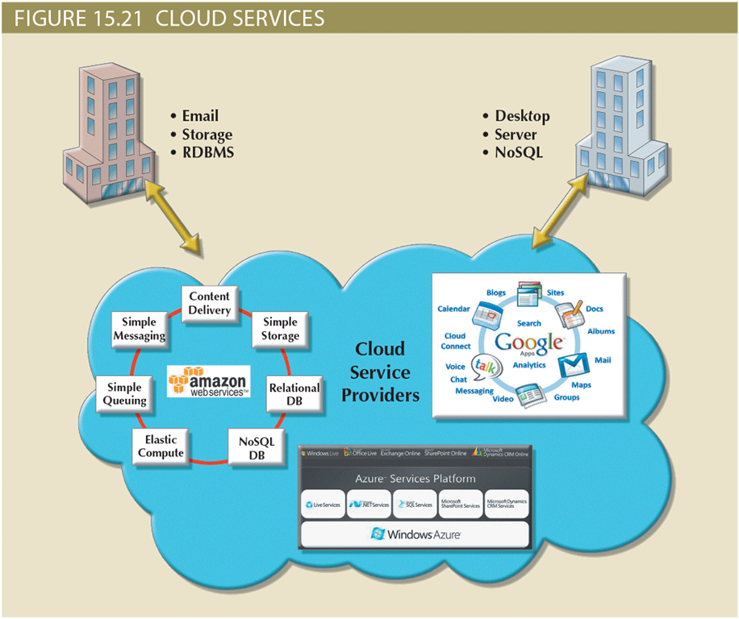
Cloud Computing Services (2 of 2)

Slide 77
Cloud Implementation Types
Public cloud
Built by a third-party organization to sell cloud services to the general public
Private cloud
Built by an organization for the sole purpose of servicing its own needs
Community cloud
Built by and for a specific group of organizations that share a common trade

Slide 78
Characteristics of Cloud Services
Cloud computing services share a set of guiding principles
Ubiquitous access via Internet technologies
Shared infrastructure
Lower costs and variable pricing
Flexible and scalable services
Dynamic provisioning
Service orientation
Managed operations

Slide 79
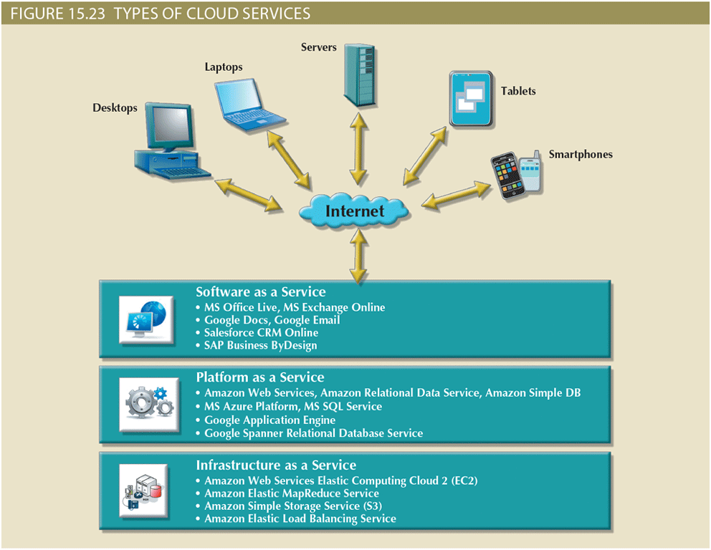
Types of Cloud Services

Slide 80
Cloud Services: Advantages and Disadvantages
Table 15.4: Advantages and Disadvantages of Cloud Computing
Advantage | Disadvantage
Low initial cost of entry. Cloud computing has lower costs of entry when compared with the alternative of building in house. | Issues of security, privacy, and compliance. Trusting sensitive company data to external entities is difficult for most data-cautious organizations.
Scalability/elasticity. It is easy to add and remove resources on demand. | Hidden costs of implementation and operation. It is hard to estimate bandwidth and data migration costs.
Support for mobile computing. Cloud computing providers support multiple types of mobile computing devices. | Data migration is a difficult and lengthy process. Migrating large amounts of data to and from the cloud infrastructure can be difficult and time-consuming.
Ubiquitous access. Consumers can access the cloud resources from anywhere at any time, as long as they have Internet access. | Complex licensing schemes. Organizations that implement cloud services are faced with complex licensing schemes and complicated service-level agreements.
High reliability and performance. Cloud providers build solid infrastructures that otherwise are difficult for the average organization to leverage. | Loss of ownership and control. Companies that use cloud services are no longer in complete control of their data. What is the responsibility of the cloud provider if data are breached? Can the vendor use your data without your consent?
Fast provisioning. Resources can be provisioned on demand in a matter of minutes with minimal effort. | Organization culture. End users tend to be resistant to change. Do the savings justify being dependent on a single provider? Will the cloud provider be around in 10 years?
Managed infrastructure. Most cloud implementations are managed by dedicated internal or external staff. This allows the organization’s IT staff to focus on other areas. | Difficult integration with internal IT system. Configuring the cloud services to integrate transparently with internal authentication and other internal services could be a daunting task.

Slide 81
SQL Data Services
Cloud computing-based data management service
Provides relational data management to companies
Hosted data management and standard protocols
Standard protocols
Common programming interface
Advantages
Reliable and scalable at a lower cost than in-house systems
High level of failure tolerance
Dynamic and automatic load balancing
Automated data backup and disaster recovery are included
Dynamic creation and allocation of processes and storage

Slide 82
Summary (1 of 2)
Database connectivity refers to the mechanisms through which application programs connect and communicate with data repositories
Microsoft database connectivity interfaces are dominant players in the market and enjoy the support of most database vendors
Native database connectivity refers to the connection interface that is provided by the database vendor and is unique to that vendor
Object Linking and Embedding for Database (OLE-DB) is database middleware developed with the goal of adding object-oriented functionality for access to relational and nonrelational data
Database access through the web is achieved through middleware
Extensible Markup Language (XML) facilitates the exchange of B2B and other data over the Internet

Slide 83
Summary (2 of 2)
Cloud computing is a computing model that provides ubiquitous, on-demand access to a shared pool of configurable resources that can be rapidly provisioned
SQL data services (SDS) refers to a cloud computing-based data management service that provides relational data storage, ubiquitous access, and local management to companies of all sizes

Slide 84
Chapter 16
Database Administration and Security

Slide 85
Learning Objectives
After completing this chapter, you will be able to:
Describe the impact of data quality on a company’s assets and competitive position
Describe the role of the database in supporting operational, tactical, and strategic decision-making
Describe the impact that the introduction of a DBMS has on technological, managerial, and cultural aspects of an organization
Describe the managerial and technical roles of the database administrator
Describe the processes and systems in the information security framework that support the three database security goals
Identify the standards, strategies, and tools used in database administration
Describe the impact that cloud-based data services have on the role of the DBA
Perform various technical tasks of database administration with Oracle

Slide 86
Data as a Corporate Asset (1 of 3)
Data is a valuable resource that can translate into information
If the information is accurate and timely, it can enhance the company’s competitive position and generate wealth
An organization is subject to a data-information-decision cycle
Data user applies intelligence to data to produce information that is the basis of knowledge used in decision making

Slide 87
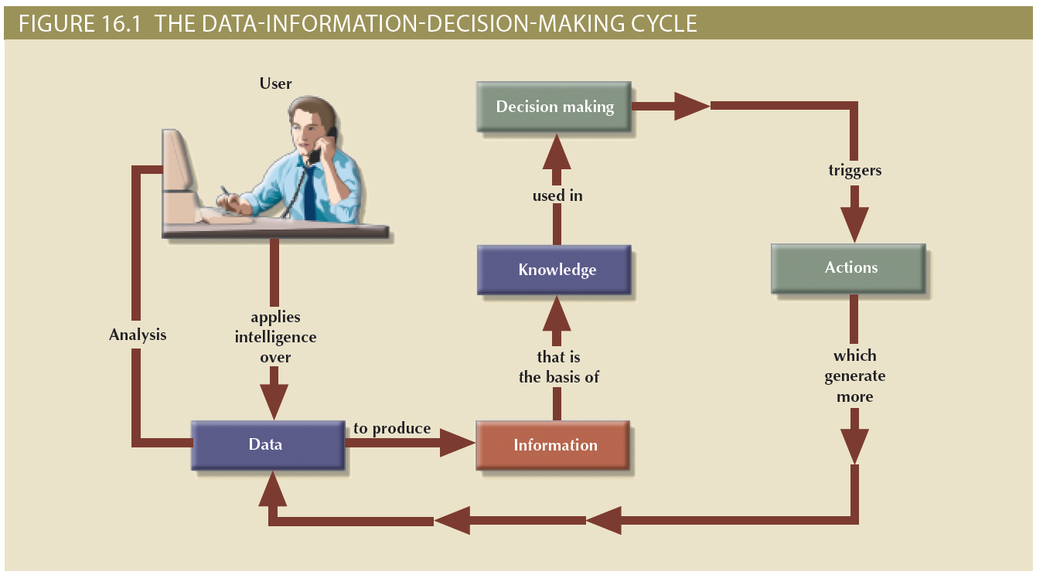
Data as a Corporate Asset (2 of 3)

Slide 88
Data as a Corporate Asset (3 of 3)
Dirty data
Suffers from inaccuracies and inconsistencies
Data quality
Ensures accuracy, validity, and timeliness of data
Data profiling software
Determines data patterns and compares them against standards defined by the organization
Master data management (MDM) software
Helps prevent dirty data by coordinating across multiple systems

Slide 89
The Need for a Database and Its Role in an Organization (1 of 2)
Top management level
Enable strategic decision making and planning
Identify growth opportunities
Define and enforce organizational policies
Reduce costs and boost productivity
Provide feedback
Middle management level
Deliver the data required for tactical planning
Monitor the use of resources
Evaluate performance
Enforce security and privacy of data in the database

Slide 90
The Need for a Database and Its Role in an Organization (2 of 2)
Operational management level
Represent and support company operations
Produce query results within specified performance levels
Enhance the company’s short-term operations
Create query results within specified performance levels
Enhance the company’s short-term operations

Slide 91
Introduction of a Database: Special Considerations
Technological aspect
Selecting, installing, configuring, and monitoring the DBMS to ensure that it operates efficiently
Managerial aspect
Careful planning to create an appropriate organizational structure
Cultural aspect
Listening to people’s concerns about the system and explaining its uses and benefits

Slide 92
The Evolution of Database Administration (1 of 4)
Information systems (IS) department
Provides end users with data management support and solutions for information needs
Database administrator
Responsible for control of the centralized and shared database
Systems administrator
General coordinator of all DBAs
Data administrator (DA) or information resource manager (IRM)
Usually reports directly to top management; has a higher degree of responsibility and authority than the DBA

Slide 93
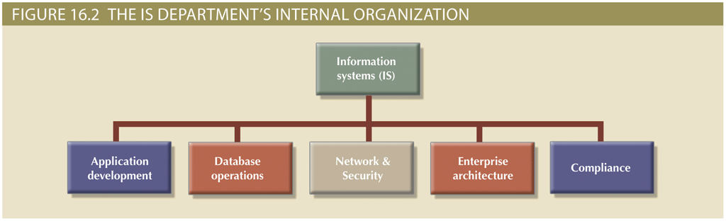
The Evolution of Database Administration (2 of 4)

Slide 94
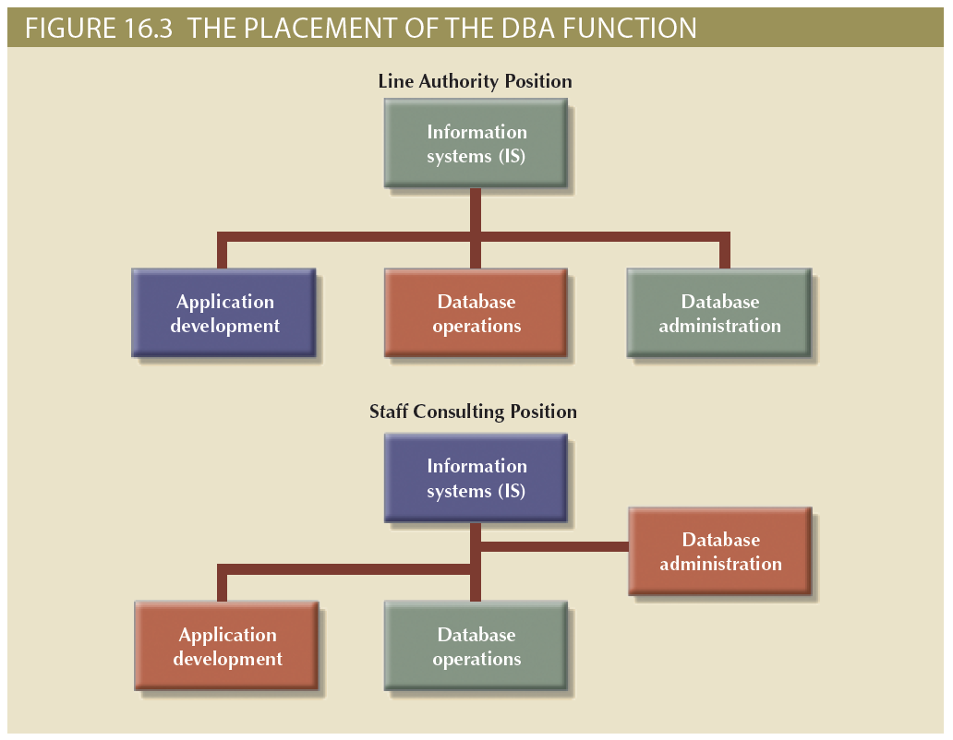
The Evolution of Database Administration (3 of 4)

Slide 95
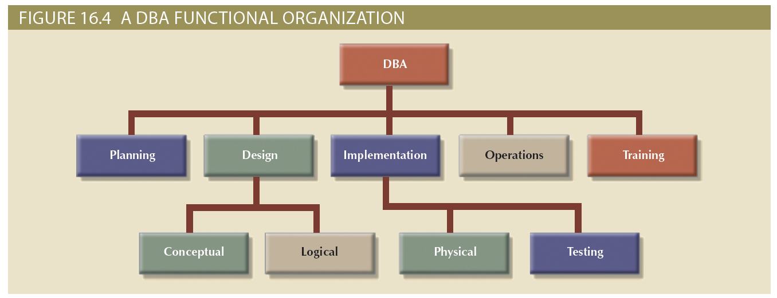
The Evolution of Database Administration (4 of 4)

Slide 96
The Database Environment’s Human Component (1 of 3)
Even the most carefully crafted database system cannot operate without human assistance
Effective data administration requires both technical and managerial skills
Administration goals are defined by various data issues
“Sharability” and time availability
Consistency and integrity
Security and privacy
Quality standards
Extent and type of use

Slide 97
The Database Environment’s Human Component (2 of 3)
Table 16.1: Contrasting DA and DBA Activities and Characteristics
Data Administrator (DA) | Database Administrator (DBA)
Performs strategic planning | Controls and supervises
Sets long-term goals | Executes plans to reach goals
Sets policies and standards | Enforces policies and procedures Enforces programming standards
Job is broad in scope | Job is narrow in scope
Focuses on the long term | Focuses on the short term (daily operations)
Has a managerial orientation | Has a technical orientation
Is DBMS-independent | Is DBMS-specific

Slide 98
The Database Environment’s Human Component (3 of 3)
Table 16.2: Desired DBA Skills
Managerial | Technical
Broad business understanding | Broad data-processing background and up-to-date knowledge of database technologies
Coordination skills | Understanding of Systems Development Life Cycle
Analytical skills | Structured methodologies • Data flow diagrams • Structure charts • Programming languages
Conflict resolution skills | Knowledge of Database Life Cycle
Communication skills (oral and written) | Database modeling and design skills • Conceptual • Logical • Physical
Negotiation skills | Operational skills: database implementation, data dictionary management, security, and so on
Experience: 10 years in a large DP department | Experience: 10 years in a large DP department

Slide 99
The DBA’s Managerial Role (1 of 2)
Important roles
Offer end-user support
Enforce policies, procedures, and standards for correct data creation, usage, and distribution within the database
Provide data security, privacy, and integrity
Supply data backup and recovery
Disaster management: planning, organizing, and testing of database contingency plans and recovery procedures
Ensure data is distributed to the right people, at the right time, and in the right format

Slide 100
The DBA’s Managerial Role (2 of 2)
Backup and recovery measures must include at least:
Periodic data and application backups
Proper backup identification
Convenient and safe backup storage
Physical protection of both hardware and software
Personal access control to the software of a database installation
Insurance coverage for the data in the database
Additional points
Data recovery and contingency plans must be tested, evaluated, and practiced frequently
A backup and recovery plan is not likely to cover all information system components

Slide 101
The DBA’s Technical Role
Areas of operation
Evaluate, select, and install DBMS and related utilities
Design and implement databases and applications
Test and evaluate databases and applications
Operate the DBMS, utilities, and applications
Train and support users
Maintain the DBMS, utilities, and applications

Slide 102
Security
Confidentiality
Protecting data against unauthorized access
Compliance
Activities that meet data privacy and security reporting guidelines
Integrity
Keeping data consistent and free of errors or anomalies
Availability
Accessibility of data whenever required by authorized users and for authorized purposes

Slide 103
Security Policies
Collection of standards, policies, and procedures created to guarantee security
Ensures auditing and compliance
Security audit process
Identifies security vulnerabilities
Finds measures to protect the system

Slide 104
Security Vulnerabilities
Weakness in a system component that could allow unauthorized access or cause service disruptions
Categories: technical, managerial, cultural, and procedural
Security threat: imminent security violation
Security breach: occurs when a security threat is exploited and could lead to a database whose integrity is preserved or corrupted
Preserved or corrupted

Slide 105
Database Security
DBMS features and related measures that comply with the security requirements
Authorization management: procedures to protect database security and integrity
User access management
View definition
DBMS access control
DBMS usage monitoring
Audit log: automatically records description of database operations performed by all users

Slide 106
Database Administration Tools
There are many sophisticated data administration tools
Monitoring
Load testing
Performance tuning
SQL code optimization
Bottleneck identification and remediation
Modeling and design
Data extraction, transformation, and loading

Slide 107
The Data Dictionary (1 of 2)
Main types
Integrated: included with the DBMS
Standalone: third-party systems
Active: automatically updated by the DBMS with every database access
Passive: requires running a batch process
Main function: store description of all objects that interact with the database
Provides database designers and end users with a much-improved ability to communicate
Helps the DBA resolve data conflicts

Slide 108
The Data Dictionary (2 of 2)
Key element of information resource management
Can be described as the information resource dictionary
Metadata is the basis for monitoring database use and for assigning access rights to users
Information stored in the data dictionary is usually based on a relational table format, thus enabling the DBA to query the database with SQL commands
DBA uses data dictionary to support data analysis and design

Slide 109
CASE Tools (1 of 2)
Computer-aided systems engineering (CASE) tools
Automated framework for the Systems Development Life Cycle (SDLC)
Use structured methodologies and powerful graphical interfaces
Classified according to extent of support provided
Front-end CASE tools: planning, analysis, and design phases
Back-end CASE tools: coding and implementation phases

Slide 110
CASE Tools (2 of 2)
Components of a CASE tools
Graphics
Screen painters and report generators
Integrated repository
Analysis segment
Program documentation generator

Slide 111
Developing a Data Administration Strategy
Information engineering (IE)
Translates strategic goals into data and applications
Information systems architecture (ISA)
Helps plan, develop, and control future information systems
Critical success factors
Management commitment
Thorough analysis of the company situation
End-user involvement
Defined standards
Training
A small pilot project

Slide 112
The DBA’s Role in the Cloud
Significant impact on role of DBAs
Tasks split between internal DBA and cloud service provider
Cloud service partner company provides:
DBMS installation and updates
Server/network management
Backup and recovery operations

Slide 113
The DBA at Work: Using Oracle for Database Administration
Tools and procedures
Supply Oracle database administration tools
Ensure the RDBMS starts automatically
Create tablespaces and datafiles
Tablespace: logical storage space
Datafile: physically stores the database’s data
Manage users and establish security
User: allows a given person to log on to the database
Role: authorizes a user to connect to the database and use its system resources
Profile: controls how much of the database resource a given user can access

Slide 114
Customizing the Database Initialization Parameters
Fine-tuning a database is an important task that usually requires modification of parameters
Initialization parameters reserve resources used by the database at run-time
Restart may be required after modifying parameters database
The DBA is responsible for a wide range of tasks
Quality and completeness of administration tools go a long way toward making the DBA’s job easier
The DBA must become familiar with the tools and technical details of the RDBMS to perform tasks properly and efficiently

Slide 115
Summary (1 of 3)
Data management is a critical activity for any organization, so data must be treated as a corporate asset
Data quality is a comprehensive approach to ensure the accuracy, validity, and timeliness of data
The DBMS is the most commonly used tool for corporate data management
The database administrator (DBA) is responsible for managing the corporate database
The DA and DBA functions tend to overlap

Slide 116
Summary (2 of 3)
A DBA’s managerial services include supporting end users; defining and enforcing policies, procedures, and standards for the database; ensuring data security, privacy, and integrity; providing data backup and recovery services; and monitoring distribution and use of the data in the database
The DBA’s technical role requires involvement in at least the following activities: evaluating, selecting, and installing the DBMS; designing and implementing databases and applications; testing and evaluating databases and applications; operating and maintaining the DBMS, utilities, and applications; and training and supporting users
Security refers to activities and measures that ensure the confidentiality, integrity, and availability of an information system and its main asset, data
A security vulnerability is a weakness in a system component that could be exploited to allow unauthorized access or service disruption

Slide 117
Summary (3 of 3)
The development of a data administration strategy is closely related to the company’s mission and objectives
To help translate strategic plans into operational plans, the DBA has access to an arsenal of database administration tools, including a data dictionary and computer-aided systems engineering (CASE) tools
With the introduction of reliable cloud-based data services, the role of the DBA has expanded beyond corporate walls

Slide 118
Introduction to Database Systems Week 7 Exam Review
School of Engineering and Computing Sciences Fall 2020
Dr. Stan Ustymenko
stanislav.ustymenko@tamucc.edu

Slide 119
Exam 1
Date: Friday Oct. 2nd
Time: 8:00-8:50
Up to 90 minutes
Place: BlackBoard

Slide 120
Respondus Lock-Down Browser
Download and install LockDown Browser from this link:
https://download.respondus.com/lockdown/download.php?id=797913747
Once Installed, you can:
Start LockDown Browser
Log into Blackboard Learn
Navigate to the test

Slide 121
Topics
Overview of Database Systems
Transaction Management and Concurrency Control
Performance tuning
Basics
MySQL
Oracle
Business Intelligence & Data Warehouses

Slide 122
Database Systems
Information, Data, Metadata
Database management system (DBMS)
Database access languages and application programming interfaces
Query language: lets the user specify what must be done without having to specify how
Structured Query Language (SQL): de facto query language and data access standard supported by the majority of DBMS vendors

Slide 123
Data versus Information
Data consists of raw facts
Not yet processed to reveal meaning to the end user
Building blocks of information
Information results from processing raw data to reveal meaning
Requires context
Bedrock of knowledge
Should be accurate, relevant, and timely

Slide 124
Problems with File System Data Processing
Problems with file systems challenge the types of information that can be created from data as well as information accuracy
Lengthy development times
Difficulty of getting quick answers
Complex system administration
Lack of security and limited data sharing
Extensive programming

Slide 125
Structural and Data Dependence (1 of 2)
Structural dependence
Access to a file is dependent on its own structure
All file system programs are modified to conform to a new file structure
Structural independence
File structure is changed without affecting the application’s ability to access the data

Slide 126
Structural and Data Dependence (2 of 2)
Data dependence
Data access changes when data storage characteristics change
Data independence
Data storage characteristics are changed without affecting the program’s ability to access the data
Practical significance of data dependence is the difference between logical and physical format

Slide 127
Relational Model
Relational database model enables logical representation of the data and its relationships
Keys: consist of one or more attributes that determine other attributes
Ensure that each row in a table is uniquely identifiable
Establish relationships among tables and to ensure the integrity of the data
Primary key: attribute or combination of attributes that uniquely identifies a row
Dependencies

Slide 128
What is a Transaction?
A logical unit of work that must be entirely completed or aborted
Consists of:
Combination of SELECT, UPDATE, and INSERT statements
Consistent database state
All data integrity constraints are satisfied
Must begin with the database in a known consistent state to ensure consistency
Most are formed by two or more database requests
Database requests: equivalent of a single SQL statement in an application program or transaction
Transaction log keeps track of all transactions that update the database
DBMS uses the information stored in a log for (a):
Recovery requirement triggered by a ROLLBACK statement
Program’s abnormal termination
System failure

Slide 129
Transaction Properties
Atomicity
All operations of a transaction must be completed; if not the transaction is aborted
Consistency
Permanence of database’s consistent state
Isolation
Data used during transaction cannot be used by second transaction until the first is completed
Durability
Ensures that once transactions are committed they cannot be undone or lost
Serializability
Ensures that the schedule for the concurrent execution of several transactions should yield consistent results

Slide 130
The Scheduler
Establishes the order in which the operations are executed within concurrent transactions
Interleaves the execution of database operations to ensure serializability and isolation of transactions
Bases actions on concurrent control algorithms
Determines appropriate order
Creates serialization schedule
Serializable schedule: interleaved execution of transactions yields the same results as the serial execution of the transactions

Slide 131
Concurrency Control with Locking Methods
Locking methods facilitate isolation of data items used in concurrently executing transactions
Lock: guarantees exclusive use of a data item to a current transaction
Pessimistic locking: use of locks based on the assumption that conflict between transactions is likely
Lock manager: responsible for assigning and policing the locks used by the transactions

Slide 132
Lock Granularity (1 of 5)
Indicates the level of lock use
Database-level lock
Table-level lock
Page-level lock
Page or diskpage: directly addressable section of a disk
Row-level lock
Field-level lock

Slide 133
Concurrency Control
Coordination of the simultaneous transactions execution in a multiuser database system
Objective: ensures serializability of transactions in a multiuser database environment
Important because the simultaneous execution of transactions over a shared database can create several data integrity and consistency problems
Three main problems are lost updates, uncommitted data, and inconsistent retrievals

Slide 134
Lock Granularity
Indicates the level of lock use
Database-level lock
Table-level lock
Page-level lock
Page or diskpage: directly addressable section of a disk
Row-level lock
Field-level lock

Slide 135
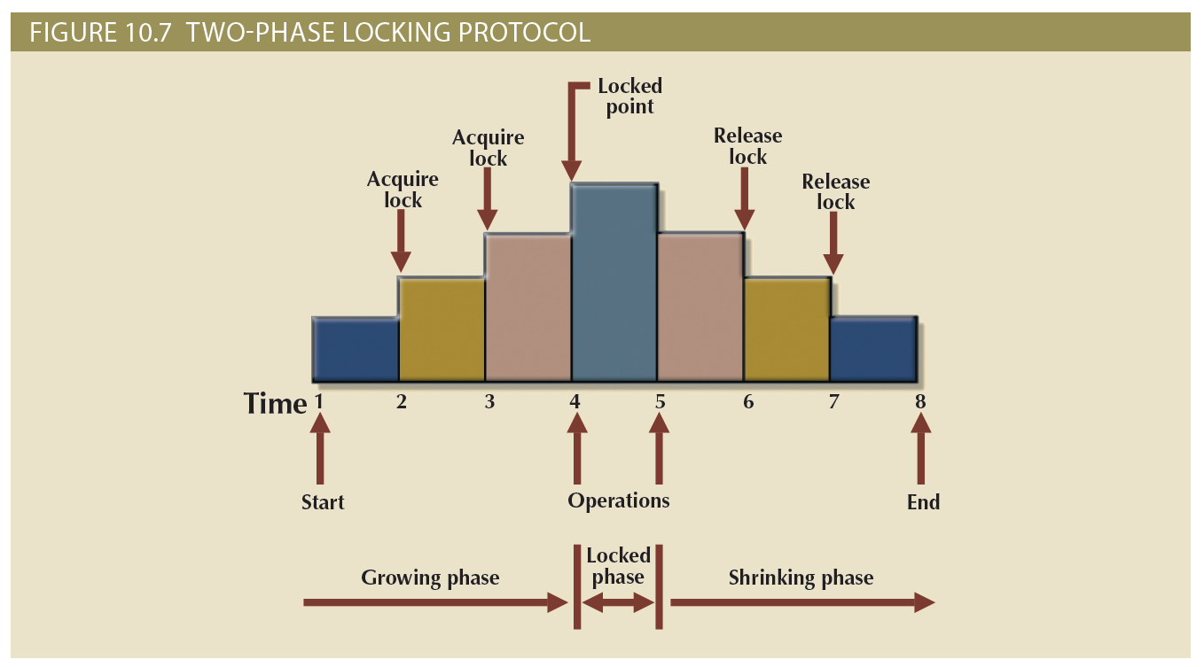
Two-Phase Locking to Ensure Serializability (1 of 3)
Defines how transactions acquire and relinquish locks
Guarantees serializability but does not prevent deadlocks
Phases
Growing phase: transaction acquires all required locks without unlocking any data
Shrinking phase: transaction releases all locks and cannot obtain any new lock

Slide 136
ANSI Levels of Transaction Isolation (1 of 2)
The ANSI SQL standard (1992) defines transaction management based on transaction isolation levels
Transaction isolation levels refer to the degree to which transaction data is “protected or isolated” from other concurrent transactions
Transaction isolation levels are described by the type of “reads” that a transaction allows or not
Dirty read: transaction can read data that is not yet committed
Nonrepeatable read: transaction reads a given row at time t1, and then it reads the same row at time t2, yielding different results
The original row may have been updated or deleted
Phantom read: transaction executes a query at time t1, and then it runs the same query at time t2, yielding additional rows that satisfy the query

Slide 137
ANSI Levels of Transaction Isolation (2 of 2)
Read Uncommitted will read uncommitted data from other transactions
Increases transaction performance but at the cost of data consistency
Read Committed forces transactions to read only committed data
Default mode of operation for most databases
Repeatable Read isolation level ensures that queries return consistent results
Uses shared locks to ensure other transactions do not update a row after the original query reads it
Serializable isolation level is the most restrictive level defined by the ANSI SQL standard
Deadlocks are still always possible

Slide 138
Database Performance-Tuning Concepts
Table 11.1 General Guidelines for Better System Performance
 | System Resources | Client | Server
Hardware | CPU | The fastest possible Dual-core CPU or higher "Virtualized Client desktop technologies could also be used" | The fastest possible Multiple processors (quad-core technology or higher) Cluster of networked computers "Virtualized server technology could be used"
 | RAM | The maximum possible to avoid OS memory to disk swapping | The maximum possible to avoid OS memory to disk swapping
 | Storage | Fast SATA/EIDE hard disk with sufficient free hard disk space solid state drives (SSDs) for faster speed | Multiple high-speed, high-capacity disks Fast disk interface (SAS / SCSI / Firewire / Fibre Channel) RAID configuration optimized for throughput Solid state drives (SSDs) for faster speed Separate disks for OS, DBMS, and data spaces
 | Network | High-speed connection | High-speed connection
Software | Operating system (OS) | 64-bit OS for larger address spaces Fine-tuned for best client application performance | 64-bit OS for larger address spaces Fine-tuned for best server application performance
 | Network | Fine-tuned for best throughput | Fine-tuned for best throughput
 | Application | Optimize SQL in client application | Optimize DBMS server for best performance

Slide 139
Performance Tuning: Client and Server
Client side: SQL performance tuning
Generate SQL query that returns correct answer in least amount of time
Using minimum amount of resources at server
Server side: DBMS performance tuning
DBMS environment is configured to respond to clients’ requests as fast as possible
While making optimum use of existing resources

Slide 140
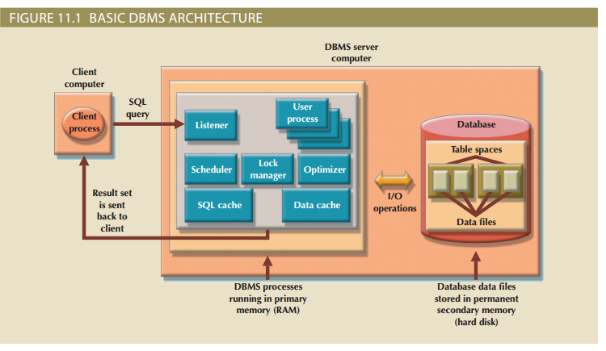
DBMS Architecture for Performance

Slide 141
Database Query Optimization Modes
Classification of operation modes
Automatic query optimization: DBMS finds the most cost-effective access path without user intervention
Manual query optimization: requires that optimization be selected and scheduled by the end-user or programmer
Algorithms proposed for query optimization are based on selection of:
Optimum order to achieve the fastest execution time
Sites to be accessed to minimize communication costs
Classification based on type of information used to optimize the query
Statistically based query optimization algorithm: statistics are used by the DBMS to determine the best access strategy
Rule-based query optimization algorithm: based on a set of user-defined rules to determine the best query access strategy

Slide 142
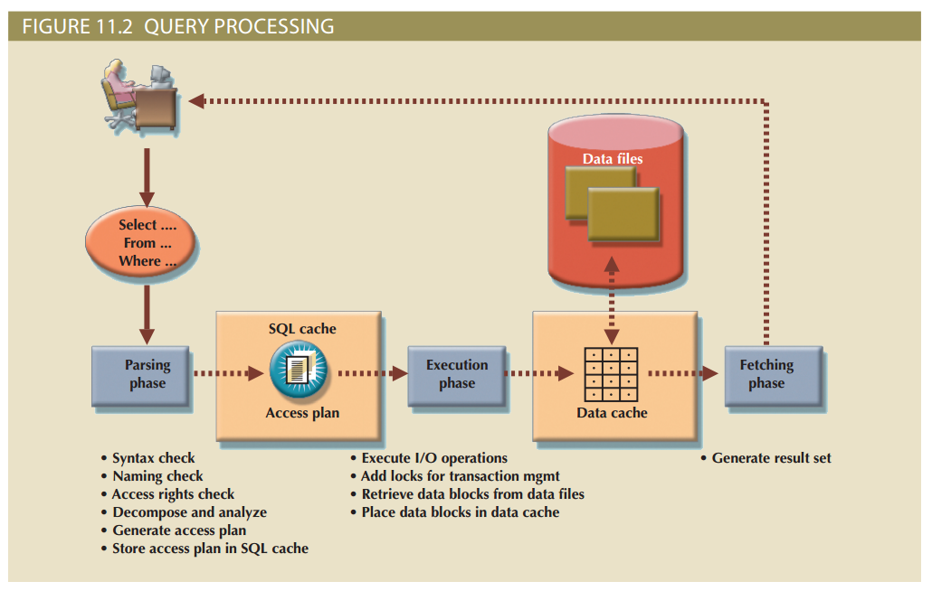
Query Processing (2 of 2)

Slide 143
SQL Access Plan
Table 11.3 Sample DBMS Access Plan I/O Operations
Operation | Description
Table scan (full) | Reads the entire table sequentially, from the first row to the last, one row at a time (slowest)
Table access (row ID) | Reads a table row directly, using the row ID value (fastest)
Index scan (range) | Reads the index first to obtain the row IDs and then accesses the table rows directly (faster than a full table scan)
Index access (unique) | Used when a table has a unique index in a column
Nested loop | Reads and compares a set of values to another set of values, using a nested loop style (slow)
Merge | Merges two data sets (slow)
Sort | Sorts a data set (slow)

Slide 144
Using Hints to Affect Optimizer Choices
Table 11.5 Optimizer Hints
Hint | Usage
ALL_ROWS | Instructs the optimizer to minimize the overall execution time—that is, to minimize the time needed to return all rows in the query result set. This hint is generally used for batch mode processes. For example: SELECT /*+ ALL_ROWS */ * FROM PRODUCT WHERE P_QOH < 10;
FIRST_ROWS | Instructs the optimizer to minimize the time needed to process the first set of rows—that is, to minimize the time needed to return only the first set of rows in the query result set. This hint is generally used for interactive mode processes. For example: SELECT /*+ FIRST_ROWS */ * FROM PRODUCT WHERE P_QOH < 10;
INDEX(name) | Forces the optimizer to use the P_QOH_NDX index to process this query. For example: SELECT /*+ INDEX(P_QOH_NDX) */ * FROM PRODUCT WHERE P_QOH < 10

Slide 145
MySQL performance features
MySQL query analyzer
Optimizer
Cost-based
Cost model customizable starting with MySQL 5.7
Optimized DB engines
Indices
SQL Query Cache
Full Text search feature

Slide 146
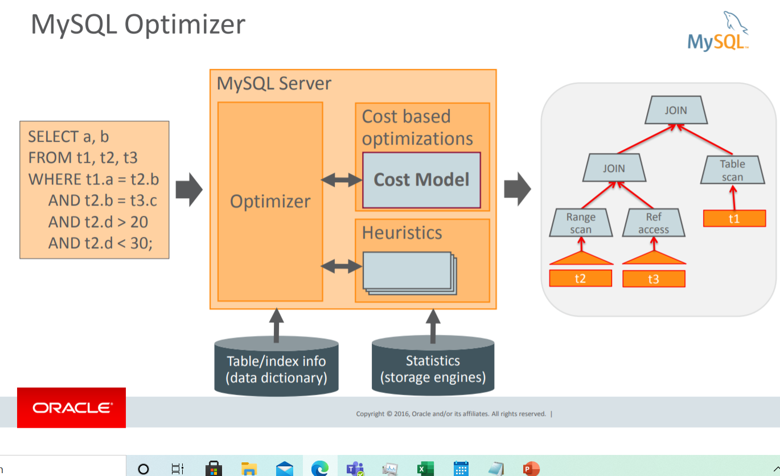
Query Optimizer

Slide 147
Tuning steps
Identify the query
Check the EXPLAIN plan of the query
Review the table definition
Create indexes
Start with columns in the WHERE clause
For composite indexes, start with the most selective column and work to the least selective column
Ensure sorted columns are at the end of the composite index
Review the updated explain plan and revise as needed
Continue to review the server to identify changes in access patterns that require new indexing

Slide 148
Oracle performance features
Has counterparts of everything MySQL offers
Performance-tuning options in all admin tools
Automatic Database Diagnostic Monitor
Query Optimizer
Tuning Optimizer
SQL Plan Management

Slide 149
Oracle tuning method
Perform the following initial standard checks:
Get candid feedback from users
Get a full set of operating system, database, and application statistics from the system
Sanity-check the operating systems of all computers involved with user performance.
Check for the "Top Ten Mistakes Found in Oracle Systems".
Build a conceptual model of what is happening on the system. See "A Sample Decision Process for Performance Conceptual Modeling".

Slide 150
Oracle performance tuning method
4. Propose a series of remedy actions and the anticipated behavior to the system, then apply them in the order that can benefit the application the most. ADDM produces recommendations each with an expected benefit.
5. Validate that the changes made have had the desired effect. Otherwise, look for more bottlenecks, and continue refining the conceptual model until your understanding of the application becomes more accurate.
Repeat the last three steps until performance goals are met or become impossible due to other constraints.
See: https://docs.oracle.com/cd/E11882_01/server.112/e41573/technique.htm#PFGRF94136

Slide 151
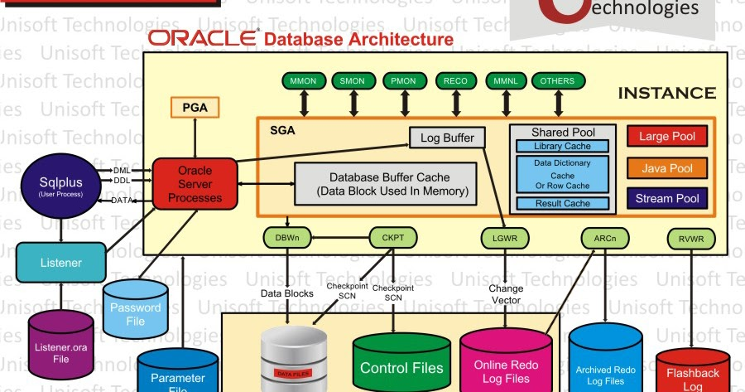
Oracle architecture

Slide 152
Configuring for performance
Parameter | Description
COMPATIBLE | Specifies the release with which the Oracle database must maintain compatibility.
DB_BLOCK_SIZE | Sets the size of the Oracle database blocks stored in the database files and cached in the SGA.
SGA_TARGET | Specifies the total size of all SGA components. If SGA_TARGET is specified, then the buffer cache (DB_CACHE_SIZE), Java pool (JAVA_POOL_SIZE), large pool (LARGE_POOL_SIZE), and shared pool (SHARED_POOL_SIZE) memory pools are automatically sized. See "Automatic Shared Memory Management".
PGA_AGGREGATE_TARGET | Specifies the target aggregate PGA memory available to all server processes attached to the instance. See "PGA Memory Management".
PROCESSES | Sets the maximum number of processes that can be started by that instance.
SESSIONS | This is set by default from the value of processes. However, if you are using the shared server, then the deduced value is likely to be insufficient.
UNDO_MANAGEMENT | Specifies the undo space management mode used by the database. The default is AUTO. If unspecified, the database uses AUTO.
UNDO_TABLESPACE | Specifies the undo tablespace to be used when an instance starts.

Slide 153
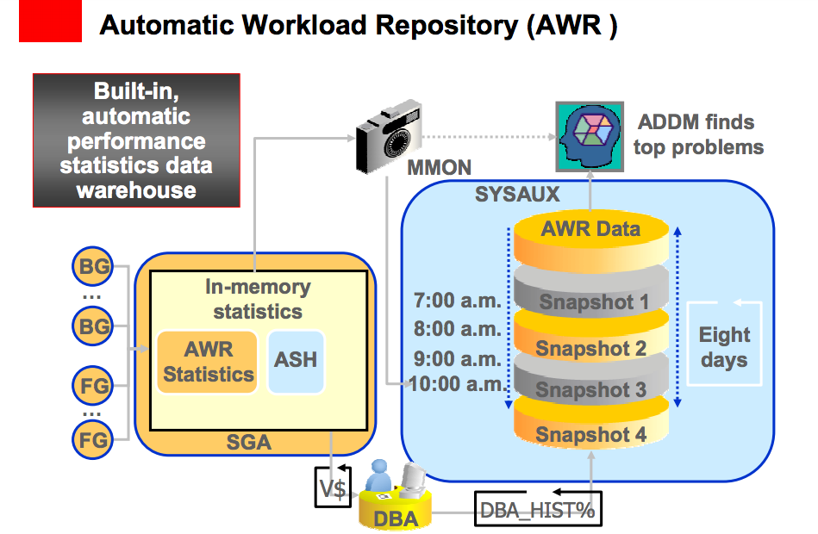
AWR and ADDM

Slide 154
Business Intelligence
Concepts, practices, tools and techniques to help business
Understand core capabilities
Provide snapshots of the company situation
Identify key opportunities to create a competitive advantage
Provides a framework
Collecting and storing operational data and aggregating it into decision support data
Analyzing decision support data and presenting generated information to end users to support business decisions
Making business decisions which generate more data
Monitoring results to evaluate outcomes and predicting future outcomes with a high degree of accuracy

Slide 155
Business Intelligence Architecture (1 of 3)

Slide 156
Business Intelligence Architecture (2 of 3)
Table 13.2 Basic BI Architectural Components
Component | Description
ETL tools | Data extraction, transformation, and loading (ETL ) tools collect, filter, integrate, and aggregate internal and external data to be saved into a data store optimized for decision support.
Data store | The data store is optimized for decision support and is generally represented by a data warehouse or a data mart. The data is stored in structures that are optimized for data analysis and query speed.
Query and reporting | This component performs data selection and retrieval, and it is used by the data analyst to create queries that access the database and create the required reports.
Data visualization | This component presents data to the end user in a variety of meaningful and innovative ways. This tool helps the end user select the most appropriate presentation format, such as summary reports, maps, pie or bar graphs, mixed graphs, and static or interactive dashboards.
Data monitoring and alerting | This component allows real-time monitoring of business activities. The BI system will present concise information in a single integrated view. This integrated view could include specific metrics about the system performance or activities, such as number of orders placed in the last four hours, number of customer complaints by product by month, and total revenue by region. Alerts can be placed on a given metric; once the value of a metric goes below or above a certain baseline, the system will perform a given action, such as emailing shop floor managers, presenting visual alerts, or starting an application.
Data analytics | This component performs data analysis and data-mining tasks using the data in the data store. This tool advises the user as to which data analysis tool to select and how to build a reliable business data model. Business models are generated by special algorithms that identify and enhance the understanding of business situations and problems.

Slide 157
Operational Data versus Decision Support Data
Operational data and decision support data serve different purposes
Operational data is useful for capturing daily business transactions
Decision support data gives tactical and strategic business meaning to the operational data
Decision support data differs from operational data in three main areas
Time span
Granularity (level of aggregation)
Dimensionality

Slide 158
Operational Data versus Decision Support Data
Table 13.5 Contrasting Operational and Decision Support Data Characteristics
Characteristic | Operational Data | Decision Support Data
Data currency | Current operations Real-time data | Historic data Snapshot of company data Time component (week/month/year)
Granularity | Atomic-detailed data | Summarized data
Summarization level | Low; some aggregate yields | High; many aggregation levels
Data model | Highly normalized Mostly relational DBMSs | Non-normalized Complex structures Some relational, but mostly multidimensional DBMSs
Transaction type | Mostly updates | Mostly query
Transaction volumes | High-update volumes | Periodic loads and summary calculations
Transaction speed | Updates are critical | Retrievals are critical
Query activity | Low to medium | High
Query scope | Narrow range | Broad range
Query complexity | Simple to medium | Very complex
Data volumes | Hundreds of gigabytes | Terabytes to petabytes

Slide 159
The Data Warehouse (1 of 3)
Collection of data
Provides support for decision making
Components
Integrated
Subject-oriented
Time-variant
Nonvolatile

Slide 160
The Data Warehouse (2 of 3)
Table 13.8 Characteristics of Data Warehouse Data and Operational Database Data
Characteristic | Operational Database Data | Data Warehouse Data
Integrated | Similar data can have different representations or meanings. For example, Social Security numbers may be stored as ###-##-#### or as #########, and a given condition may be labeled as T/F or 0/1 or Y/N. A sales value may be shown in thousands or in millions. | Provide a unified view of all data elements with a common definition and representation for all business units.
Subject-oriented | Data is stored with a functional, or process, orientation. For example, data may be stored for invoices, payments, and credit amounts. | Data is stored with a subject orientation that facilitates multiple views of the data and decision making. For example, sales may be recorded by product, division, manager, or region.
Time-variant | Data is recorded as current transactions. For example, the sales data may be the sale of a product on a given date, such as $342.78 on 12-MAY-2016. | Data is recorded with a historical perspective in mind. Therefore, a time dimension is added to facilitate data analysis and various time comparisons.
Nonvolatile | Data updates are frequent and common. For example, an inventory amount changes with each sale. Therefore, the data environment is fluid. | Data cannot be changed. Data is added only periodically from historical systems. Once the data is properly stored, no changes are allowed. Therefore, the data environment is relatively static.

Slide 161
The Data Warehouse (3 of 3)

Slide 162
Data Marts
Small, single-subject data warehouse subset
Provides decision support to a small group of people
Benefits over data warehouses
Lower cost and shorter implementation time
Technologically advanced
Inevitable “people issues”

Slide 163
Star Schemas (1 of 3)
Basic star schema components
Facts: numeric values that represent a specific business aspect
Dimensions: qualifying characteristics that provide additional perspectives to a given fact
Attributes: used to search, filter, and classify facts
Slice and dice: ability to focus on slices of the data cube for more detailed analysis
Attribute hierarchies: provide a top-down data organization
Aggregation and drill-down/roll-up data analysis

Slide 164
Star Schemas (2 of 3)
Star schema representation
Facts and dimensions represented by physical tables in data warehouse database
Many-to-one (M:1) relationship between fact table and each dimension table
Fact and dimension tables
Related by foreign keys
Subject to primary and foreign key constraints
Primary key of a fact table
Composite primary key because the fact table is related to many dimension tables
Always formed by combining the foreign keys pointing to the related dimension tables

Slide 165
Star Schemas (3 of 3)

Slide 166
OLAP Architecture

Slide 167
Data Analytics

Slide 168
Questions?

Slide 169
Database Management Week 2 Review of DBMS
School of Engineering and Computing Sciences Fall 2020
Dr. Stan Ustymenko
stanislav.ustymenko@tamucc.edu

Slide 170
Learning Objectives
After completing this chapter, you will be able to:
Describe the database transaction management process
Identify the four properties of a database transaction
Explain concurrency control and its role in maintaining database integrity
Describe how locking methods are used for concurrency control
Describe how stamping methods are used for concurrency control
Describe how optimistic methods are used for concurrency control
List and explain the ANSI levels of transaction isolation
Describe the role of database recovery management in maintaining database integrity

Slide 171
What is a Transaction?
A logical unit of work that must be entirely completed or aborted
Consists of:
SELECT statement
Series of related UPDATE statements
Series of INSERT statements
Combination of SELECT, UPDATE, and INSERT statements
Consistent database state
All data integrity constraints are satisfied
Must begin with the database in a known consistent state to ensure consistency
Most are formed by two or more database requests
Database requests: equivalent of a single SQL statement in an application program or transaction

Slide 172
Evaluating Transaction Results
Not all transactions update the database
SQL code represents a transaction because it accesses the database
Improper or incomplete transactions can have devastating effect on database integrity
Users can define enforceable constraints based on business rules
Other integrity rules are automatically enforced by the DBMS

Slide 173
Transaction Properties
Atomicity
All operations of a transaction must be completed; if not the transaction is aborted
Consistency
Permanence of database’s consistent state
Isolation
Data used during transaction cannot be used by second transaction until the first is completed
Durability
Ensures that once transactions are committed they cannot be undone or lost
Serializability
Ensures that the schedule for the concurrent execution of several transactions should yield consistent results

Slide 174
Transaction Management with SQL
SQL statements that provide transaction support:
COMMIT
ROLLBACK
Transaction sequence must continue until one of four events occur:
COMMIT statement is reached
ROLLBACK statement is reached
End of program is reached
Program is abnormally terminated

Slide 175
The Transaction Log
Keeps track of all transactions that update the database
DBMS uses the information stored in a log for (a):
Recovery requirement triggered by a ROLLBACK statement
Program’s abnormal termination
System failure

Slide 176
Concurrency Control
Coordination of the simultaneous transactions execution in a multiuser database system
Objective: ensures serializability of transactions in a multiuser database environment
Important because the simultaneous execution of transactions over a shared database can create several data integrity and consistency problems
Three main problems are lost updates, uncommitted data, and inconsistent retrievals

Slide 177
Problems in Concurrency Control
Lost update
Occurs in two concurrent transactions when:
Same data element is updated
One of the updates is lost
Uncommitted data
Occurs when:
Two transactions are executed concurrently
First transaction is rolled back after the second transaction has already accessed uncommitted data
Inconsistent retrievals
Occurs when:
A transaction accesses data before and after one or more other transactions finish working with such data

Slide 178
The Scheduler
Establishes the order in which the operations are executed within concurrent transactions
Interleaves the execution of database operations to ensure serializability and isolation of transactions
Bases actions on concurrent control algorithms
Determines appropriate order
Creates serialization schedule
Serializable schedule: interleaved execution of transactions yields the same results as the serial execution of the transactions

Slide 179
Concurrency Control with Locking Methods
Locking methods facilitate isolation of data items used in concurrently executing transactions
Lock: guarantees exclusive use of a data item to a current transaction
Pessimistic locking: use of locks based on the assumption that conflict between transactions is likely
Lock manager: responsible for assigning and policing the locks used by the transactions

Slide 180
Lock Granularity (1 of 5)
Indicates the level of lock use
Database-level lock
Table-level lock
Page-level lock
Page or diskpage: directly addressable section of a disk
Row-level lock
Field-level lock

Slide 181
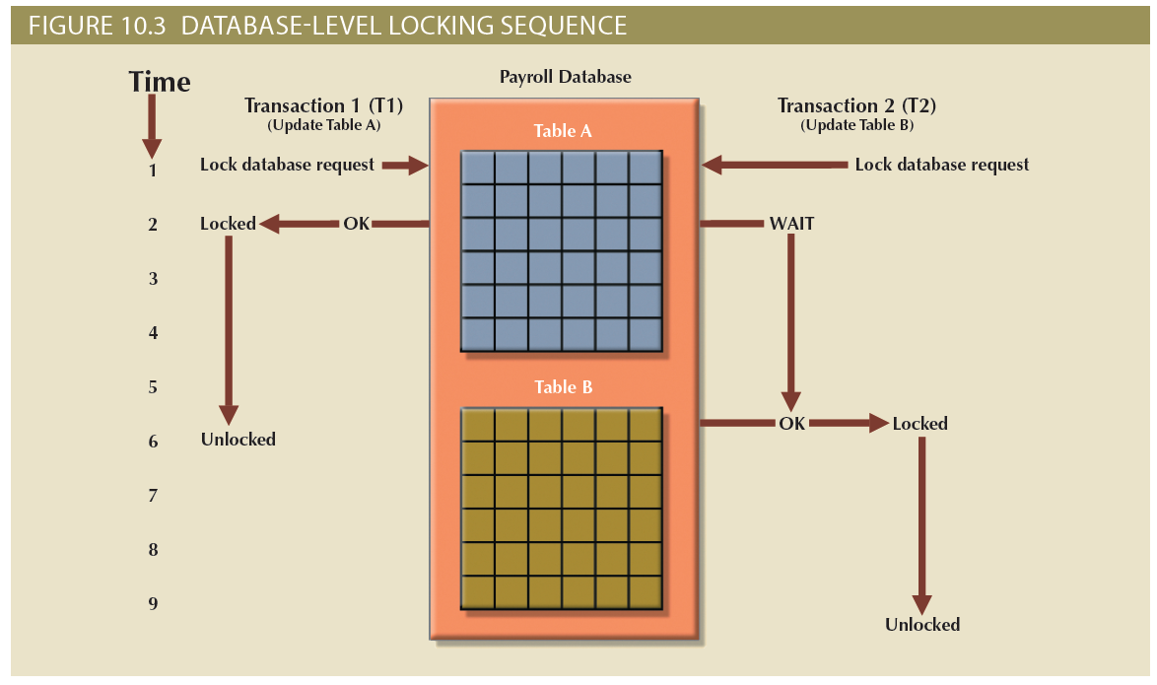
Lock Granularity (2 of 5)

Slide 182
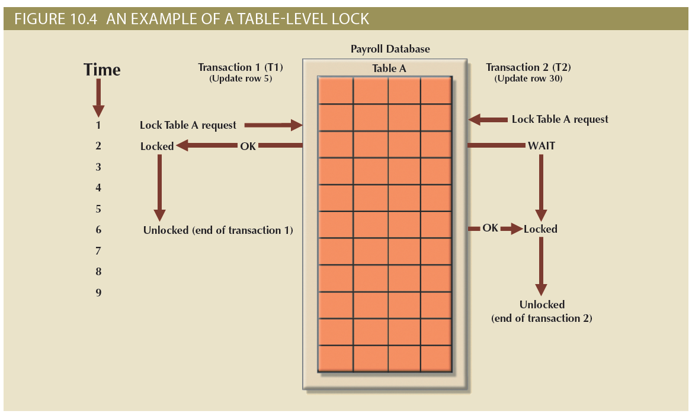
Lock Granularity (3 of 5)

Slide 183
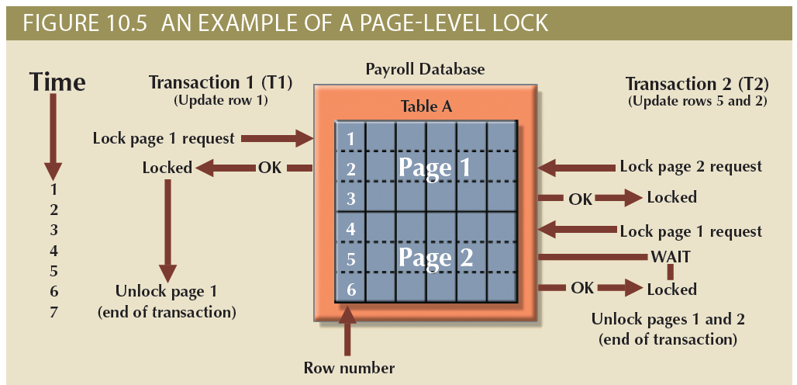
Lock Granularity (4 of 5)

Slide 184
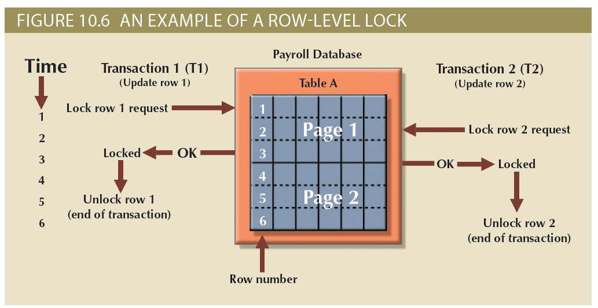
Lock Granularity (5 of 5)

Slide 185
Lock Types (1 of 2)
Binary lock
Two states: locked (1) and unlocked (0)
If an object is locked by a transaction, no other transaction can use that object
If an object is unlocked, any transaction can lock the object for its use
Exclusive lock
Access is reserved for the transaction that locked the object
Shared lock
Concurrent transactions are granted read access on the basis of a common lock

Slide 186
Lock Types (2 of 2)
Problems using locks
Resulting transaction schedule might not be serializable
Schedule might create deadlocks

Slide 187
Two-Phase Locking to Ensure Serializability (1 of 3)
Defines how transactions acquire and relinquish locks
Guarantees serializability but does not prevent deadlocks
Phases
Growing phase: transaction acquires all required locks without unlocking any data
Shrinking phase: transaction releases all locks and cannot obtain any new lock

Slide 188
Two-Phase Locking to Ensure Serializability (2 of 3)
Governing rules
Two transactions cannot have conflicting locks
No unlock operation can precede a lock operation in the same transaction
No data are affected until all locks are obtained

Slide 189
Two-Phase Locking to Ensure Serializability (3 of 3)

Slide 190
Deadlocks
Occur when two transactions wait indefinitely for each other to unlock data
Also known as deadly embrace
Control techniques
Deadlock prevention
Deadlock detection
Deadlock avoidance
Choice of deadlock control method depends on database environment

Slide 191
Concurrency Control with Time Stamping Methods (1 of 2)
Time stamping assigns global, unique time stamp to each transaction
Produces explicit order in which transactions are submitted to DBMS
Properties
Uniqueness: ensures no equal time stamp values exist
Monotonicity: ensures time stamp values always increases

Slide 192
Concurrency Control with Time Stamping Methods (2 of 2)
Disadvantages
Each value stored in the database requires two additional stamp fields
Increases memory needs
Increases the database’s processing overhead
Demands a lot of system resources

Slide 193
Wait/Die and Wound/Wait Schemes (1 of 2)
Wait/die
A concurrency control scheme in which an older transaction must wait for the younger transaction to complete and release the locks before requesting the locks itself
Otherwise, the newer transaction dies and is rescheduled
Wound/wait
A concurrency control scheme in which an older transaction can request the lock, preempt the younger transaction, and reschedule it
Otherwise, the newer transaction waits until the older transaction finishes

Slide 194
Wait/Die and Wound/Wait Schemes (2 of 2)
Wait/Die and Wound/Wait Concurrency Control Schemes
Transaction Requesting Lock | Transaction Owning Lock | Wait/Die Scheme | Wound/Wait Scheme
T1 (11548789) | T2 (19562545) | T1 waits until T2 is completed and T2 releases its locks. | T1 preempts (rolls back) T2. T2 is rescheduled using the same time stamp.
T2 (19562545) | T1 (11548789) | T2 dies (rolls back). T2 is rescheduled using the same time stamp. | T2 waits until T1 is completed and T1 releases its locks.

Slide 195
Concurrency Control with Optimistic Methods (1 of 2)
Optimistic approach: based on the assumption that the majority of database operations do not conflict
Does not require locking or time stamping techniques
Transaction is executed without restrictions until it is committed
Phases of optimistic approach
Read
Validation
Write

Slide 196
Concurrency Control with Optimistic Methods (2 of 2)
Read phase
Transaction:
Reads the database
Executes the needed computations
Makes the updates to a private copy of the database values
Validation phase
Transaction is validated to ensure that the changes made will not affect the integrity and consistency of the database
Write phase
Changes are permanently applied to the database

Slide 197
ANSI Levels of Transaction Isolation (1 of 2)
The ANSI SQL standard (1992) defines transaction management based on transaction isolation levels
Transaction isolation levels refer to the degree to which transaction data is “protected or isolated” from other concurrent transactions
Transaction isolation levels are described by the type of “reads” that a transaction allows or not
Dirty read: transaction can read data that is not yet committed
Nonrepeatable read: transaction reads a given row at time t1, and then it reads the same row at time t2, yielding different results
The original row may have been updated or deleted
Phantom read: transaction executes a query at time t1, and then it runs the same query at time t2, yielding additional rows that satisfy the query

Slide 198
ANSI Levels of Transaction Isolation (2 of 2)
Read Uncommitted will read uncommitted data from other transactions
Increases transaction performance but at the cost of data consistency
Read Committed forces transactions to read only committed data
Default mode of operation for most databases
Repeatable Read isolation level ensures that queries return consistent results
Uses shared locks to ensure other transactions do not update a row after the original query reads it
Serializable isolation level is the most restrictive level defined by the ANSI SQL standard
Deadlocks are still always possible

Slide 199
Database Recovery Management
Database recovery: restores database from a given state to a previously consistent state
Recovery transactions are based on the atomic transaction property
All portions of a transaction must be treated as a single logical unit of work
If transaction operation cannot be completed:
Transaction must be aborted
Changes to database must be rolled back

Slide 200
Transaction Recovery (1 of 3)
Concepts that affect the recovery process
Write-ahead log protocol
Ensures that transaction logs are always written before the data are updated
Redundant transaction logs
Ensure that a physical disk failure will not impair the DBMS’s ability to recover data
Buffers
Temporary storage areas in a primary memory used to speed up disk operations
Checkpoints
Allows DBMS to write all its updated buffers in memory to disk

Slide 201
Transaction Recovery (2 of 3)
Techniques used in transaction recovery procedures
Deferred-write technique or deferred update
Transaction operations do not immediately update the physical database
Only transaction log is updated
Write-through technique or immediate update
Database is immediately updated by transaction operations during transaction’s execution

Slide 202
Transaction Recovery (3 of 3)
Recovery process steps
Identify the last check point in the transaction log
If transaction was committed before the last check point nothing needs to be done
If transaction was committed after the last check point the transaction log is used to redo the transaction
If transaction had a ROLLBACK operation after the last check point the DBMS uses the transaction log records to ROLLBACK or undo the operations, using the “before” values in the transaction log

Slide 203
Summary (1 of 2)
A transaction is a sequence of database operations that access the database
Transactions have four main properties: atomicity, consistency, isolation, and durability
SQL provides support for transactions through the use of two statements: COMMIT, which saves changes to disk, and ROLLBACK, which restores the previous database state
Concurrency control coordinates the simultaneous execution of transactions
A lock guarantees unique access to a data item by a transaction
Serializability of schedules is guaranteed through the use of two-phase locking

Slide 204
Summary (2 of 2)
Concurrency control with time stamping methods assigns a unique time stamp to each transaction and schedules the execution of conflicting transactions in time stamp order
Concurrency control with optimistic methods assumes that the majority of database transactions do not conflict and that transactions are executed concurrently, using private, temporary copies of the data
Database recovery restores the database from a given state to a previous consistent state

Slide 205
Introduction to Database Systems Week 7 Exam Review
School of Engineering and Computing Sciences Fall 2020
Dr. Stan Ustymenko
stanislav.ustymenko@tamucc.edu

Slide 206
Exam 1
Date: Friday Oct. 2nd
Time: 8:00-8:50
Up to 90 minutes
Place: BlackBoard

Slide 207
Respondus Lock-Down Browser
Download and install LockDown Browser from this link:
https://download.respondus.com/lockdown/download.php?id=797913747
Once Installed, you can:
Start LockDown Browser
Log into Blackboard Learn
Navigate to the test

Slide 208
Topics
Overview of Database Systems
Transaction Management and Concurrency Control
Performance tuning
Basics
MySQL
Oracle
Business Intelligence & Data Warehouses

Slide 209
Database Systems
Information, Data, Metadata
Database management system (DBMS)
Database access languages and application programming interfaces
Query language: lets the user specify what must be done without having to specify how
Structured Query Language (SQL): de facto query language and data access standard supported by the majority of DBMS vendors

Slide 210
Data versus Information
Data consists of raw facts
Not yet processed to reveal meaning to the end user
Building blocks of information
Information results from processing raw data to reveal meaning
Requires context
Bedrock of knowledge
Should be accurate, relevant, and timely

Slide 211
Problems with File System Data Processing
Problems with file systems challenge the types of information that can be created from data as well as information accuracy
Lengthy development times
Difficulty of getting quick answers
Complex system administration
Lack of security and limited data sharing
Extensive programming

Slide 212
Structural and Data Dependence (1 of 2)
Structural dependence
Access to a file is dependent on its own structure
All file system programs are modified to conform to a new file structure
Structural independence
File structure is changed without affecting the application’s ability to access the data

Slide 213
Structural and Data Dependence (2 of 2)
Data dependence
Data access changes when data storage characteristics change
Data independence
Data storage characteristics are changed without affecting the program’s ability to access the data
Practical significance of data dependence is the difference between logical and physical format

Slide 214
Relational Model
Relational database model enables logical representation of the data and its relationships
Keys: consist of one or more attributes that determine other attributes
Ensure that each row in a table is uniquely identifiable
Establish relationships among tables and to ensure the integrity of the data
Primary key: attribute or combination of attributes that uniquely identifies a row
Dependencies

Slide 215
What is a Transaction?
A logical unit of work that must be entirely completed or aborted
Consists of:
Combination of SELECT, UPDATE, and INSERT statements
Consistent database state
All data integrity constraints are satisfied
Must begin with the database in a known consistent state to ensure consistency
Most are formed by two or more database requests
Database requests: equivalent of a single SQL statement in an application program or transaction
Transaction log keeps track of all transactions that update the database
DBMS uses the information stored in a log for (a):
Recovery requirement triggered by a ROLLBACK statement
Program’s abnormal termination
System failure

Slide 216
Transaction Properties
Atomicity
All operations of a transaction must be completed; if not the transaction is aborted
Consistency
Permanence of database’s consistent state
Isolation
Data used during transaction cannot be used by second transaction until the first is completed
Durability
Ensures that once transactions are committed they cannot be undone or lost
Serializability
Ensures that the schedule for the concurrent execution of several transactions should yield consistent results

Slide 217
The Scheduler
Establishes the order in which the operations are executed within concurrent transactions
Interleaves the execution of database operations to ensure serializability and isolation of transactions
Bases actions on concurrent control algorithms
Determines appropriate order
Creates serialization schedule
Serializable schedule: interleaved execution of transactions yields the same results as the serial execution of the transactions

Slide 218
Concurrency Control with Locking Methods
Locking methods facilitate isolation of data items used in concurrently executing transactions
Lock: guarantees exclusive use of a data item to a current transaction
Pessimistic locking: use of locks based on the assumption that conflict between transactions is likely
Lock manager: responsible for assigning and policing the locks used by the transactions

Slide 219
Lock Granularity (1 of 5)
Indicates the level of lock use
Database-level lock
Table-level lock
Page-level lock
Page or diskpage: directly addressable section of a disk
Row-level lock
Field-level lock

Slide 220
Concurrency Control
Coordination of the simultaneous transactions execution in a multiuser database system
Objective: ensures serializability of transactions in a multiuser database environment
Important because the simultaneous execution of transactions over a shared database can create several data integrity and consistency problems
Three main problems are lost updates, uncommitted data, and inconsistent retrievals

Slide 221
Lock Granularity
Indicates the level of lock use
Database-level lock
Table-level lock
Page-level lock
Page or diskpage: directly addressable section of a disk
Row-level lock
Field-level lock

Slide 222
Two-Phase Locking to Ensure Serializability (1 of 3)
Defines how transactions acquire and relinquish locks
Guarantees serializability but does not prevent deadlocks
Phases
Growing phase: transaction acquires all required locks without unlocking any data
Shrinking phase: transaction releases all locks and cannot obtain any new lock

Slide 223
ANSI Levels of Transaction Isolation (1 of 2)
The ANSI SQL standard (1992) defines transaction management based on transaction isolation levels
Transaction isolation levels refer to the degree to which transaction data is “protected or isolated” from other concurrent transactions
Transaction isolation levels are described by the type of “reads” that a transaction allows or not
Dirty read: transaction can read data that is not yet committed
Nonrepeatable read: transaction reads a given row at time t1, and then it reads the same row at time t2, yielding different results
The original row may have been updated or deleted
Phantom read: transaction executes a query at time t1, and then it runs the same query at time t2, yielding additional rows that satisfy the query

Slide 224
ANSI Levels of Transaction Isolation (2 of 2)
Read Uncommitted will read uncommitted data from other transactions
Increases transaction performance but at the cost of data consistency
Read Committed forces transactions to read only committed data
Default mode of operation for most databases
Repeatable Read isolation level ensures that queries return consistent results
Uses shared locks to ensure other transactions do not update a row after the original query reads it
Serializable isolation level is the most restrictive level defined by the ANSI SQL standard
Deadlocks are still always possible

Slide 225
Database Performance-Tuning Concepts
Table 11.1 General Guidelines for Better System Performance
 | System Resources | Client | Server
Hardware | CPU | The fastest possible Dual-core CPU or higher "Virtualized Client desktop technologies could also be used" | The fastest possible Multiple processors (quad-core technology or higher) Cluster of networked computers "Virtualized server technology could be used"
 | RAM | The maximum possible to avoid OS memory to disk swapping | The maximum possible to avoid OS memory to disk swapping
 | Storage | Fast SATA/EIDE hard disk with sufficient free hard disk space solid state drives (SSDs) for faster speed | Multiple high-speed, high-capacity disks Fast disk interface (SAS / SCSI / Firewire / Fibre Channel) RAID configuration optimized for throughput Solid state drives (SSDs) for faster speed Separate disks for OS, DBMS, and data spaces
 | Network | High-speed connection | High-speed connection
Software | Operating system (OS) | 64-bit OS for larger address spaces Fine-tuned for best client application performance | 64-bit OS for larger address spaces Fine-tuned for best server application performance
 | Network | Fine-tuned for best throughput | Fine-tuned for best throughput
 | Application | Optimize SQL in client application | Optimize DBMS server for best performance

Slide 226
Performance Tuning: Client and Server
Client side: SQL performance tuning
Generate SQL query that returns correct answer in least amount of time
Using minimum amount of resources at server
Server side: DBMS performance tuning
DBMS environment is configured to respond to clients’ requests as fast as possible
While making optimum use of existing resources

Slide 227
DBMS Architecture for Performance

Slide 228
Database Query Optimization Modes
Classification of operation modes
Automatic query optimization: DBMS finds the most cost-effective access path without user intervention
Manual query optimization: requires that optimization be selected and scheduled by the end-user or programmer
Algorithms proposed for query optimization are based on selection of:
Optimum order to achieve the fastest execution time
Sites to be accessed to minimize communication costs
Classification based on type of information used to optimize the query
Statistically based query optimization algorithm: statistics are used by the DBMS to determine the best access strategy
Rule-based query optimization algorithm: based on a set of user-defined rules to determine the best query access strategy

Slide 229
Query Processing (2 of 2)

Slide 230
SQL Access Plan
Table 11.3 Sample DBMS Access Plan I/O Operations
Operation | Description
Table scan (full) | Reads the entire table sequentially, from the first row to the last, one row at a time (slowest)
Table access (row ID) | Reads a table row directly, using the row ID value (fastest)
Index scan (range) | Reads the index first to obtain the row IDs and then accesses the table rows directly (faster than a full table scan)
Index access (unique) | Used when a table has a unique index in a column
Nested loop | Reads and compares a set of values to another set of values, using a nested loop style (slow)
Merge | Merges two data sets (slow)
Sort | Sorts a data set (slow)

Slide 231
Using Hints to Affect Optimizer Choices
Table 11.5 Optimizer Hints
Hint | Usage
ALL_ROWS | Instructs the optimizer to minimize the overall execution time—that is, to minimize the time needed to return all rows in the query result set. This hint is generally used for batch mode processes. For example: SELECT /*+ ALL_ROWS */ * FROM PRODUCT WHERE P_QOH < 10;
FIRST_ROWS | Instructs the optimizer to minimize the time needed to process the first set of rows—that is, to minimize the time needed to return only the first set of rows in the query result set. This hint is generally used for interactive mode processes. For example: SELECT /*+ FIRST_ROWS */ * FROM PRODUCT WHERE P_QOH < 10;
INDEX(name) | Forces the optimizer to use the P_QOH_NDX index to process this query. For example: SELECT /*+ INDEX(P_QOH_NDX) */ * FROM PRODUCT WHERE P_QOH < 10

Slide 232
MySQL performance features
MySQL query analyzer
Optimizer
Cost-based
Cost model customizable starting with MySQL 5.7
Optimized DB engines
Indices
SQL Query Cache
Full Text search feature

Slide 233
Query Optimizer

Slide 234
Tuning steps
Identify the query
Check the EXPLAIN plan of the query
Review the table definition
Create indexes
Start with columns in the WHERE clause
For composite indexes, start with the most selective column and work to the least selective column
Ensure sorted columns are at the end of the composite index
Review the updated explain plan and revise as needed
Continue to review the server to identify changes in access patterns that require new indexing

Slide 235
Oracle performance features
Has counterparts of everything MySQL offers
Performance-tuning options in all admin tools
Automatic Database Diagnostic Monitor
Query Optimizer
Tuning Optimizer
SQL Plan Management

Slide 236
Oracle tuning method
Perform the following initial standard checks:
Get candid feedback from users
Get a full set of operating system, database, and application statistics from the system
Sanity-check the operating systems of all computers involved with user performance.
Check for the "Top Ten Mistakes Found in Oracle Systems".
Build a conceptual model of what is happening on the system. See "A Sample Decision Process for Performance Conceptual Modeling".

Slide 237
Oracle performance tuning method
4. Propose a series of remedy actions and the anticipated behavior to the system, then apply them in the order that can benefit the application the most. ADDM produces recommendations each with an expected benefit.
5. Validate that the changes made have had the desired effect. Otherwise, look for more bottlenecks, and continue refining the conceptual model until your understanding of the application becomes more accurate.
Repeat the last three steps until performance goals are met or become impossible due to other constraints.
See: https://docs.oracle.com/cd/E11882_01/server.112/e41573/technique.htm#PFGRF94136

Slide 238
Oracle architecture

Slide 239
Configuring for performance
Parameter | Description
COMPATIBLE | Specifies the release with which the Oracle database must maintain compatibility.
DB_BLOCK_SIZE | Sets the size of the Oracle database blocks stored in the database files and cached in the SGA.
SGA_TARGET | Specifies the total size of all SGA components. If SGA_TARGET is specified, then the buffer cache (DB_CACHE_SIZE), Java pool (JAVA_POOL_SIZE), large pool (LARGE_POOL_SIZE), and shared pool (SHARED_POOL_SIZE) memory pools are automatically sized. See "Automatic Shared Memory Management".
PGA_AGGREGATE_TARGET | Specifies the target aggregate PGA memory available to all server processes attached to the instance. See "PGA Memory Management".
PROCESSES | Sets the maximum number of processes that can be started by that instance.
SESSIONS | This is set by default from the value of processes. However, if you are using the shared server, then the deduced value is likely to be insufficient.
UNDO_MANAGEMENT | Specifies the undo space management mode used by the database. The default is AUTO. If unspecified, the database uses AUTO.
UNDO_TABLESPACE | Specifies the undo tablespace to be used when an instance starts.

Slide 240
AWR and ADDM

Slide 241
Business Intelligence
Concepts, practices, tools and techniques to help business
Understand core capabilities
Provide snapshots of the company situation
Identify key opportunities to create a competitive advantage
Provides a framework
Collecting and storing operational data and aggregating it into decision support data
Analyzing decision support data and presenting generated information to end users to support business decisions
Making business decisions which generate more data
Monitoring results to evaluate outcomes and predicting future outcomes with a high degree of accuracy

Slide 242
Business Intelligence Architecture (1 of 3)

Slide 243
Business Intelligence Architecture (2 of 3)
Table 13.2 Basic BI Architectural Components
Component | Description
ETL tools | Data extraction, transformation, and loading (ETL ) tools collect, filter, integrate, and aggregate internal and external data to be saved into a data store optimized for decision support.
Data store | The data store is optimized for decision support and is generally represented by a data warehouse or a data mart. The data is stored in structures that are optimized for data analysis and query speed.
Query and reporting | This component performs data selection and retrieval, and it is used by the data analyst to create queries that access the database and create the required reports.
Data visualization | This component presents data to the end user in a variety of meaningful and innovative ways. This tool helps the end user select the most appropriate presentation format, such as summary reports, maps, pie or bar graphs, mixed graphs, and static or interactive dashboards.
Data monitoring and alerting | This component allows real-time monitoring of business activities. The BI system will present concise information in a single integrated view. This integrated view could include specific metrics about the system performance or activities, such as number of orders placed in the last four hours, number of customer complaints by product by month, and total revenue by region. Alerts can be placed on a given metric; once the value of a metric goes below or above a certain baseline, the system will perform a given action, such as emailing shop floor managers, presenting visual alerts, or starting an application.
Data analytics | This component performs data analysis and data-mining tasks using the data in the data store. This tool advises the user as to which data analysis tool to select and how to build a reliable business data model. Business models are generated by special algorithms that identify and enhance the understanding of business situations and problems.

Slide 244
Operational Data versus Decision Support Data
Operational data and decision support data serve different purposes
Operational data is useful for capturing daily business transactions
Decision support data gives tactical and strategic business meaning to the operational data
Decision support data differs from operational data in three main areas
Time span
Granularity (level of aggregation)
Dimensionality

Slide 245
Operational Data versus Decision Support Data
Table 13.5 Contrasting Operational and Decision Support Data Characteristics
Characteristic | Operational Data | Decision Support Data
Data currency | Current operations Real-time data | Historic data Snapshot of company data Time component (week/month/year)
Granularity | Atomic-detailed data | Summarized data
Summarization level | Low; some aggregate yields | High; many aggregation levels
Data model | Highly normalized Mostly relational DBMSs | Non-normalized Complex structures Some relational, but mostly multidimensional DBMSs
Transaction type | Mostly updates | Mostly query
Transaction volumes | High-update volumes | Periodic loads and summary calculations
Transaction speed | Updates are critical | Retrievals are critical
Query activity | Low to medium | High
Query scope | Narrow range | Broad range
Query complexity | Simple to medium | Very complex
Data volumes | Hundreds of gigabytes | Terabytes to petabytes

Slide 246
The Data Warehouse (1 of 3)
Collection of data
Provides support for decision making
Components
Integrated
Subject-oriented
Time-variant
Nonvolatile

Slide 247
The Data Warehouse (2 of 3)
Table 13.8 Characteristics of Data Warehouse Data and Operational Database Data
Characteristic | Operational Database Data | Data Warehouse Data
Integrated | Similar data can have different representations or meanings. For example, Social Security numbers may be stored as ###-##-#### or as #########, and a given condition may be labeled as T/F or 0/1 or Y/N. A sales value may be shown in thousands or in millions. | Provide a unified view of all data elements with a common definition and representation for all business units.
Subject-oriented | Data is stored with a functional, or process, orientation. For example, data may be stored for invoices, payments, and credit amounts. | Data is stored with a subject orientation that facilitates multiple views of the data and decision making. For example, sales may be recorded by product, division, manager, or region.
Time-variant | Data is recorded as current transactions. For example, the sales data may be the sale of a product on a given date, such as $342.78 on 12-MAY-2016. | Data is recorded with a historical perspective in mind. Therefore, a time dimension is added to facilitate data analysis and various time comparisons.
Nonvolatile | Data updates are frequent and common. For example, an inventory amount changes with each sale. Therefore, the data environment is fluid. | Data cannot be changed. Data is added only periodically from historical systems. Once the data is properly stored, no changes are allowed. Therefore, the data environment is relatively static.

Slide 248
The Data Warehouse (3 of 3)

Slide 249
Data Marts
Small, single-subject data warehouse subset
Provides decision support to a small group of people
Benefits over data warehouses
Lower cost and shorter implementation time
Technologically advanced
Inevitable “people issues”

Slide 250
Star Schemas (1 of 3)
Basic star schema components
Facts: numeric values that represent a specific business aspect
Dimensions: qualifying characteristics that provide additional perspectives to a given fact
Attributes: used to search, filter, and classify facts
Slice and dice: ability to focus on slices of the data cube for more detailed analysis
Attribute hierarchies: provide a top-down data organization
Aggregation and drill-down/roll-up data analysis

Slide 251
Star Schemas (2 of 3)
Star schema representation
Facts and dimensions represented by physical tables in data warehouse database
Many-to-one (M:1) relationship between fact table and each dimension table
Fact and dimension tables
Related by foreign keys
Subject to primary and foreign key constraints
Primary key of a fact table
Composite primary key because the fact table is related to many dimension tables
Always formed by combining the foreign keys pointing to the related dimension tables

Slide 252
Star Schemas (3 of 3)

Slide 253
OLAP Architecture

Slide 254
Data Analytics

Slide 255
Questions?

Slide 256
Database Management Week 2 Review of DBMS
School of Engineering and Computing Sciences Fall 2020
Dr. Stan Ustymenko
stanislav.ustymenko@tamucc.edu

Slide 257
Learning Objectives
After completing this chapter, you will be able to:
Describe the database transaction management process
Identify the four properties of a database transaction
Explain concurrency control and its role in maintaining database integrity
Describe how locking methods are used for concurrency control
Describe how stamping methods are used for concurrency control
Describe how optimistic methods are used for concurrency control
List and explain the ANSI levels of transaction isolation
Describe the role of database recovery management in maintaining database integrity

Slide 258
What is a Transaction?
A logical unit of work that must be entirely completed or aborted
Consists of:
SELECT statement
Series of related UPDATE statements
Series of INSERT statements
Combination of SELECT, UPDATE, and INSERT statements
Consistent database state
All data integrity constraints are satisfied
Must begin with the database in a known consistent state to ensure consistency
Most are formed by two or more database requests
Database requests: equivalent of a single SQL statement in an application program or transaction

Slide 259
Evaluating Transaction Results
Not all transactions update the database
SQL code represents a transaction because it accesses the database
Improper or incomplete transactions can have devastating effect on database integrity
Users can define enforceable constraints based on business rules
Other integrity rules are automatically enforced by the DBMS

Slide 260
Transaction Properties
Atomicity
All operations of a transaction must be completed; if not the transaction is aborted
Consistency
Permanence of database’s consistent state
Isolation
Data used during transaction cannot be used by second transaction until the first is completed
Durability
Ensures that once transactions are committed they cannot be undone or lost
Serializability
Ensures that the schedule for the concurrent execution of several transactions should yield consistent results

Slide 261
Transaction Management with SQL
SQL statements that provide transaction support:
COMMIT
ROLLBACK
Transaction sequence must continue until one of four events occur:
COMMIT statement is reached
ROLLBACK statement is reached
End of program is reached
Program is abnormally terminated

Slide 262
The Transaction Log
Keeps track of all transactions that update the database
DBMS uses the information stored in a log for (a):
Recovery requirement triggered by a ROLLBACK statement
Program’s abnormal termination
System failure

Slide 263
Concurrency Control
Coordination of the simultaneous transactions execution in a multiuser database system
Objective: ensures serializability of transactions in a multiuser database environment
Important because the simultaneous execution of transactions over a shared database can create several data integrity and consistency problems
Three main problems are lost updates, uncommitted data, and inconsistent retrievals

Slide 264
Problems in Concurrency Control
Lost update
Occurs in two concurrent transactions when:
Same data element is updated
One of the updates is lost
Uncommitted data
Occurs when:
Two transactions are executed concurrently
First transaction is rolled back after the second transaction has already accessed uncommitted data
Inconsistent retrievals
Occurs when:
A transaction accesses data before and after one or more other transactions finish working with such data

Slide 265
The Scheduler
Establishes the order in which the operations are executed within concurrent transactions
Interleaves the execution of database operations to ensure serializability and isolation of transactions
Bases actions on concurrent control algorithms
Determines appropriate order
Creates serialization schedule
Serializable schedule: interleaved execution of transactions yields the same results as the serial execution of the transactions

Slide 266
Concurrency Control with Locking Methods
Locking methods facilitate isolation of data items used in concurrently executing transactions
Lock: guarantees exclusive use of a data item to a current transaction
Pessimistic locking: use of locks based on the assumption that conflict between transactions is likely
Lock manager: responsible for assigning and policing the locks used by the transactions

Slide 267
Lock Granularity (1 of 5)
Indicates the level of lock use
Database-level lock
Table-level lock
Page-level lock
Page or diskpage: directly addressable section of a disk
Row-level lock
Field-level lock

Slide 268
Lock Granularity (2 of 5)

Slide 269
Lock Granularity (3 of 5)

Slide 270
Lock Granularity (4 of 5)

Slide 271
Lock Granularity (5 of 5)

Slide 272
Lock Types (1 of 2)
Binary lock
Two states: locked (1) and unlocked (0)
If an object is locked by a transaction, no other transaction can use that object
If an object is unlocked, any transaction can lock the object for its use
Exclusive lock
Access is reserved for the transaction that locked the object
Shared lock
Concurrent transactions are granted read access on the basis of a common lock

Slide 273
Lock Types (2 of 2)
Problems using locks
Resulting transaction schedule might not be serializable
Schedule might create deadlocks

Slide 274
Two-Phase Locking to Ensure Serializability (1 of 3)
Defines how transactions acquire and relinquish locks
Guarantees serializability but does not prevent deadlocks
Phases
Growing phase: transaction acquires all required locks without unlocking any data
Shrinking phase: transaction releases all locks and cannot obtain any new lock

Slide 275
Two-Phase Locking to Ensure Serializability (2 of 3)
Governing rules
Two transactions cannot have conflicting locks
No unlock operation can precede a lock operation in the same transaction
No data are affected until all locks are obtained

Slide 276
Two-Phase Locking to Ensure Serializability (3 of 3)

Slide 277
Deadlocks
Occur when two transactions wait indefinitely for each other to unlock data
Also known as deadly embrace
Control techniques
Deadlock prevention
Deadlock detection
Deadlock avoidance
Choice of deadlock control method depends on database environment

Slide 278
Concurrency Control with Time Stamping Methods (1 of 2)
Time stamping assigns global, unique time stamp to each transaction
Produces explicit order in which transactions are submitted to DBMS
Properties
Uniqueness: ensures no equal time stamp values exist
Monotonicity: ensures time stamp values always increases

Slide 279
Concurrency Control with Time Stamping Methods (2 of 2)
Disadvantages
Each value stored in the database requires two additional stamp fields
Increases memory needs
Increases the database’s processing overhead
Demands a lot of system resources

Slide 280
Wait/Die and Wound/Wait Schemes (1 of 2)
Wait/die
A concurrency control scheme in which an older transaction must wait for the younger transaction to complete and release the locks before requesting the locks itself
Otherwise, the newer transaction dies and is rescheduled
Wound/wait
A concurrency control scheme in which an older transaction can request the lock, preempt the younger transaction, and reschedule it
Otherwise, the newer transaction waits until the older transaction finishes

Slide 281
Wait/Die and Wound/Wait Schemes (2 of 2)
Wait/Die and Wound/Wait Concurrency Control Schemes
Transaction Requesting Lock | Transaction Owning Lock | Wait/Die Scheme | Wound/Wait Scheme
T1 (11548789) | T2 (19562545) | T1 waits until T2 is completed and T2 releases its locks. | T1 preempts (rolls back) T2. T2 is rescheduled using the same time stamp.
T2 (19562545) | T1 (11548789) | T2 dies (rolls back). T2 is rescheduled using the same time stamp. | T2 waits until T1 is completed and T1 releases its locks.

Slide 282
Concurrency Control with Optimistic Methods (1 of 2)
Optimistic approach: based on the assumption that the majority of database operations do not conflict
Does not require locking or time stamping techniques
Transaction is executed without restrictions until it is committed
Phases of optimistic approach
Read
Validation
Write

Slide 283
Concurrency Control with Optimistic Methods (2 of 2)
Read phase
Transaction:
Reads the database
Executes the needed computations
Makes the updates to a private copy of the database values
Validation phase
Transaction is validated to ensure that the changes made will not affect the integrity and consistency of the database
Write phase
Changes are permanently applied to the database

Slide 284
ANSI Levels of Transaction Isolation (1 of 2)
The ANSI SQL standard (1992) defines transaction management based on transaction isolation levels
Transaction isolation levels refer to the degree to which transaction data is “protected or isolated” from other concurrent transactions
Transaction isolation levels are described by the type of “reads” that a transaction allows or not
Dirty read: transaction can read data that is not yet committed
Nonrepeatable read: transaction reads a given row at time t1, and then it reads the same row at time t2, yielding different results
The original row may have been updated or deleted
Phantom read: transaction executes a query at time t1, and then it runs the same query at time t2, yielding additional rows that satisfy the query

Slide 285
ANSI Levels of Transaction Isolation (2 of 2)
Read Uncommitted will read uncommitted data from other transactions
Increases transaction performance but at the cost of data consistency
Read Committed forces transactions to read only committed data
Default mode of operation for most databases
Repeatable Read isolation level ensures that queries return consistent results
Uses shared locks to ensure other transactions do not update a row after the original query reads it
Serializable isolation level is the most restrictive level defined by the ANSI SQL standard
Deadlocks are still always possible

Slide 286
Database Recovery Management
Database recovery: restores database from a given state to a previously consistent state
Recovery transactions are based on the atomic transaction property
All portions of a transaction must be treated as a single logical unit of work
If transaction operation cannot be completed:
Transaction must be aborted
Changes to database must be rolled back

Slide 287
Transaction Recovery (1 of 3)
Concepts that affect the recovery process
Write-ahead log protocol
Ensures that transaction logs are always written before the data are updated
Redundant transaction logs
Ensure that a physical disk failure will not impair the DBMS’s ability to recover data
Buffers
Temporary storage areas in a primary memory used to speed up disk operations
Checkpoints
Allows DBMS to write all its updated buffers in memory to disk

Slide 288
Transaction Recovery (2 of 3)
Techniques used in transaction recovery procedures
Deferred-write technique or deferred update
Transaction operations do not immediately update the physical database
Only transaction log is updated
Write-through technique or immediate update
Database is immediately updated by transaction operations during transaction’s execution

Slide 289
Transaction Recovery (3 of 3)
Recovery process steps
Identify the last check point in the transaction log
If transaction was committed before the last check point nothing needs to be done
If transaction was committed after the last check point the transaction log is used to redo the transaction
If transaction had a ROLLBACK operation after the last check point the DBMS uses the transaction log records to ROLLBACK or undo the operations, using the “before” values in the transaction log

Slide 290
Summary (1 of 2)
A transaction is a sequence of database operations that access the database
Transactions have four main properties: atomicity, consistency, isolation, and durability
SQL provides support for transactions through the use of two statements: COMMIT, which saves changes to disk, and ROLLBACK, which restores the previous database state
Concurrency control coordinates the simultaneous execution of transactions
A lock guarantees unique access to a data item by a transaction
Serializability of schedules is guaranteed through the use of two-phase locking

Slide 291
Summary (2 of 2)
Concurrency control with time stamping methods assigns a unique time stamp to each transaction and schedules the execution of conflicting transactions in time stamp order
Concurrency control with optimistic methods assumes that the majority of database transactions do not conflict and that transactions are executed concurrently, using private, temporary copies of the data
Database recovery restores the database from a given state to a previous consistent state

Slide 292
Database Management Week 12 Object-Relational Mapping
School of Engineering and Computing Sciences Fall 2020
Dr. Stan Ustymenko
stanislav.ustymenko@tamucc.edu

Slide 293
Learning Objectives
Application persistence
Object-Oriented vs Relational Model
Object-Relational Mismatch
ORM concepts
Java Persistence API (JPA)
Hibernate
Limitations & Issues

Slide 294
Motivation
Applications need to save data to persistent storage.
Persistent storage can be database, directory service, or other.
For O-O programming, we'd like to save and retrieve objects to/from storage.
Java Application
object
Persistent Storage

Slide 295
Persistence
Applications manipulate objects to process information and maintain state
Object lifetime: limited to the lifetime of application process
Programs end, interrupt, fail etc.
Persistence is methods allowing application’s data to outlive the applications process

Slide 296
Data Modeling and Data Models
Data modeling: creating a specific data model for a determined problem domain
Data model: simple representation of complex real-world data structures
Useful for supporting a specific problem domain
Model: abstraction of a more complex real-world object or event

Slide 297
The Relational Model (1 of 4)
Produced an automatic transmission database that replaced standard transmission databases
Based on a relation (i.e., table): matrix composed of intersecting tuples (rows) and attributes (columns)
Describes a precise set of data manipulation constructs

Slide 298
The Relational Model (2 of 4)
Relational database management system (RDBMS)
Performs basic functions provided by the hierarchical and network DBMS systems
Makes the relational data model easier to understand and implement
Hides the complexities of the relational model from the user

Slide 299
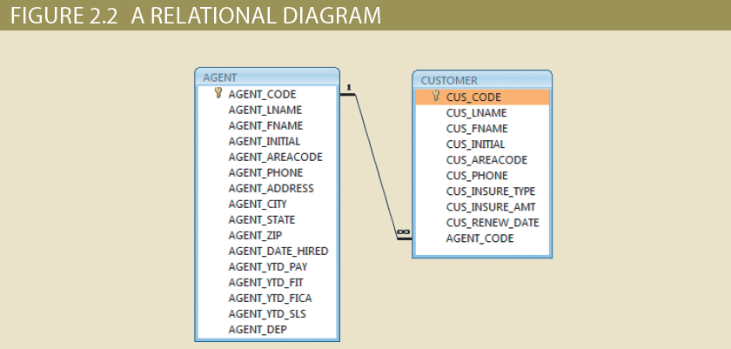
The Relational Model (3 of 4)

Slide 300
The Relational Model (4 of 4)
SQL-based relational database application
End-user interface
Allows end user to interact with the data
Collection of tables stored in the database
Each table is independent from another
Rows in different tables are related based on common values in common attributes
SQL engine
Executes all queries

Slide 301
The Entity Relationship Model (1 of 2)
Graphical representation of entities and their relationships in a database structure
Entity relationship diagram (ERD): uses graphic representations to model database components
Entity instance or entity occurrence: rows in the relational table
Attributes: describe particular characteristics
Connectivity: term used to label the relationship types

Slide 302
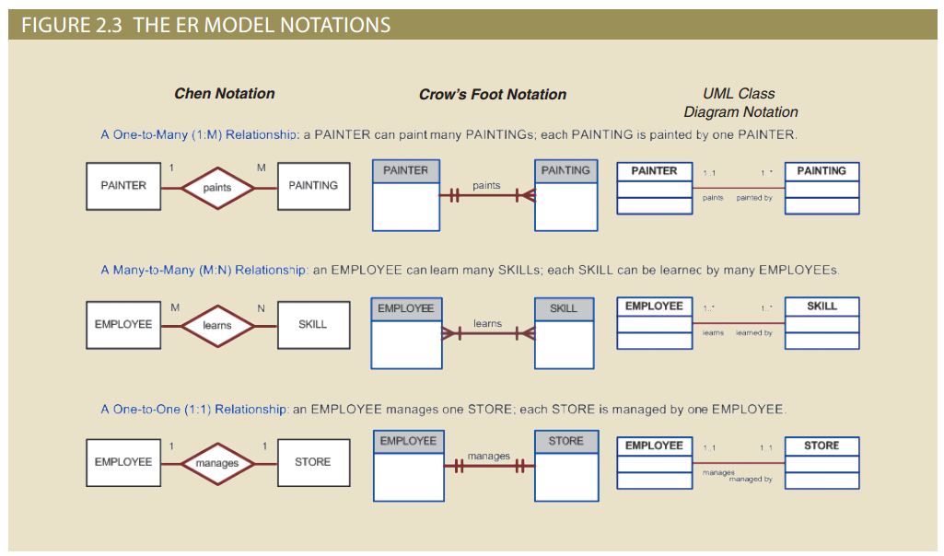
The Entity Relationship Model (2 of 2)

Slide 303
Object-Oriented Model
Classes
Objects
Inheritance
Composition
Polymorphism
State + Behaviour

Slide 304
The Object-Oriented Data Model (1 of 3)
Both data and its relationships are contained in a single structure known as an object
Object-oriented database management system(OODBMS): based on OODM
Object: contains data and their relationships with operations that are performed on it
Basic building block for autonomous structures
Abstraction of real-world entity
Attribute: describes the properties of an object

Slide 305
The Object-Oriented Data Model (2 of 3)
Class: collection of similar objects with shared structure and behavior organized in a class hierarchy
Class hierarchy: resembles an upside-down tree in which each class has only one parent
Inheritance: object inherits methods and attributes of classes above it
Unified Modeling Language (UML): describes sets of diagrams and symbols to graphically model a system

Slide 306
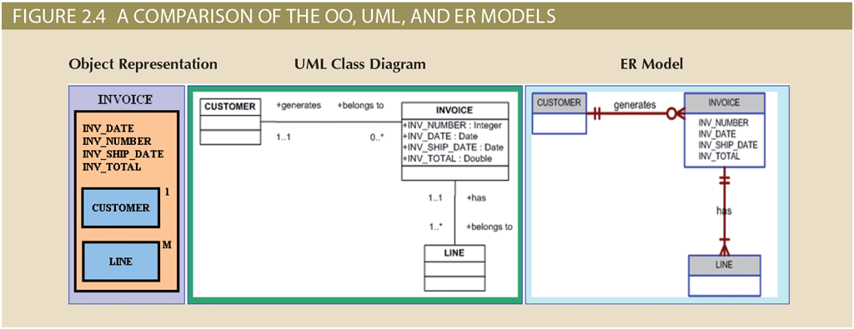
The Object-Oriented Data Model (3 of 3)

Slide 307
Object/Relational and XML
Extended relational data model (ERDM)
Supports OO features, extensible data types based on classes, and inheritance
Object/relational database management system (O/R DBMS): based on ERDM
Extensible Markup Language (XML)
Manages unstructured data for efficient and effective exchange of structured, semistructured, and unstructured data

Slide 308
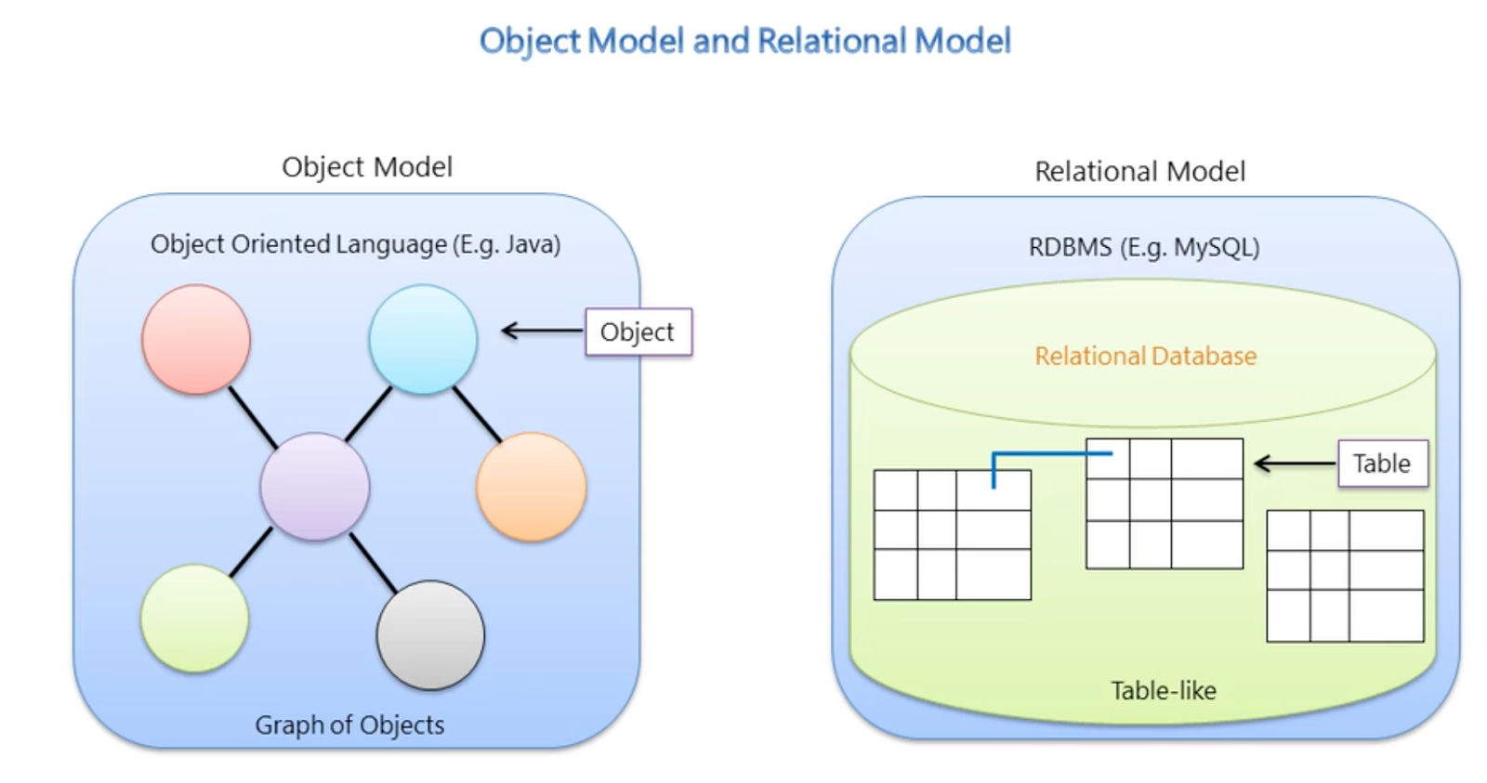
The Object-Relational Impedance Mismatch

Slide 309
Object-Relational Impendance Mismatch
Granularity
Object model with more classes than the number of corresponding tables in the database (object model is more granular than the relational model)
Subtypes (inheritance)
Inheritance is a natural paradigm in object-oriented programming languages.
RDBMSs do not define anything similar on the whole ​
Identity
A RDBMS defines exactly one notion of 'sameness': the primary key.
Java defines both object identity a==b and object equality a.equals(b).

Slide 310
Object-Relational Impendance Mismatch
Associations
Associations are represented as unidirectional references in Object Oriented languages
RDBMSs use the notion of foreign keys. Bidirectional relationships in Java: define the association twice.
Cannot determine the multiplicity of a relationship by the object domain model.
Data navigation
The way you access data in Java is fundamentally different than the way you do it in a relational database. In Java, you navigate from one association to an other walking the object network.
RDBMS: efficient to minimize the number of SQL queries and load several entities via JOINs and select the targeted entities before walking the object network.

Slide 311
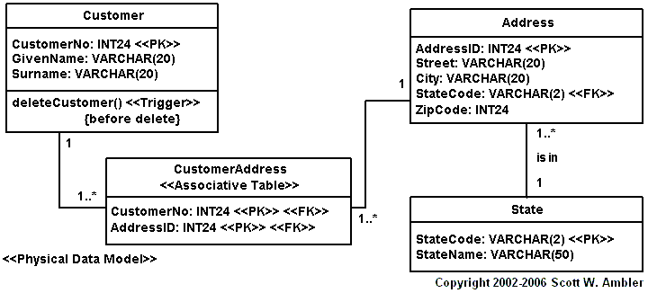
Data Model

Slide 312
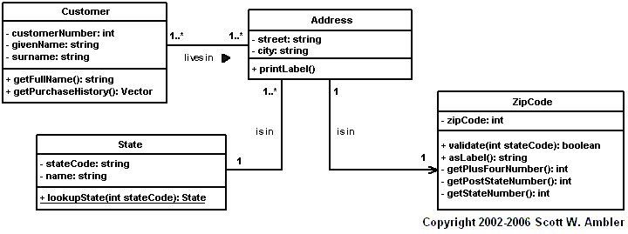
Object Model

Slide 313
Java Persistence API (JPA)
Defines a blueprint for Object-Relational Mapping (ORM)
Part of extended Java ecosystem
Can be used in Java EE and Java ME
JPA is a specification and several implementations are available
Hibernate
EclipseLink
Apache OpenJPA.
JPA permits the developer to work directly with objects rather than with SQL statements

Slide 314
Java Persistence
The Java Persistence API
The query language
The Java Persistence Criteria API
Object/relational mapping metadata

Slide 315
JPA Entities
Entities
Entity Inheritance
Managing Entities
Querying Entities

Slide 316
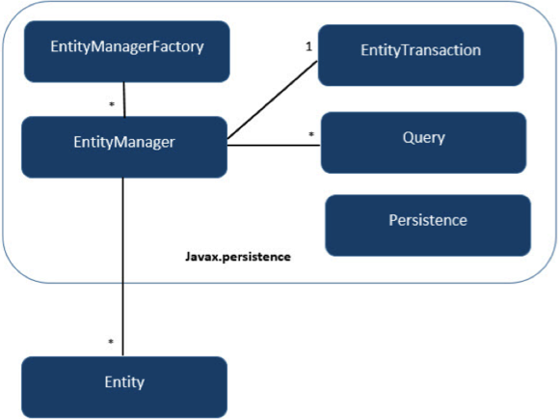
JPA classes

Slide 317
Entity classes
At heart, Plain Old Java Objects (POJOs)
Must be annotated with javax.persistence.Entity. JPA uses a database table for every entity. Persisted instances are one row in the table each.
Must define a primary key, must have a non-arg constructor and or not allowed to be final
JPA allows to auto-generate the primary key in the database via the @GeneratedValue annotation.
By default, the table name corresponds to the class name.
can change this: @Table(name="NEWTABLENAME").

Slide 318
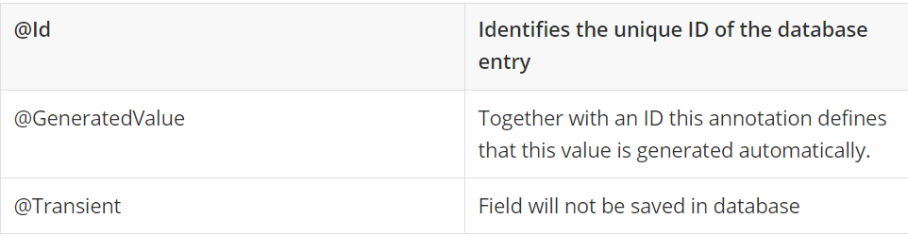
Persistence of fields
By default each field is mapped to a column with the name of the field. You can change the default name via @Column (name="newColumnName").
Fields are mapped to attributes
Either variables or getter/setter pair (not both)
By default field is mapped to a column with the name of the field
change the default name via @Column (name="newColumnName").
Other annotations:

Slide 319
Mapping relations
Class aggregation
Attributes, can be objects or collections
Relationship annotations:
@OneToOne
@OneToMany
@ManyToOne
@ManyToMany

Slide 320
Entity Inheritance
Entities support class inheritance, polymorphic associations, and polymorphic queries.
Entity classes can extend non-entity classes, and non-entity classes can extend entity classes.
Entity classes can be both abstract and concrete.
Mapped Superclasses

Slide 321
Mapped Superclasses
@MappedSuperclass
public class Employee {
@Id
protected Integer employeeId;
...
}
@Entity
public class FullTimeEmployee extends Employee {
protected Integer salary;
...}
@Entity
public class PartTimeEmployee extends Employee {
protected Float hourlyWage;
…}

Slide 322
Inheritance strategies
A single table per class hierarchy
A table per concrete entity class
A “join” strategy, whereby fields or properties that are specific to a subclass are mapped to a different table than the fields or properties that are common to the parent class
Set strategy element of @Inheritance to one of the options defined in the javax.persistence.InheritanceType:
public enum InheritanceType {
SINGLE_TABLE,
JOINED,
TABLE_PER_CLASS
};

Slide 323
Managing Entities
represented by javax.persistence.EntityManager instances
Entity manager: represented by javax.persistence.EntityManager instances
Container-managed - automatically propagated by the container, within single Java Transaction API context
@PersistenceContext
Application-managed: lifecycle controlled by code

Slide 324
Example
@PersistenceContext
EntityManagerFactory emf;
EntityManager em;
@Resource
UserTransaction utx;
...
em = emf.createEntityManager();
try {
utx.begin();
em.persist(SomeEntity);
em.merge(AnotherEntity);
em.remove(ThirdEntity);
utx.commit();
} catch (Exception e) {
utx.rollback();
}

Slide 325
Persistance contexts
persistence.xml configuration file:
<persistence>
<persistence-unit name="OrderManagement">
<description>This unit manages orders and customers.
</description>
<jta-data-source>jdbc/MyOrderDB</jta-data-source>
<jar-file>MyOrderApp.jar</jar-file>
<class>com.widgets.Order</class>
<class>com.widgets.Customer</class>
</persistence-unit>
</persistence>

Slide 326
Summary (1 of 2)
A transaction is a sequence of database operations that access the database
Transactions have four main properties: atomicity, consistency, isolation, and durability
SQL provides support for transactions through the use of two statements: COMMIT, which saves changes to disk, and ROLLBACK, which restores the previous database state
Concurrency control coordinates the simultaneous execution of transactions
A lock guarantees unique access to a data item by a transaction
Serializability of schedules is guaranteed through the use of two-phase locking

Slide 327
Querying entities
Java Persistence Query Language or the Criteria API
SELECT DISTINCT p
FROM Player p, IN (p.teams) AS t
WHERE t.city = :city

Slide 328
Hibernate
A Hibernate is a Java framework which is used to store the Java objects in the relational database system.
It is an open-source, lightweight, ORM (Object Relational Mapping) tool.
Hibernate implements Java Persistence API

Slide 329
JPA vs Hibernate
JPA | Hibernate
Java Persistence API (JPA) defines the management of relational data in the Java applications. | Hibernate is an Object-Relational Mapping (ORM) tool which is used to save the state of Java object into the database.
It is just a specification. Various ORM tools implement it for data persistence. | It is one of the most frequently used JPA implementation.
It is defined in javax.persistence package. | It is defined in org.hibernate package.
The EntityManagerFactory interface is used to interact with the entity manager factory for the persistence unit. Thus, it provides an entity manager. | It uses SessionFactory interface to create Session instances.
It uses EntityManager interface to create, read, and delete operations for instances of mapped entity classes. This interface interacts with the persistence context. | It uses Session interface to create, read, and delete operations for instances of mapped entity classes. It behaves as a runtime interface between a Java application and Hibernate.
It uses Java Persistence Query Language (JPQL) as an object-oriented query language to perform database operations. | It uses Hibernate Query Language (HQL) as an object-oriented query language to perform database operations.

Slide 330
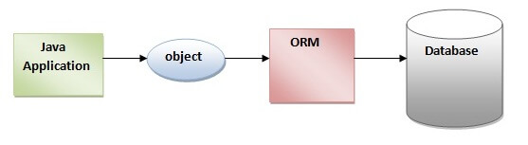
Hibernate

Slide 331
Hibernate advantages
Open Source and Lightweight
Fast Performance
Database Independent Query
Automatic Table Creation
Simplifies Complex Join
Provides Query Statistics and Database Status

Slide 332
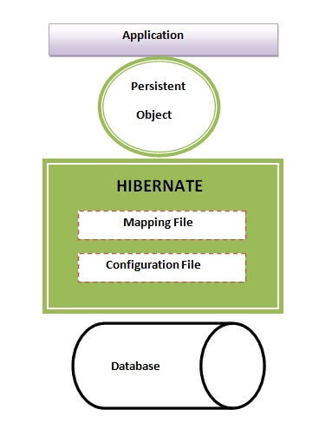
Hibernate architecture

Slide 333
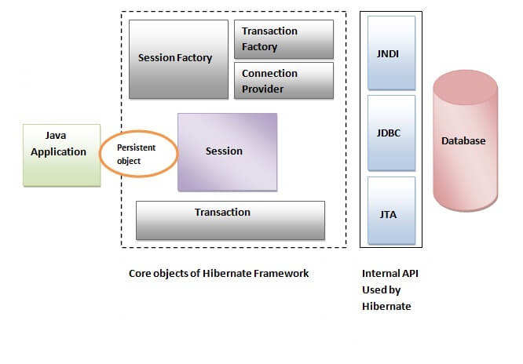
Hibernate classes

Slide 334
Persistance choices
Stick with SQL
Utilize a ORM framework
Have an ad-hoc framework

Slide 335
ORM advantages
Models are DRY (don't repeat yourself): write your model once,
easier to update and maintain.
Handling the underlying database connection(s) to localisation.
SQL injection is more difficult
It can improve the formation of the underlying SQL
When you change the underlying database, you do not have to rewrite code.
Models use OOP, which means you an extend and inherit from Models.

Slide 336
ORM challenges
Performance issues
As all abstractions, quite a lot of overhead
“N+1” issue
Separate queries to bring data from related table
Hides the database layer
Learning curve
Lets developers get away with not learning SQL

Slide 337
Summary
Application persistence
Object-Oriented and Relational Model are similar ways to model a domain, but with differences in practice: Object-Relational Mismatch
Object-Relational Mapping is a set of techniques to bridge a mismatch
Java Persistence API (JPA): an abstract specification
Hibernate is an ORM framework between Java and RDBMS with many important technical advantages
An JPA “persistence provider”
Has typical advantages and limitations of a “leaking abstraction”

Slide 338
Database Management Week 13 Polyglot Persistence
School of Engineering and Computing Sciences Fall 2020
Dr. Stan Ustymenko
stanislav.ustymenko@tamucc.edu

Slide 339
Learning Objectives
Concepts and Ideas
Enterprise IS Design and diverse databases
Polyglot Persistence design approach
Diverse data in JPA & Hibernate
Limitations & Issues

Slide 340
Motivation
With NoSQL, relational model is no longer the only choice for data architecture
Each approach “shines” when use case is compatible
Performance gains of newer technologies turn to losses when application is squeezed into ill-fitting model
Good example: a graph database is great for social media data! But if you use it for an inventory database?
Often, there is no one size fits all solution to data storage.

Slide 341
Polyglot persistence
Grows from the idea of “polyglot programming”: mixing languages within single project
Idea is to use strengths of each methodology
Using a variety of languages according to the context in which your working
Polyglot persistence is applying same principle to databases
PP is more of an enterprise architecture design pattern than a particular technology

Slide 342
Hypothetical example: e-Commerce
Finances
Product Catalog
Product reviews
Analytics
Shopping cart
User log
Traditional approach: put everything into a RDBMS

Slide 343
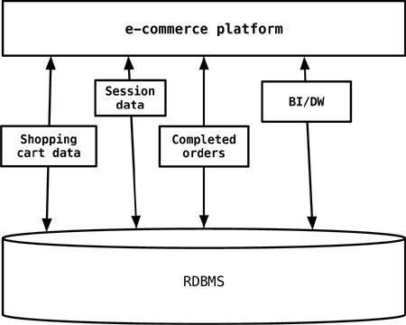
Traditional approach

Slide 344
Microservices architecture
General approach to increase modularity
Instead of monolythic applications, break up into pieces, usually along the lines of business capabilities
As usual, gains are achieved when coupling between components is kept to minimum
Overview:
https://martinfowler.com/articles/microservices.html

Slide 345
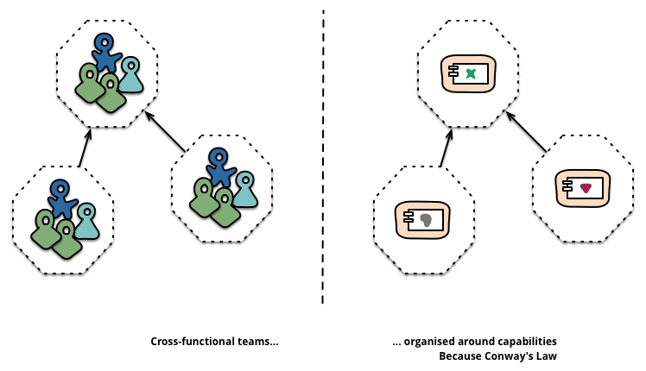
Microservices
© Martin Fowler

Slide 346
Back to example
Now, instead of a single DB, we are free to choose solutions suitable for each unit:
The original RDBMS with relational data model for financial data (such as checkouts, invoices, refunds, and more) & reporting.
MongoDB with flexible document data model for product catalog.
Cassandra for high volume use cases such as real-time analytics (using Apache Spark) and user activity logs.
Riak key-value store for managing shopping cart.
Redis for managing user sessions and an in-memory cache for low latency reads.
Neo4J graph database for storing recommendations.

Slide 347
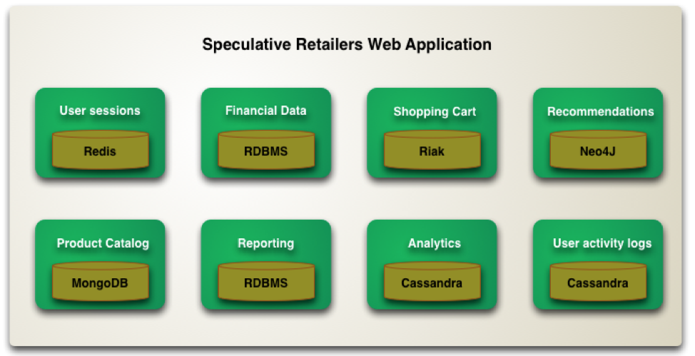

Slide 348
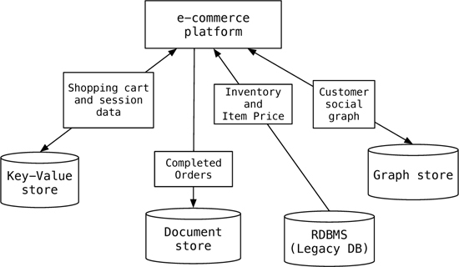
Polyglot data architecture

Slide 349
Consequences
It is not necessary for the application to use a single data store for all of its needs, since different databases are built for different purposes and not all problems can be elegantly solved by a singe database.
Even using specialized relational databases for different purposes, such as data warehousing appliances or analytics appliances within the same application, can be viewed as polyglot persistence

Slide 350
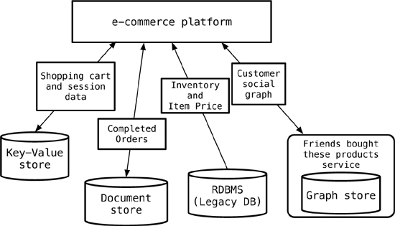
Design choice: service wrappers
As we move towards multiple data stores in the application, there may be other applications in the enterprise that could benefit from the use of our data stores or the data stored in them.
EG., the graph data store can serve data to other applications that need to understand, for example, which products are being bought by a certain segment of the customer base.

Slide 351
Services
Wrap all databases into services, letting the application to only talk to a bunch of services
This allows for the databases inside the services to evolve without you having to change the dependent applications

Slide 352
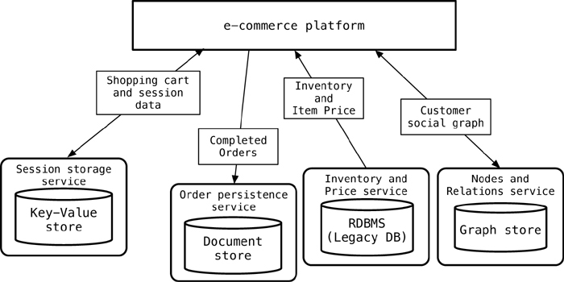
Talk to the service

Slide 353
Expanding for Better Functionality
Often, hard to change the data storage, because of the existing legacy applications and their dependency on chosen data storage.
We can, however, add functionality such as caching for better performance, or use indexing engines such as Solr
Synchronization must be implemented

Slide 354
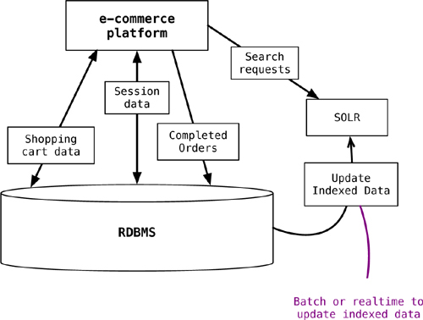
Expanding for Better Functionality

Slide 355
Enterprise Concerns with Polyglot Persistence
The enterprise is used to having uniform RDBMS environments
all its applications will be built around the same database.
DBA groups will have to become more poly-skilled
Licensing requirements and third-party vendors
Many tools are open source, with companies that provide commercial support
Toolsets are less mature, but quickly catch up
tools such as MongoDB Monitoring Service, Datastax Ops Center or Rekon browser for Riak etc.

Slide 356
Enterprise Concerns with Polyglot Persistence
Another enterprise concern is data security
the ability to create users and assign privileges
In many NoSQL platforms the application owns the data and serve it using services
Thus, responsibility for the security lies with the application
Enterprises often have data warehouse systems, BI, and analytics system
ETL tools should be able to read data from the NoSQL data
vendors are adding support for NoSQL databases
Enterprise analytics is a great use case for NoSQL databases
allowing to write large volumes of data

Slide 357
Implementing Applications with Polyglot Persistence
3 alternatives
Native APIs for each DBMS
Potentially best performance, but lack of uniform architecture
Learning curve for app developers
Mismatch between data models
Web Services
SOAP vs REST
Encapsulates the data access
Additional indirection level
Persistence frameworks
Integrated in popular application frameworks
JPA, Spring, …
Pros&cons similar to ORMs

Slide 358
Service Oriented Architecture
Framework provides a set of fundamental operations via web services
May also provide local services using Windows services
All applications based on that framework share the common services
Don’t have to recreate the same functionality for each new application
Can provide those same services to Partner businesses, suppliers, and customers
Longhorn’s Indigo model is a service oriented architecture

Slide 359
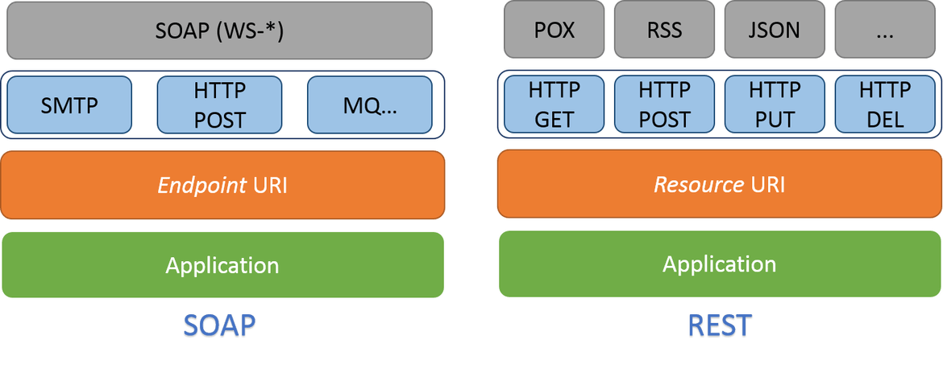
SOAP and TREST ASSPI

Slide 360
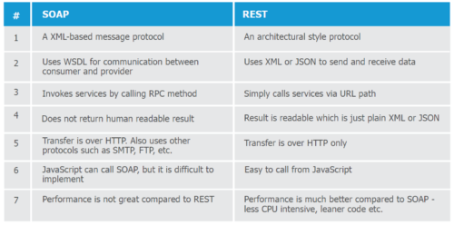
SOAP and REST API

Slide 361
Polymorphic frameworks
Integrate with Java EE or other popular frameworks that support enterprise application development
Spring Data
JPA
EclipseLink
Hibernate OGM

Slide 362
JPA/EclipseLink
Concepts and interfaces of JPA are applicable to NoSQL mechanisms
JPA is a specification and several implementations are available
Hibernate
EclipseLink
Apache OpenJPA.
There are persistence providers supporting NoSQL:
EclipseLink, the reference implementation, supports MongoDB and Oracle NoSQL sinv=ce version 2.4
Hibernate OGM is a branch of Hibernate

Slide 363
EclipseLink NoSQL persistence units
NoSQL persistence units are configured the same as JPA persistence units.
The persistence.xml file is used to define the persistence unit.
NoSQL defines the following persistence unit properties:
eclipselink.nosql.connection-spec
eclipselink.nosql.connection-factory
eclipselink.nosql.property
eclipselink.target-database
JDBC-specific properties are not supported

Slide 364
Mapping NoSQL objects
NoSQL maps objects to structured data such as XML or JSON.
NoSQL supports embedded data, embedded collections, and all of the existing JPA mapping annotations.

Slide 365
PersistenceUnit Composition
Added in version 2.4
This feature adds support for persistence units being composed.
This means a user can define multiple persistence units with a unique set of entity types and expose them through a composite persistence unit which combines the set of classes across multiple data sources to expose a single persistence context.
The goal is to combine several persistence units into a single one.

Slide 366
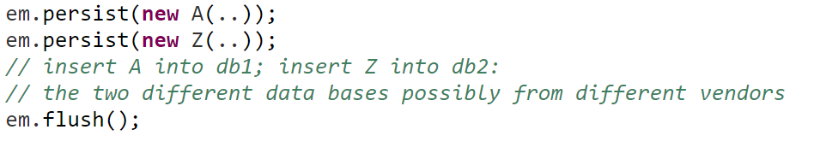
PersistenceUnit Composition

Slide 367


Slide 368
Hibernate OGM
The power and simplicity of JPA for NoSQL datastores.
It reuses Hibernate ORM’s engine but persists entities into a NoSQL datastore instead of a relational database.
Currently there is support for
Key/Value: Infinispan, Ehcache
Document: MongoDB
Graph: Neo4j

Slide 369
Hibernate OGM Querying
Hibernate OGM supports several ways for searching entities and returning them as Hibernate managed objects:
JP-QL queries (we convert them into a native backend query)
datastore specific native queries
full-text queries, using Hibernate Search as indexing engine
When JPA isn’t enough, Hibernate OGM extends it with family-specific and product-specific options

Slide 370

Hibernate OGM Architecture

Slide 371

Hibernate OGM Architecture

Slide 372

Spring Framework
XML configuration
Spring Boot is well-suited for microservices

Slide 373
Spring Data
Spring Data’s mission is to provide a familiar and consistent, Spring-based programming model for data access while still retaining the special traits of the underlying data store.
Powerful repository and custom object-mapping abstractions
Dynamic query derivation from repository method names
Implementation domain base classes providing basic properties
Easy Spring integration via JavaConfig and custom XML namespaces
Advanced integration with Spring MVC controllers
Experimental support for cross-store persistenc

Slide 374
Spring Data Modules
Spring Data Commons - Core Spring concepts underpinning every Spring Data module.
Spring Data JPA - Spring Data repository support for JPA.
Spring Data KeyValue - Map based repositories and SPIs to easily build a Spring Data module for key-value stores.
Spring Data LDAP - Spring Data repository support for Spring LDAP.
Spring Data MongoDB - Spring based, object-document support and repositories for MongoDB.
Spring Data Redis - Easy configuration and access to Redis from Spring applications.
Spring Data REST - Exports Spring Data repositories as hypermedia-driven RESTful resources.

Slide 375
Polyglot Persistence Benefits
Polyglot Persistence provides support for multiple database models and is able to utilize the best data model for the job.
Simplifies Operations: Different databases, coordinating and working with one another, make for complicated operations and cause fragmentation. Polyglot Persistence simplifies operations and helps to select the best component for the situation, helping to eliminate fragmentation.
Faster Response Time: All the features of databases in the program are leveraged, improving response times.
Efficiency: The ElasticSearch app can return results using “relevance” as a priority in the listings, while MongoDB cannot. A Polyglot Persistence application would “automatically” assign relevance-oriented processing.

Slide 376
Polyglot Persistence Drawbacks
Utilizing a Polyglot Persistence model can be both difficult and expensive. Specialists often need to be brought in to integrate the different databases.
Permanent IT staff will need training on the “new” systems.
Maintenance and repairs can be time consuming, because running tests is difficult.
Making sure a system with multiple components is fault-tolerant is difficult
A Polyglot Persistence model with separate databases solves specific problems, but can also become an operational nightmare.
The operation of multiple data silos can cause just as many difficulties as it resolves, starting with operational complexity.

Slide 377

Polyglot-Performance-as-a-service

Slide 378
Challenges for Release Agility
App developers must not only learn efficient data modeling with various database APIs, but also understand the underlying storage engine and replication architectures for each of the databases.
Build engineers have to ensure that the full application stack including multiple databases can be built into deployment artifacts fast and reliably.
Test automation engineers now have to account for the nuances of each database and how the microservices deal with them.
Operations teams are now forced to understand scaling, fault tolerance, backup/restore, software upgrades, and hardware portability for multiple databases.

Slide 379
Summary
Polyglot persistence is about using different data storage technologies to handle varying data storage needs.
Polyglot persistence can apply across an enterprise or within a single application.
Encapsulating data access into services reduces the impact of data storage choices on other parts of a system.
Adding more data storage technologies increases complexity in programming and operations, so the advantages of a good data storage fit need to be weighed against this complexity.

Slide 380
Database Management Week 1 Review of DBMS
School of Engineering and Computing Sciences Fall 2020
Dr. Stan Ustymenko
stanislav.ustymenko@tamucc.edu

Slide 381
Learning Objectives
Review the rationale and moving parts of a DBMS
Review relational database model
Review SQL

Slide 382
Introducing the Database
Shared, integrated computer structure that stores data
End-user data: raw facts of interest to end user
Metadata: data about data, through which the end-user data is integrated and managed
Describes data characteristics and relationships
Database management system (DBMS)
Collection of programs
Manages the database structure
Controls access to data stored in the database

Slide 383

Role and Advantages of the DBMS (2 of 2)

Slide 384
Evolution of File System Data Processing (2 of 3)
Table 1.2 | Basic File Terminology
TERM | DEFINITION
Data | Raw facts, such as a telephone number, a birth date, a customer name, and a year-to-date (YTD) sales value. Data has little meaning unless it has been organized in some logical manner.
Field | A character or group of characters (alphabetic or numeric) that has a specific meaning. A field is used to define and store data.
Record | A logically connected set of one or more fields that describes a person, place, or thing. For example, the fields that constitute a record for a customer might consist of the customer’s name, address, phone number, date of birth, credit limit, and unpaid balance.
File | A collection of related records. For example, a file might contain data about the students currently enrolled at Gigantic University.

Slide 385

Evolution of File System Data Processing (3 of 3)

Slide 386
Problems with File System Data Processing
Problems with file systems challenge the types of information that can be created from data as well as information accuracy
Lengthy development times
Difficulty of getting quick answers
Complex system administration
Lack of security and limited data sharing
Extensive programming

Slide 387
Structural and Data Dependence (1 of 2)
Structural dependence
Access to a file is dependent on its own structure
All file system programs are modified to conform to a new file structure
Structural independence
File structure is changed without affecting the application’s ability to access the data

Slide 388
Structural and Data Dependence (2 of 2)
Data dependence
Data access changes when data storage characteristics change
Data independence
Data storage characteristics are changed without affecting the program’s ability to access the data
Practical significance of data dependence is the difference between logical and physical format

Slide 389
Data Redundancy (1 of 2)
Unnecessarily storing the same data at different places
Islands of information (i.e., scattered data locations)
Increases the probability of having different versions of the same data

Slide 390
Data Redundancy (2 of 2)
Possible results of uncontrolled data redundancy
Poor data security
Data inconsistency
Data-entry errors
Data integrity problems

Slide 391

Database Systems

Slide 392
The Database System Environment (1 of 2)
Database system: organization of components that define and regulate the collection, storage, management, and use of data within a database environment
Hardware
Software
People
Procedures
Data

Slide 393

The Database System Environment (2 of 2)

Slide 394
DBMS Functions (1 of 3)
Data dictionary management
Data dictionary: stores definitions of data elements and their relationships
Data storage management
Performance tuning ensures efficient performance
Data transformation and presentation
Data is formatted to conform to logical expectations
Security management
Enforces user security and data privacy

Slide 395
DBMS Functions (2 of 3)
Multiuser access control
Sophisticated algorithms ensure that multiple users can access the database concurrently without compromising its integrity
Backup and recovery management
Enables recovery of the database after a failure
Data integrity management
Minimizes redundancy and maximizes consistency

Slide 396
DBMS Functions (3 of 3)
Database access languages and application programming interfaces
Query language: lets the user specify what must be done without having to specify how
Structured Query Language (SQL): de facto query language and data access standard supported by the majority of DBMS vendors
Database communication interfaces
Accept end-user requests via multiple, different network environments

Slide 397
Data Modeling and Data Models
Data modeling: creating a specific data model for a determined problem domain
Data model: simple representation of complex real-world data structures
Useful for supporting a specific problem domain
Model: abstraction of a more complex real-world object or event

Slide 398
The Importance of Data Models
The importance of data modeling cannot be overstated
Facilitates communication
Gives various views of the database
Organizes data for various users
Provides an abstraction for the creation of good a database

Slide 399
Data Model Basic Building Blocks
Entity: person, place, thing, or event about which data will be collected and stored
Attribute: characteristic of an entity
Relationship: association among entities
One-to-many (1:M OR 1..*)
Many-to-many (M:N or *..*)
One-to-one (1:1 OR 1..1)
Constraint: restriction placed on data
Ensures data integrity

Slide 400
The Relational Model (1 of 4)
Produced an automatic transmission database that replaced standard transmission databases
Based on a relation (i.e., table): matrix composed of intersecting tuples (rows) and attributes (columns)
Describes a precise set of data manipulation constructs

Slide 401
The Relational Model (2 of 4)
Relational database management system (RDBMS)
Performs basic functions provided by the hierarchical and network DBMS systems
Makes the relational data model easier to understand and implement
Hides the complexities of the relational model from the user

Slide 402
The Relational Model (3 of 4)

Slide 403
The Relational Model (4 of 4)
SQL-based relational database application
End-user interface
Allows end user to interact with the data
Collection of tables stored in the database
Each table is independent from another
Rows in different tables are related based on common values in common attributes
SQL engine
Executes all queries

Slide 404
The Entity Relationship Model

Slide 405
Level of abstraction
Table 2.4 Levels of Data Abstraction
Model | Degree of Abstraction | Focus | Independent of
External | High | End-user views | Hardware and software
Conceptual | Medium-High | Global view of data (database model independent) | Hardware and software
Internal | Medium-Low | Specific database model | Hardware
Physical | Low | Storage and access methods | Neither hardware nor software

Slide 406
Introduction to SQL (1 of 3)
Categories of SQL functions
Data definition language (DDL)
Data manipulation language (DML) ← SELECT * FROM Table WHERE…
Transaction control language (TCL)
Data control language (DCL)
SQL is relatively easy to learn
Nonprocedural language with basic command vocabulary set of less than 100 words
Differences in SQL dialects are minor

Slide 407
Introduction to SQL (2 of 3)
Command or Option | SQL Data Definition Commands Description
CREATE SCHEMA AUTHORIZATION | Creates a database schema
CREATE TABLE | Creates a new table in the user’s database schema
NOT NULL | Ensures that a column will not have null values
UNIQUE | Ensures that a column will not have duplicate values
PRIMARY KEY | Defines a primary key for a table
FOREIGN KEY | Defines a foreign key for a table
DEFAULT | Defines a default value for a column (when no value is given)
CHECK | Validates data in an attribute
CREATE INDEX | Creates an index for a table
CREATE VIEW | Creates a dynamic subset of rows and columns from one or more tables
ALTER TABLE | Modifies a table’s definition (adds, modifies, or deletes attributes or constraints)
CREATE TABLE AS | Creates a new table based on a query in the user’s database schema
DROP TABLE | Permanently deletes a table (and its data)
DROP INDEX | Permanently deletes an index
DROP VIEW | Permanently deletes a view

Slide 408
Introduction to SQL (3 of 3)
Table 7.3 | Other SQL Commands
Command or Option | Description
Transaction Control Language
COMMIT | Permanently saves data changes
ROLLBACK | Restores data to its original values
Data Control Language
GRANT | Gives a user permission to take a system action or access a data object
REVOKE | Removes a previously granted permission from a user

Slide 409
Summary
Data consists of raw facts and is usually stored in a database
Database design defines the database structure
Can be classified according to the number of users, location, as well as data usage and structure
Databases evolved from manual and computerized file systems. DBMSs were developed to address the file system’s inherent weaknesses
A data model is an abstraction of a complex real-world data environment
There are many types of data models (e.g., hierarchical, network, relational, object-oriented, extended relational data model, etc.)
Data-modeling requirements are a function of different data views (global versus local) and the level of data abstraction
RDBMS is accessed using SQL commands, that can be divided into two overall categories: data definition language (DDL) commands and data manipulation language (DML) commands

Slide 410
Database Management Week 3 Performance tuning - basics
School of Engineering and Computing Sciences Fall 2020
Dr. Stan Ustymenko
stanislav.ustymenko@tamucc.edu

Slide 411
Chapter 11
Database Performance Tuning and Query Optimization

Slide 412
Learning Objectives
After completing this chapter, you will be able to:
Identify the procedures involved in database performance tuning
Describe how a DBMS processes SQL queries in each of its three phases
Explain the role of indexes in speeding up data access
Differentiate between a rule-based optimizer and a cost-based optimizer
Describe some common practices used to write efficient SQL code
Explain how to formulate queries and tune the DBMS for optimal performance

Slide 413
Database Performance-Tuning Concepts (1 of 2)
One of the main functions of a database system is to provide timely answers
End users interact with the DBMS through the use of queries to generate information, using the following sequence:
1. End-user (client-end) application generates a query
2. Query is sent to the DBMS (server end)
3. DBMS (server end) executes the query
4. DBMS sends the resulting data set to the end-user (client-end) application
Goal of database performance is to execute queries as fast as possible
Database performance tuning: set of activities and procedures that reduce response time of database system
Fine-tuning the performance of a system requires a holistic approach
All factors must operate at optimum level with minimal bottlenecks

Slide 414
Database Performance-Tuning Concepts (2 of 2)
Table 11.1 General Guidelines for Better System Performance
 | System Resources | Client | Server
Hardware | CPU | The fastest possible Dual-core CPU or higher "Virtualized Client desktop technologies could also be used" | The fastest possible Multiple processors (quad-core technology or higher) Cluster of networked computers "Virtualized server technology could be used"
 | RAM | The maximum possible to avoid OS memory to disk swapping | The maximum possible to avoid OS memory to disk swapping
 | Storage | Fast SATA/EIDE hard disk with sufficient free hard disk space solid state drives (SSDs) for faster speed | Multiple high-speed, high-capacity disks Fast disk interface (SAS / SCSI / Firewire / Fibre Channel) RAID configuration optimized for throughput Solid state drives (SSDs) for faster speed Separate disks for OS, DBMS, and data spaces
 | Network | High-speed connection | High-speed connection
Software | Operating system (OS) | 64-bit OS for larger address spaces Fine-tuned for best client application performance | 64-bit OS for larger address spaces Fine-tuned for best server application performance
 | Network | Fine-tuned for best throughput | Fine-tuned for best throughput
 | Application | Optimize SQL in client application | Optimize DBMS server for best performance

Slide 415
Performance Tuning: Client and Server
Client side: SQL performance tuning
Generate SQL query that returns correct answer in least amount of time
Using minimum amount of resources at server
Server side: DBMS performance tuning
DBMS environment is configured to respond to clients’ requests as fast as possible
While making optimum use of existing resources

Slide 416
DBMS Architecture (1 of 3)
All data in a database are stored in data files
Data files automatically expand in predefined increments known as extends
Data files are grouped in file groups or table spaces
Logical grouping of several data files that store data with similar characteristics
Data cache or buffer cache: shared, reserved memory area
Stores most recently executed SQL statements or PL/SQL procedures

Slide 417
DBMS Architecture (2 of 3)
SQL cache or procedure cache: shared, reserved memory
Stores most recently executed SQL statements or PL/SQL procedures
DBMS retrieves data from permanent storage and places them in RAM
Data is retrieved from the data files and placed in the data cache
Input/output request: low-level data access operation that reads or writes data to and from computer devices
Data cache is faster than working with data files
Majority of performance-tuning activities focus on minimizing I/O operations

Slide 418
DBMS Architecture (3 of 3)

Slide 419
Database Query Optimization Modes (1 of 4)
Algorithms proposed for query optimization are based on selection of:
Optimum order to achieve the fastest execution time
Sites to be accessed to minimize communication costs
Evaluated based on:
Operation mode
Timing of its optimization

Slide 420
Database Query Optimization Modes (2 of 4)
Classification of operation modes
Automatic query optimization: DBMS finds the most cost-effective access path without user intervention
Manual query optimization: requires that optimization be selected and scheduled by the end-user or programmer

Slide 421
Database Query Optimization Modes (3 of 4)
Classification based on timing of optimization
Static query optimization: best optimization strategy is selected when the query is compiled by the DBMS
Takes place at compilation time
Dynamic query optimization: access strategy is dynamically determined by the DBMS at run time, using the most up-to-date information about the database
Takes place at execution time

Slide 422
Database Query Optimization Modes (4 of 4)
Classification based on type of information used to optimize the query
Statistically based query optimization algorithm: statistics are used by the DBMS to determine the best access strategy
Statistical information is generated by DBMS through:
Dynamic statistical generation mode
Manual statistical generation mode
Rule-based query optimization algorithm: based on a set of user-defined rules to determine the best query access strategy

Slide 423
Database Statistics (1 of 2)
Measurements about database objects; provide a snapshot of database characteristics
Number of processors used
Processor speed
Temporary space available

Slide 424
Database Statistics (2 of 2)
Table 11.2 Sample Database Statistics Measurements
Database Object | Sample Measurements
Tables | Number of rows, number of disk blocks used, row length, number of columns in each row, number of distinct values in each column, maximum value in each column, minimum value in each column, and columns that have indexes
Indexes | Number and name of columns in the index key, number of key values in the index, number of distinct key values in the index key, histogram of key values in an index, and number of disk pages used by the index
Environment Resources | Logical and physical disk block size, location and size of data files, and number of extends per data file

Slide 425
Query Processing (1 of 2)
Parsing
DBMS parses the SQL query and chooses the most efficient access/execution plan
Execution
DBMS executes the SQL query using the chosen execution plan
Fetching
DBMS fetches the data and sends the result set back to the client

Slide 426
Query Processing (2 of 2)

Slide 427
SQL Parsing Phase (1 of 2)
Query is broken down into smaller units
Original SQL query transformed into slightly different version of original SQL code which is fully equivalent and more efficient
Query optimizer: analyzes SQL query
Finds most efficient way to access data
Access plans: result of parsing a SQL statement; contains a series of steps the DBMS will use to execute the query and return the result set in the most efficient way
Access plan exists for query in SQL cache: DBMS reuses it
No access plan: optimizer evaluates various plans and chooses one to be placed in SQL cache for use

Slide 428
SQL Parsing Phase (2 of 2)
Table 11.3 Sample DBMS Access Plan I/O Operations
Operation | Description
Table scan (full) | Reads the entire table sequentially, from the first row to the last, one row at a time (slowest)
Table access (row ID) | Reads a table row directly, using the row ID value (fastest)
Index scan (range) | Reads the index first to obtain the row IDs and then accesses the table rows directly (faster than a full table scan)
Index access (unique) | Used when a table has a unique index in a column
Nested loop | Reads and compares a set of values to another set of values, using a nested loop style (slow)
Merge | Merges two data sets (slow)
Sort | Sorts a data set (slow)

Slide 429
SQL Execution Phase
All I/O operations indicated in the access plan are executed
Locks are acquired
Data are retrieved and placed in data cache
Transaction management commands are processed

Slide 430
SQL Fetching Phase
Rows of resulting query result set are returned to client
DBMS may use temporary table space to store temporary data
Database server coordinates the movement of the result set rows from the server cache to the client cache

Slide 431
Query Processing Bottlenecks
Delay introduced in the processing of an I/O operation that slows the system
Caused by the:
CPU
RAM
Hard disk
Network
Application code

Slide 432
Indexes and Query Optimization (1 of 3)
Indexes
Help speed up data access
Facilitate searching, sorting, using aggregate functions, and join operations
Ordered set of values that contain the index key and pointers
More efficient than a full table scan; index data is preordered and the amount of data is usually much smaller

Slide 433

Indexes and Query Optimization (2 of 3)

Slide 434
Indexes and Query Optimization (3 of 3)
Data sparsity: number of different values a column could have
High or low
Data structures used to implement indexes
Hash indexes
B-tree indexes
Bitmap indexes
DBMS determines best type of index to use

Slide 435
Optimizer Choices
Rule-based optimizer: uses preset rules and points to determine the best approach to execute a query
Rules assign a “fixed cost” to each SQL operation
Cost-based optimizer: uses algorithms based on statistics about objects being accessed to determine the best approach to execute a query
Optimizer process adds up the processing cost, I/O costs, and resource costs (RAM and temporary space) to determine the total cost of a given execution plan

Slide 436
Using Hints to Affect Optimizer Choices (1 of 2)
Optimizer might not choose the best execution plan
Makes decisions based on existing statistics; might be old
Might choose less-efficient decisions
Optimizer hints: special instructions for the optimizer
Embedded in the SQL command text

Slide 437
Using Hints to Affect Optimizer Choices (2 of 2)
Table 11.5 Optimizer Hints
Hint | Usage
ALL_ROWS | Instructs the optimizer to minimize the overall execution time—that is, to minimize the time needed to return all rows in the query result set. This hint is generally used for batch mode processes. For example: SELECT /*+ ALL_ROWS */ * FROM PRODUCT WHERE P_QOH < 10;
FIRST_ROWS | Instructs the optimizer to minimize the time needed to process the first set of rows—that is, to minimize the time needed to return only the first set of rows in the query result set. This hint is generally used for interactive mode processes. For example: SELECT /*+ FIRST_ROWS */ * FROM PRODUCT WHERE P_QOH < 10;
INDEX(name) | Forces the optimizer to use the P_QOH_NDX index to process this query. For example: SELECT /*+ INDEX(P_QOH_NDX) */ * FROM PRODUCT WHERE P_QOH < 10

Slide 438
SQL Performance Tuning
Evaluated from client perspective
Most current relational DBMSs perform automatic query optimization at the server end
Most SQL performance optimization techniques are DBMS-specific and thus rarely portable
Majority of performance problems are related to poorly written SQL code
A carefully written query almost always outperforms a poorly written one

Slide 439
Index Selectivity
Measure of the likelihood that an index will be used in query processing
Indexes are used when a subset of rows from a large table is to be selected based on a given condition
Cannot always be used to improve performance
Function-based index: based on a specific SQL function or expression

Slide 440
Conditional Expressions (1 of 2)
Expressed within WHERE or HAVING clauses of a SQL statement
Restricts the output of a query to only rows matching conditional criteria
Guidelines to write efficient conditional expressions in SQL code
Use simple columns or literals as operands
Numeric field comparisons are faster than character, date, and NULL comparisons
Equality comparisons are faster than inequality comparisons
Transform conditional expressions to use literals
Write equality conditions first when using multiple conditional expressions
When using multiple AND conditions, write the condition most likely to be false first
When using multiple OR conditions, put the condition most likely to be true first
Avoid the use of NOT logical operator

Slide 441
Conditional Expressions (2 of 2)
Table 11.6 Conditional Criteria
Operand1 | Conditional Operator | Operand2
P_PRICE | > | 10.00
V_STATE | = | FL
V_CONTACT | LIKE | Smith%
P_QOH | > | P_MIN * 1.10

Slide 442
Query Formulation
Step to formulate a query
Pinpoint what columns and computations are required
Identify source tables
Decide how to join tables
Establish action criteria are needed
Determine the order in which to display the output

Slide 443
DBMS Performance Tuning (1 of 2)
Managing DBMS processes in primary memory and the structures in physical storage
DBMS performance tuning at server end focuses on setting parameters used for:
Data cache
SQL cache
Sort cache
Optimizer mode
In-memory database: store large portions of the database in primary storage
These systems are becoming popular
Increasing performance demands of modern database applications
Diminishing costs
Technology advances of components

Slide 444
DBMS Performance Tuning (2 of 2)
Recommendations for physical storage of databases
Utilize I/O accelerators
Use RAID (Redundant Array of Independent Disks) to provide a balance between performance improvement and fault tolerance
Minimize disk contention
Put high-usage tables in their own table spaces
Assign separate data files in separate storage volumes for indexes, system, and high-usage tables
Take advantage of the various table storage organizations in the database
Partition tables based on usage
Apply denormalized tables where appropriate
Store computed and aggregate attributes in tables

Slide 445
Summary (1 of 2)
Database performance tuning refers to a set of activities and procedures designed to ensure that an end-user query is processed by the DBMS in the least amount of time
Database statistics refer to a number of measurements gathered by the DBMS that describe a snapshot of the database objects’ characteristics
DBMSs process queries in three phases: parsing, execution, and fetching
Indexes are crucial in the process that speeds up data access
During query optimization, the DBMS must choose what indexes to use, how to perform join operations, which table to use first, and so on
A rule-based optimizer uses preset rules and points to determine the best approach to execute a query

Slide 446
Summary (2 of 2)
SQL performance tuning deals with writing queries that make good use of the statistics
Query formulation deals with how to translate business questions into specific SQL code to generate the required results
DBMS performance tuning includes tasks such as managing the DBMS processes in primary memory (allocating memory for caching purposes) and managing the structures in physical storage (allocating space for the data files)

Slide 447
Database Management Week 4 Performance tuning – SQL Queries Optimization
School of Engineering and Computing Sciences Fall 2020
Dr. Stan Ustymenko
stanislav.ustymenko@tamucc.edu

Slide 448
Learning Objectives
This module aims to:
Describe MySQL query optimization features
Use EXPLAIN and DESCRIBE to fine-tune queries
Behavior of MySQL query optimizer
Indices and Full-Text feature
SQL query hand tuning tips

Slide 449
MySQL performance features
MySQL query analyzer
Optimized DB engines
Indices
SQL Query Cache
Full Text search feature

Slide 450
Query Optimizer

Slide 451
Query Optimizer (continued)
Idea: change order of operations to improve performance
Maximize use of indices and keys
Cost-based optimization
Assign cost to operations
Assign cost to alternative paths
Search for plan with lower costs

Slide 452

Optimizer (continued)

Slide 453
Cost-based optimizations
Access Method
Join Order
Subquery strategy

Slide 454

MySQL Optimizer Characteristics

Slide 455
Cost Factors
-IO Cost
No. pages read from table
No. pages read from index
CPU cost
Evaluating query conditions
Comparing keys/records
Sortink keys

Slide 456

Cost values

Slide 457
Types of optimizations MySQL performs (automatically)
Reordering joins
Prefer left-deep plans
Converting OUTER JOINs to INNER JOINs
Applying algebraic equivalence rules
(5=5 AND a>5) will reduce to a>5.
(a<b AND b=c) AND a=5 becomes b>5 AND b=c AND a=5.

Slide 458
Types of optimizations MySQL performs (automatically)
COUNT(), MIN(), and MAX() optimizations
Using indices and storage engine metadata
Covering indexes
when the index contains all the columns the query the data from index i.
Subquery optimization
Reduce to index lookups instead of separate queries.
Early termination

Slide 459
Indexes
Used to avoid full row scans
CREATE INDEX
Types:
PRIMARY KEY,
UNIQUE,
INDEX,
FULLTEXT
Stored as B-Trees

Slide 460
Use of indexes
To find the rows matching a WHERE clause quickly.
To eliminate rows from consideration.
MySQL normally uses the index that finds the smallest number of rows (the most selective index).
If the table has a multiple-column index, any leftmost prefix of the index can be used by the optimizer to look up rows.

Slide 461
Use of indexes
To retrieve rows from other tables when performing joins.
Comparison of dissimilar columns may prevent use of indexes
To find the MIN() or MAX() value for a specific indexed column
To sort or group a table
if the sorting or grouping is done on a leftmost prefix of a usable index
In some cases, to retrieve data directly
Etc.

Slide 462
Tuning a query using indices
Determine which columns are used in JOINs often
Add indices to them
Eliminate joining on dissimilar columns, especially the need for conversion
Avoid joins on complex expressions
How do we know when an index is used/being ignored?
Use DESCRIBE and EXPLAIN

Slide 463
DESCRIBE and EXPLAIN
Use these commands for hints on inner working of database
DESCRIBE reveals internal organization of database objects
EXPLAIN shows a query’s execution plan

Slide 464

EXPLAIN

Slide 465

Adding INDEX

Slide 466


Slide 467
Tuning steps
Identify the query
Check the EXPLAIN plan of the query
Review the table definition
Create indexes
Start with columns in the WHERE clause
For composite indexes, start with the most selective column and work to the least selective column
Ensure sorted columns are at the end of the composite index
Review the updated explain plan and revise as needed
Continue to review the server to identify changes in access patterns that require new indexing

Slide 468
Query Caching
Caching the select query alongside the resulting data set
Values can be set in MySQL config files:
The directive 'query_cache_type=1' turns MySQL caching on if it was turned off by default.
The default 'query_cache_size' is 1MB
around 10 MB is recommended.
The value must be over 40 KB
The default 'query_cache_limit' is also 1MB.
This value controls the amount of individual query result that can be can be cached.

Slide 469
Full-text searching
Full-Text Search in MySQL server lets users run full-text queries against character-based data
Create a full-text index on the table before full-text queries on a table.
The full-text index can include one or more character-based columns

Slide 470
Full-text searching
FULLTEXT is the index type of full-text index in MySQL.
InnoDB or MyISAM tables use Full-text indexes.
Full-text indexes can be created only for VARCHAR, CHAR or TEXT columns.
A FULLTEXT index definition can be given in the CREATE TABLE statement or can be added later using ALTER TABLE or CREATE INDEX.
Large data sets without FULLTEXT index is much faster to load data into a table than into a table which has a FULLTEXT index.
Create the index after loading data

Slide 471
Fulltext search functions
MATCH (col1,col2,col3...) AGAINST (expr [search_modifier])
col1, col2, col3 - Comma-separated list that names the columns to be searched
AGAINST() takes a string to search, and an optional modifier that indicates what type of search to perform.
The search string must be a string value. The value is constant during query evaluation.
There are three types of full-text searches :
Natural Language Full-Text Searches
Boolean Full-Text searches
Query expansion searches

Slide 472
FTS: bottom line
FT indexes tend to be large
Additional I/O
Relatively expensive to update
Not good for tables with frequent UPDATE, INSERT, and DELETE
Used when queries need to look inside the strings
Often preferable to LIKE
Especially with leading wildcards

Slide 473
Query construction tips
Index All Columns Used in 'where', 'order by', and 'group by' Clauses
Good to query and join by primary keys
Good data design is essential
Avoid data conversion in WHERE and JOIN clauses
Optimize Like Statements With Union Clause
select * from students where first_name like 'Ade%' or last_name like 'Ade%’ ;
select from students where first_name like 'Ade%' union all select from students where last_name like 'Ade%' ;

Slide 474
Query construction tips
Avoid Like Expressions With Leading Wildcards
Optimize conditionals
Transform conditional expressions to use literals
Write equality conditions first when using multiple conditional expressions
When using multiple AND conditions, write the condition most likely to be false first
When using multiple OR conditions, put the condition most likely to be true first
Avoid the use of NOT logical operator
Etc.
Avoid Too Many Columns
Optimize JOINS

Slide 475
Query construction tips
Create joins with INNER JOIN (not WHERE)
Use WHERE instead of HAVING to define filters
Avoid linked subqueries
A subquery that relies on values of the outer query
MySQL may be forced to run a query row-by-row
For the same reason, try to use subqueries in FROM clause instead of columns
Use SELECT DISTINCT sparingly
Experiment!

Slide 476
Prefer JOINS to subqueries
SELECT * FROM bucket WHERE bucket_id IN ( SELECT bucket_id FROM bucket_items WHERE item_id = 1);
(sean@localhost:mysql.sock) [test]> explain select * from bucket where bucket_id in (select bucket_id from bucket_items where item_id = 1); +—-+——————–+————–+——+—————+——+———+——+——+————-+ | id | select_type | table | type | possible_keys | key | key_len | ref | rows | Extra | +—-+——————–+————–+——+—————+——+———+——+——+————-+ | 1 | PRIMARY | bucket | ALL | NULL | NULL | NULL | NULL | 3 | Using where | | 2 | DEPENDENT SUBQUERY | bucket_items | ALL | NULL | NULL | NULL | NULL | 2 | Using where | +—-+——————–+————–+——+—————+——+———+——+——+————-+ 2 rows in set (0.00 sec) [/code]

Slide 477
Rewrite as a JOIN
SELECT bucket.* FROM bucket INNER JOIN bucket_items USING (bucket_id) WHERE item_id = 1;
(sean@localhost:mysql.sock) [test]> explain select bucket.* from bucket inner join bucket_items using (bucket_id) where item_id = 1; +—-+————-+————–+——+—————+——+———+——+——+————-+ | id | select_type | table | type | possible_keys | key | key_len | ref | rows | Extra | +—-+————-+————–+——+—————+——+———+——+——+————-+ | 1 | SIMPLE | bucket_items | ALL | NULL | NULL | NULL | NULL | 2 | Using where | | 1 | SIMPLE | bucket | ALL | NULL | NULL | NULL | NULL | 3 | Using where | +—-+————-+————–+——+—————+——+———+——+——+————-+ 2 rows in set (0.00 sec)

Slide 478
Controlling the optimizer
optimizer_search_depth
0 to 62 (default 62)
optimizer_switch variable
batched_key_access={on|off}
block_nested_loop={on|off}
condition_fanout_filter={on|off}
derived_merge={on|off}
duplicateweedout={on|off}
engine_condition_pushdown={on|off}
prefer_ordering_index={on|off}
semijoin={on|off}
skip_scan={on|off
etc. Full reference: https://dev.mysql.com/doc/refman/8.0/en/server-system-variables.html#sysvar_optimizer_switch

Slide 479

Optimizer hints
https://dev.mysql.com/doc/refman/8.0/en/optimizer-hints.html#optimizer-hints-overview

Slide 480
Summary
MySQL supports performance using optimizer and indexes
Indexes are crucial in the process that speeds up data access
During query optimization, the DBMS must choose what indexes to use, how to perform join operations, which table to use first, and so on
MySQL optimizer uses both rules and statistics to obtain cost
A rule-based optimizer uses preset rules and points to determine the best approach to execute a query

Slide 481
Database Management Week 5 Performance tuning – Oracle performance tuning
School of Engineering and Computing Sciences Fall 2020
Dr. Stan Ustymenko
stanislav.ustymenko@tamucc.edu

Slide 482
Learning Objectives
This module aims to:
Introduce performance related features of Oracle database
Compare and contrast Oracle and MySQL
Oracle statistics
Automatic Database Diagnostic Monitor
Tuning Optimizer
SQL query tuning

Slide 483
Oracle vs. MySQL
Both highly-optimized RDBMS products
MySQL traditionally small and mid-size solution
Oracle is enterprise (generally)
MySQL is free&open source, Oracle is commercial (and expensive). There is a free version of Oracle good for training
Oracle is much older
as a result, range of solutions is much wider
Tuning tools more mature and powerful, but also more complex
For smaller databases, MySQL can provide better performance
as always, YMMV!

Slide 484
Oracle performance features
Has counterparts of everything MySQL offers
Performance-tuning options in all admin tools
Automatic Database Diagnostic Monitor
Query Optimizer
Tuning Optimizer
SQL Plan Management

Slide 485
Oracle tuning method
Perform the following initial standard checks:
Get candid feedback from users
Get a full set of operating system, database, and application statistics from the system
Sanity-check the operating systems of all computers involved with user performance.
Check for the "Top Ten Mistakes Found in Oracle Systems".
Build a conceptual model of what is happening on the system. See "A Sample Decision Process for Performance Conceptual Modeling".

Slide 486
Oracle performance tuning method
4. Propose a series of remedy actions and the anticipated behavior to the system, then apply them in the order that can benefit the application the most. ADDM produces recommendations each with an expected benefit.
5. Validate that the changes made have had the desired effect. Otherwise, look for more bottlenecks, and continue refining the conceptual model until your understanding of the application becomes more accurate.
Repeat the last three steps until performance goals are met or become impossible due to other constraints.
See: https://docs.oracle.com/cd/E11882_01/server.112/e41573/technique.htm#PFGRF94136

Slide 487
Oracle architecture

Slide 488
Configuring for performance
Parameter | Description
COMPATIBLE | Specifies the release with which the Oracle database must maintain compatibility.
DB_BLOCK_SIZE | Sets the size of the Oracle database blocks stored in the database files and cached in the SGA.
SGA_TARGET | Specifies the total size of all SGA components. If SGA_TARGET is specified, then the buffer cache (DB_CACHE_SIZE), Java pool (JAVA_POOL_SIZE), large pool (LARGE_POOL_SIZE), and shared pool (SHARED_POOL_SIZE) memory pools are automatically sized. See "Automatic Shared Memory Management".
PGA_AGGREGATE_TARGET | Specifies the target aggregate PGA memory available to all server processes attached to the instance. See "PGA Memory Management".
PROCESSES | Sets the maximum number of processes that can be started by that instance.
SESSIONS | This is set by default from the value of processes. However, if you are using the shared server, then the deduced value is likely to be insufficient.
UNDO_MANAGEMENT | Specifies the undo space management mode used by the database. The default is AUTO. If unspecified, the database uses AUTO.
UNDO_TABLESPACE | Specifies the undo tablespace to be used when an instance starts.

Slide 489
Gathering Data: Automatic Workload Repository
Object statistics that determine both access and usage statistics of database segments
Time model statistics based on time usage for activities, displayed in the V$SYS_TIME_MODEL and V$SESS_TIME_MODEL views
Some of the system and session statistics collected in the V$SYSSTAT and V$SESSTAT views
SQL statements that are producing the highest load on the system, based on criteria such as elapsed time and CPU time
ASH statistics, representing the history of recent sessions activity
The Automatic Workload Repository (AWR) collects, processes, and maintains performance statistics for problem detection and self-tuning purposes
Statistics include:
Object statistics - access and usage statistics of database segments
Time model statistics based on time usage for activities, displayed in the V$SYS_TIME_MODEL and V$SESS_TIME_MODEL views
Some of the system and session statistics collected in the V$SYSSTAT and V$SESSTAT views
SQL statements that are producing the highest load on the system
ASH statistics - the history of recent sessions activity

Slide 490
Automatic Workload Repository (cont.)
Snapshots - sets of historical data for specific time periods that are used for performance comparisons
By default, generated every hour
You can specify when system generates a snapshot

Slide 491
Automatic Workload Repository (cont.)
Baseline - contains performance data from a specific time period that is preserved for comparison with other similar workload periods when performance problems occur.
Fixed Baselines
Moving Window Baseline - all AWR data that exists within the AWR retention period.
By default, 8 days
Baseline Templates – to create baselines for a contiguous time period in the future
Admins must allocate sufficient space for this data

Slide 492

Performance Monitoring (EM Express)

Slide 493

Performance Hub

Slide 494
Automatic Database Diagnostics Monitor (ADDM)
Automatic self-diagnostic engine
Uses AWR data to identify problems
Specifically, snapshots
Analyzes the AWR data on a regular basis
Diagnoses the root causes of performance problems
Provides recommendations for correcting any problems
Identifies non-problem areas of the system

Slide 495
AWR and ADDM

Slide 496
ADDM Benefits
Automatic performance diagnostic report every hour by default
Problem diagnosis based on decades of tuning expertise
Time-based quantification of problem impacts and recommendation benefits
Identification of root cause, not symptoms
Recommendations for treating the root causes of problems
Identification of non-problem areas of the system
Minimal overhead to the system during the diagnostic proces

Slide 497
ADDM Analysis
performed top down, first identifying symptoms, then reach the root causes of performance problems.
The goal is to reduce a throughput metric called DB_TIME.
the cumulative time spent by the database in processing user requests.
Reducing DB_TIME increases throughput
Running:
Through Enterprise Manager
Stored procedures in the the DBMS_ADDM package

Slide 498


Stored procedure syntax (instance mode)

Slide 499
Issues ADDM uncovers (sample)
CPU bottlenecks - Is the system CPU bound by Oracle Database or some other application?
Undersized Memory Structures - Are the Oracle Database memory structures, such as the SGA, PGA, and buffer cache, adequately sized?
I/O capacity issues - Is the I/O subsystem performing as expected?
High load SQL statements - Are there any SQL statements which are consuming excessive system resources?
Sub-optimal use of Oracle Database by the application - Are there problems with poor connection management, excessive parsing, or application level lock contention?
Database configuration issues - Is there evidence of incorrect sizing of log files, archiving issues, excessive checkpoints, or sub-optimal parameter settings?
Concurrency issues - Are there buffer busy problems?

Slide 500

Sample report

Slide 501
Query optimizer
Generates a set of potential plans for the SQL statement
Estimates the cost of each plan based on statistics in the data dictionary.
Cost is an estimated value proportional to the expected resource use needed to execute the statement with a particular plan.
Calculates the cost of access paths and join orders based on the estimated computer resources, which includes I/O, CPU, and memory.
Compares the plans and chooses the plan with the lowest cost.

Slide 502
Optimizer Operations
Operation | Description
Evaluation of expressions and conditions | First evaluates expressions and conditions containing constants as fully as possible.
Statement transformation | Eg. Transform correlated subqueries or views into an equivalent join statement.
Choice of optimizer goals | The optimizer determines the goal of optimization. See "Choosing an Optimizer Goal".
Choice of access paths | Chooses one or more of the available access paths to obtain table data. See "Overview of Optimizer Access Paths".
Choice of join orders | For a join statement that joins more than two tables, chooses which pair of tables is joined first, and then which table is joined to the result, and so on

Slide 503

Query Optimizer

Slide 504

EXPLAIN PLAN

Slide 505
Automatic Tuning Optimizer
Optimizer can be run in a mode performs additional analysis to check whether it can further improve the plan produced in normal mode
Output is not an execution plan, but a series of actions
Can take several minutes for a single query
Performs these tasks:
Statistics Analysis
SQL Profiling
Access Path Analysis
SQL Structure Analysis
Alternative Plan Analysis
Used by Automatic Tuning Advisor tool to allow admins to perform reactive tuning

Slide 506
Tuning views
Advisor information views: DBA_ADVISOR_TASKS, DBA_ADVISOR_EXECUTIONS, DBA_ADVISOR_FINDINGS, DBA_ADVISOR_RECOMMENDATIONS, and DBA_ADVISOR_RATIONALE views.
SQL tuning information views: DBA_SQLTUNE_STATISTICS, DBA_SQLTUNE_BINDS, and DBA_SQLTUNE_PLANS views.
SQL tuning set views: DBA_SQLSET, DBA_SQLSET_BINDS, DBA_SQLSET_STATEMENTS, and DBA_SQLSET_REFERENCES views.
Information on captured execution plans for statements in SQL tuning sets: DBA_SQLSET_PLANS and USER_SQLSET_PLANS views.
SQL profile information: DBA_SQL_PROFILES view.

Slide 507
Summary
Oracle supports performance tuning using automated tools
Performance data is constantly collected and stored in AWD tablespace
ADDM use information from AWD to suggest ways to reduce DB_TIME
Query optimizer performs cost-based analysis
Automatic Tuning Advisor uses optimizer plans to suggest areas of interest
Performance information is available through EM as well as using system tablespaces and views

Slide 508
Database Management Week 8 Big Data, NoSQL
School of Engineering and Computing Sciences Fall 2020
Dr. Stan Ustymenko
stanislav.ustymenko@tamucc.edu

Slide 509
Chapter 14
Big Data and NoSQL

Slide 510
Learning Objectives
After completing this chapter, you will be able to:
Explain the role of Big Data in modern business
Describe the primary characteristics of Big Data and how these go beyond the traditional “3 Vs”
Explain how the core components of the Hadoop framework operate
Identify the major components of the Hadoop ecosystem
Summarize the four major approaches of the NoSQL data model and how they differ from the relational model
Describe the characteristics of NewSQL databases
Understand how to work with document databases using MongoDB
Understand how to work with graph databases using Neo4j

Slide 511
Big Data (1 of 4)
Volume: quantity of data to be stored
Scaling up: keeping the same number of systems but migrating each one to a larger system
Scaling out: when the workload exceeds server capacity, it is spread out across a number of servers
Velocity: speed at which data is entered into system and must be processed
Stream processing: focuses on input processing and requires analysis of data stream as it enters the system
Feedback loop processing: analysis of data to produce actionable results
Variety: variations in the structure of data to be stored
Structured data: fits into a predefined data model
Unstructured data: does not fit into a predefined model

Slide 512

Big Data (2 of 4)

Slide 513

Big Data (3 of 4)

Slide 514
Big Data (4 of 4)
Other characteristics
Variability: changes in meaning of data based on context
Sentimental analysis: attempts to determine if a statement conveys a positive, negative, or neutral attitude about a topic
Veracity: trustworthiness of data
Value: degree data can be analyzed for meaningful insight
Visualization: ability to graphically resent data to make it understandable
Relational databases are not necessarily the best for storing and managing all organizational data
Polyglot persistence: coexistence of a variety of data storage and management technologies within an organization’s infrastructure

Slide 515
Hadoop (1 of 8)
De facto standard for most Big Data storage and processing
Java-based framework for distributing and processing very large data sets across clusters of computers
Important components
Hadoop Distributed File System (HDFS): low-level distributed file processing system that can be used directly for data storage
MapReduce: programming model that supports processing large data sets

Slide 516
Hadoop (2 of 8)
Hadoop Distributed File System (HDFS)
Based on several key assumptions
High volume: default block sizes is 64 MB and can be configured to even larger values
Write-once, read-many: model simplifies concurrency issues and improves data throughput
Streaming access: optimized for batch processing of entire files as a continuous stream of data
Fault tolerance: designed to replicate data across many different devices so that when one fails, data is still available from another device

Slide 517
Hadoop (3 of 8)
Hadoop uses several types of nodes; computers that perform one or more types of tasks within the system
Data node store the actual file data
Name node contains file system metadata
Client node makes requests to the file system as needed to support user applications
Data node communicates with name node and send back block reports and heartbeats

Slide 518

Hadoop (4 of 8)

Slide 519
Hadoop (5 of 8)
MapReduce
Framework used to process large data sets across clusters
Breaks down complex tasks into smaller subtasks, performing the subtasks, and producing a final result
Map function takes a collection of data and sorts and filters it into a set of key-value pairs
Mapper program performs the map function
Reduce summaries results of map function produce a single result
Reducer program performs the reduce function
Implementation complements HDFS structure
Job tracker: central control program
Task tracker: reduces tasks on a node
Batch processing: runs tasks from beginning to end with no user interaction

Slide 520
Hadoop (6 of 8)
Hadoop ecosystem
Most organizations that use Hadoop also use a set of other related products that interact and complement each other to produce an entire ecosystem of applications and tools
Like any ecosystem, the interconnected pieces are constantly evolving and their relationships are changing, so it is a rather fluid situation

Slide 521

Hadoop (7 of 8)

Slide 522
Hadoop (8 of 8)
Map reduce simplification applications
Hive: data warehousing system that sites on top of HDFS and supports its own SQL-like language
Pig: tool that compiles a high-level scripting language, named Pig Latin, into MapReduce jobs for executing in Hadoop
Data ingestion applications
Flume: component for ingesting data in Hadoop
Sqoop: tool for converting data back and forth between a relational database and the HDFS
Direct query applications
Hbase: column-oriented NoSQL database designed to sit on top of the HDFS that quickly processes sparse datasets
Impala: the first SQL on Hadoop application

Slide 523
NoSQL (1 of 7)
Nosql: non-relational database technologies developed to address Big Data challenges
Name does not describe what the NoSQL technologies are, but rather what they are not (poor job of that as well)
Key-value (KV) databases: conceptually the simplest of the NoSQL data models
Store data as a collection of key-value pairs organized as buckets which are the equivalent of tables
Document databases: similar to key-value databases and can almost be considered a subtype of KV databases
Store data in key-value pairs in which the value components are encoded documents grouped into large groups called collections

Slide 524

NoSQL (2 of 7)

Slide 525

NoSQL (3 of 7)

Slide 526
NoSQL (4 of 7)
Column-oriented databases refers to two technologies
Column-centric storage: data stored in blocks which hold data from a single column across many rows
Row-centric storage: data stored in block which hold data from all columns of a given set of rows
Graph databases store data on relationship-rich data as a collection of nodes and edges
Properties: like attributes; they are the data that we need to store about the node
Traversal: query in a graph database

Slide 527

NoSQL (5 of 7)

Slide 528

NoSQL (6 of 7)

Slide 529
NoSQL (7 of 7)
Aggregate awareness: data is collected or aggregated around a central topic or entity
Aggregate aware database models achieve clustering efficiency by making each piece of data relatively independent
Graph databases, like relational databases, are aggregate ignorant
Do not organize the data into collections based on a central entity

Slide 530
NewSQL Databases (1 of 2)
Database model that attempts to provide ACID-compliant transactions across a highly distributed infrastructure
Latest technologies to appear in the data management area to address Big Data problems
No proven track record
Have been adopted by relatively few organizations

Slide 531
NewSQL Databases (2 of 2)
NewSQL databases support:
SQL as the primary interface
ACID-compliant transactions
Similar to NoSQL, NewSQL databases also support:
Highly distributed clusters
Key-value or column-oriented data stores

Slide 532
Working with Document Databases Using MongoDB (1 of 2)
Popular document database
Among the NoSQL databases currently available, MongoDB has been one of the most successful in penetrating the database market
MongoDB, comes from the word humongous as its developers intended their new product to support extremely large data sets
High availability
High scalability
High performance

Slide 533
Working with Document Databases Using MongoDB (2 of 2)
Importing Documents in MongoDB
Refer to the text for an importation example and considerations
Example of a MongoDB Query Using find()
Methods are programed functions to manipulate objects
Find() method retrieves objects from a collection that match the restrictions provided
Pretty() method is used to improve readability of the documents by placing key:value pairs on separate lines
Refer to the text for a query example

Slide 534
Working with Graph Databases Using Neo4j (1 of 3)
Even though Neo4j is not yet as widely adopted as MongoDB, it has been one of the fastest growing NoSQL databases
Graph databases still work with concepts similar to entities and relationships
Focus is on the relationships
Graph databases are used in environments with complex relationships among entities
Heavily reliant on interdependence among their data
Neo4j provides several interface options
Designed with Java programming in mind
Creating nodes in Neo4j
Nodes in a graph database correspond to entity instances in a relational database
Cypher is the interactive, declarative query language in Neo4j
Nodes and relationships are created using a CREATE command

Slide 535
Working with Graph Databases Using Neo4j (2 of 3)
Refer to the text for examples
Using the CREATE command to create a member node
Retrieving node data with MATCH and WHERE
Retrieving relationship data with MATCH and WHERE

Slide 536

Working with Graph Databases Using Neo4j (3 of 3)

Slide 537
Summary (1 of 2)
Big Data is characterized by data of such volume, velocity, and/or variety that the relational model struggles to adapt to it
Volume, velocity, and variety are collectively referred to as the 3 Vs of Big Data
The Hadoop framework has quickly emerged as a standard for the physical storage of Big Data
NoSQL is a broad term to refer to any of several nonrelational database approaches to data management
Key-value databases store data in key-value pairs
Document databases also store data in key-value pairs, but the data in the value component is an encoded document

Slide 538
Summary (2 of 2)
Column-oriented databases, also called column family databases, organize data into key-value pairs in which the value component is composed of a series of columns, which are themselves key-value pairs
Graph databases are based on graph theory and represent data through nodes, edges, and properties
NewSQL databases attempt to integrate features of both RDBMS (providing ACID-compliant transactions) and NoSQL databases (using a highly distributed infrastructure)
MongoDB is a document database that stores documents in JSON format
Neo4j is a graph database that stores data as nodes and relationships, both of which can contain properties to describe them

Slide 539
Database Management Week 8 Big Data, NoSQL
School of Engineering and Computing Sciences Fall 2020
Dr. Stan Ustymenko
stanislav.ustymenko@tamucc.edu

Slide 540
Appendix P (online)
MongoDB

Slide 541
Learning Objectives
Understand how to work with document databases using MongoDB
Understand JSON/BSON documents
MongoDB databases and collections
Insert, delete, update data
Queries

Slide 542
Motivations
Problems with SQL
Rigid schema
Not easily scalable (designed for 90’s technology or worse)
Requires unintuitive joins
Perks of mongoDB
Easy interface with common languages (Java, Javascript, PHP, etc.)
DB tech should run anywhere (VM’s, cloud, etc.)
Keeps essential features of RDBMS’s while learning from key-value noSQL systems
http://www.slideshare.net/spf13/mongodb-9794741?v=qf1&b=&from_search=13
Notes:
Quotes from a person

Slide 543
MongoDB
Popular document database
Among the NoSQL databases currently available, MongoDB has been one of the most successful in penetrating the database market
MongoDB, comes from the word humongous as its developers intended their new product to support extremely large data sets
High availability
High scalability
High performance

Slide 544
Working with Document Databases Using MongoDB (2 of 2)
Importing Documents in MongoDB
Refer to the text for an importation example and considerations
Example of a MongoDB Query Using find()
Methods are programed functions to manipulate objects
Find() method retrieves objects from a collection that match the restrictions provided
Pretty() method is used to improve readability of the documents by placing key:value pairs on separate lines

Slide 545
MongoDB
Schema-less: all documents are not required to conform to the same structure
structure of documents does not have to be declared ahead of time
Aggregate aware: data is collected or aggregated around a central topic or entity
Aggregate aware database models achieve clustering efficiency by making each piece of data relatively independent
JSON as data model
data is represented as a logical object.
Objects are enclosed in curly brackets {} that contain key-value pairs.
Based on language JavaScript, and can be accessed using essentially JavaScript code
Stored as a BSON: binary serialization of JSON, supports more data types and “links”

Slide 546
MongoDB data model
To the users, the documents appear as JSON files
JSON is an established interchange format, so it is easy to manipulate in a variety of programming languages.
Database consists of collections
In turn, consisting of documents of a similar type
Documents have sections in common, but do not have to have same structure
Information is accessed by searching
find() method

Slide 547
JSON
“JavaScript Object Notation”
Easy for humans to write/read, easy for computers to parse/generate
Objects can be nested
Built on
name/value pairs
Ordered list of values
http://json.org/

Slide 548
Summary (1 of 2)
Document databases store data in key-value pairs, but the data in the value component is an encoded document
MongoDB is a document database that stores documents in JSON format
{
_id: 101,
title: “Database Systems”,
author: [“Coronel”, “Morris”]
}

Slide 549
Embedded documents
{
_id: 101,
title: “Database Systems”,
author: [“Coronel”, “Morris”],
publisher: {
name: “Cengage”,
street: “500 Topbooks Avenue”,
city: “Boston”,
state: “MA”
}
}

Slide 550
Subdocuments and collections
{
_id: 101,
title: “Database Systems”,
author: [
{
name: “Coronel”,
email: “ccoronel@mtsu.edu”,
phone: “6155551212”
},
{
name: “Morris”,
email: “smorris@mtsu.edu”,
}
],
…}

Slide 551
Working with mongoDB: console
Can connect from many different languages (JavaScript, Java, Python, PHP etc)
Use MQL, based on JavaScript
Console app available

Slide 552
Creating collections
use demo
db.createCollection(“newproducts”)

Slide 553
Adding documents
db.products.insert ({name: “standard desk chair,”
price: 150,
brand: “CheapCo”,
type: “chair”})
Documents can be retrieved using find() method:
Note: _id attribute tupically set by default using autoIndexID

Slide 554
Updating documents
db.<collection name>.update({<query>}, -- like WHERE clause
{<change>}, -- like SET clause
<upsert>, -- Update and insert combo
<multi>) -- are we updating multiple values?
Updates can be:
Replacement updates – the whole contents replaced by <change> object
Operator updates
$set, $unset, and $inc

Slide 555

Common operators

Slide 556
Example
db.products.update({name: “basic desk chair”},
{$set:
{name: “standard desk chair”}
})
db.products.update({name: “standard desk chair”},
{$set:
{price: 125, qoh: 10}
})

Slide 557
Updating Arrays: $push, $pull, and $addToSet
db.products.update({name: “cushioned desk chair”},
{$push:
{keywords: “elegant”}
})

Slide 558
Querying: find()
General syntax: find({<query>}, {<projection>})
db.patron.find({display: “Robert Carter”})

Slide 559
Querying: projection
db.patron.find({display: “Robert Carter”}, {display:1, type:1})

Slide 560
Pagination: limit() and skip()
db.patron.find({type: “student”}, {display:1}).skip(2).limit(2)

Slide 561

Querying using inequalities
db.patron.find({age: {$lte:30} }, {display:1, age:1}).sort({age: −1})

Slide 562
Combining criteria: implicit and
db.patron.find({age: {$lt:21}, “checkouts.pubyear”:2017}).pretty()

Slide 563
Explicit logical or
db.patron.find({$or: [{type: “faculty”}, {age: {$gt:30}}]}, {display:1, type:1, age: 1,
_id:0}).sort({age:1})

Slide 564
Matching elements: #elemMatch
db.patron.find({checkouts: {$elemMatch: {subject: “programming”, pubyear:
2015}}}).pretty()
Requires both criteria are satisfied by the same element

Slide 565


Index in MongoDB
Definition
Indexes are special data structures that store a small portion of the collection’s data set in an easy to traverse form.
Index
Diagram of a query that uses an index to select

Slide 566
Index in MongoDB
Operations
Creation index
db.users.ensureIndex( { score: 1 } )
Show existing indexes
db.users.getIndexes()
Drop index
db.users.dropIndex( {score: 1} )
Explain—Explain
db.users.find().explain()
Returns a document that describes the process and indexes
Hint
db.users.find().hint({score: 1})
Overide MongoDB’s default index selection

Slide 567

Replication
What is replication?
Purpose of replication/redundancy
Fault tolerance
Availability
Increase read capacity

Slide 568

Replication in MongoDB
Replica Set Members
Primary
Read, Write operations
Secondary
Asynchronous Replication
Can be primary
Arbiter
Voting
Can’t be primary
Delayed Secondary
Can’t be primary

Slide 569

Replication in MongoDB
Automatic Failover
Heartbeats
Elections
The Standard Replica Set Deployment
Deploy an Odd Number of Members
Rollback
Security
SSL/TLS

Slide 570

Sharding
What is sharding?
Purpose of sharding
Horizontal scaling out
Query Routers
mongos
Shard keys
Range based sharding
Cardinality
Avoid hotspotting

Slide 571
Summary
MongoDB is a document database that stores documents in JSON format.
Documents of a similar nature are stored together in a collection. Even though the documents are similar, they are not required to have exactly the same structures.
A document database may contain many collections.
Data retrieval is done primarily through the find() method. Within the find() method,functions can be used to write complex logical criteria.
Other methods can be chained to the find() method to support pagination, restricting results, and formatting output.

Slide 572
Database Management Week 10 Working with Neo4j
School of Engineering and Computing Sciences Fall 2020
Dr. Stan Ustymenko
stanislav.ustymenko@tamucc.edu

Slide 573
Appendix Q (online)
Working with Neo4j

Slide 574
Learning Objectives
Understand how to work with graph databases using Neo4j
Understand Neo4j graphs
MongoDB databases and collections
Insert, delete, update data
Queries

Slide 575
Motivations
Conventional DBMS deal with entities and relationships
SQL overhead
Joins: need both entities and relationships to do useful queries
Most NoSQL solutions focus on storage and performance issues this brings
Hadoop
MongoDB
Aggregate-aware: keep relevant data together to do away with joins and enable distributed storage
Notes:
Quotes from a person

Slide 576
Motivation
This works great UNTIL data heavily depends on links between things
Social networks
The whole area of graph algorithms and “Internet mathematics”
Neo4j goes into opposite direction
Emphasize relationships, not entities

Slide 577
Neo4j
Fastest-growing NoSQL solution
Has quite a bit of ground to cover to catch up to MongoDB
Native graph storage and processing
ACID-compliant transactions
Declarative query language called Cypher

Slide 578


Graph data model
Graph databases store data on relationship-rich data as a collection of nodes and edges
Properties: like attributes; they are the data that we need to store about the node
Traversal: query in a graph database
Graphs are ancient mathematical formalism

Slide 579
Graph Data Model
Node
Edge
Attribute
Can belong to either node or an edge
Natively, does not impose a schema

Slide 580
Graph Data Model

Slide 581
Graph vs. Relational
Imagine a database of persons with social relations between them
Retrieving sets of friends requires 2 recursive joins
Going beyond 1 degree of friendship already taxing
What if relations are transitive?
Infinite joins?
What if we want to find all the shortest paths between nodes?
“6 degrees of Kevin Bacon”
The whole field of graph algorithms already exist forever (tracing back to Euler in 17xx); what was lacking is storage and querying mechanism
That’s Node4j

Slide 582
Working with Graph Databases Using Neo4j (1 of 3)
Even though Neo4j is not yet as widely adopted as MongoDB, it has been one of the fastest growing NoSQL databases
Graph databases still work with concepts similar to entities and relationships
Focus is on the relationships
Graph databases are used in environments with complex relationships among entities
Heavily reliant on interdependence among their data
Neo4j provides several interface options
Designed with Java programming in mind
Creating nodes in Neo4j
Nodes in a graph database correspond to entity instances in a relational database
Cypher is the interactive, declarative query language in Neo4j
Nodes and relationships are created using a CREATE command

Slide 583
Working with Graph Databases Using Neo4j (2 of 3)
Refer to the text for examples
Using the CREATE command to create a member node
Retrieving node data with MATCH and WHERE
Retrieving relationship data with MATCH and WHERE

Slide 584
Working with Graph Databases Using Neo4j (3 of 3)

Slide 585
Working with Neo4j
Multiple interfaces
Focus on working with Java, so Java API is the original interface
Text-based shell added later
Has both REST-based Web Services connection and Web-based user interface

Slide 586

Web-based interface

Slide 587

Working with Neo4j: creating a node

Slide 588
1 label, 1 node, 3 properties
No edges (yet)
Label: analogous to a tag in MongoDB
Closest thing to a “table”
Node: a record
Conceptually, don’t have to belong to a single “label”:
CREATE (new :Member:Owner {mid: 2, fname: “Mo”, lname: “Saleem”})
RETURN new

Slide 589

Viewing the new node

Slide 590
Updating nodes
Suppose this node is created:
CREATE (:Restaurant {rid: 1, name: “Joe’s Eatery”, city: “Browningville”})
To update, we must first locate using MATCH command
MATCH(r {rid: 1})
SET r.city = “Brownville”, r.state = “OH”

Slide 591

Updating node

Slide 592
Removing a property
MATCH (r {rid: 1})
REMOVE r.city

Slide 593
Retrieving nodes using MATCH
Pattern matching:
MATCH (m {mid: 1}), (r {rid: 1})
RETURN m, r

Slide 594
Retrieving nodes using MATCH
MATCH (x {mid: 1}), (x {rid: 1})
RETURN x ← returns nothing
MATCH (x {fname: “Phillip”}), (x {lname: “Stallings”})
RETURN x

Slide 595

RETURN Nodes and Properties
MATCH (phil :Member {mid: 1})
RETURN phil.fname, phil.lname

Slide 596
Retrieving Nodes with WHERE
MATCH (m :Member)
WHERE m.birth > 1987
RETURN m
MATCH (m :Member)
WHERE (m.state = “TN” or m.state = “KY”) and m.birth < 1984
RETURN m

Slide 597

Common String Functions in Neo4j
MATCH (res :Restaurant)
WHERE lower(res.city) = “brentwood”
RETURN res

Slide 598
String matching: starts with, contains, and ends with
MATCH (res :Restaurant)
WHERE upper(res.name) STARTS WITH “CHEESE”
RETURN res.name

Slide 599
Matching relationships
Graph databases are meant to to work with highly interconnected data.
Data retrievals involving relationships are the most common type
Retrieving data on relationships is very similar to retrieving data on nodes, and also use patterns with MATCH

Slide 600
Matching relationships: immediate relationships
MATCH (m :Member) -[r :REVIEWED]-> (res :Restaurant {name: “The Yucatan”})
RETURN m, r, res

Slide 601
Matching relationships: properties
MATCH (m :Member) -[r :REVIEWED]-> (res :Restaurant)
WHERE (r.value > 4 OR r.taste > 4 ) AND res.state = “KY”
RETURN m, r, res

Slide 602

Matching relationships: properties

Slide 603
Matching relationships: variables
If the same variable is used in multiple nodes, Cypher requires the same node in both patterns:
MATCH (sicilian :Restaurant {name: “The Sicilian”}) <-[:OWNS]- (m :Member) -[r
:REVIEWED]-> (res :Restaurant)
RETURN m, r, res

Slide 604

Matching relationships: variables

Slide 605

Retrieving Data on Distant Relationships
MATCH (dirk :Member {fname: “Dirk”, lname: “Gray”}) -[*2]- (node)
RETURN node

Slide 606

Retrieving Data on Distant Relationships
MATCH (dirk :Member {fname: “Dirk”, lname: “Gray”}) -[r *1..3]- (node)
RETURN dirk, r, node

Slide 607
Retrieving Data on Distant Relationships
MATCH (dirk :Member {fname: “Dirk”, lname: “Gray”}) -[r :REVIEWED *1..4]- (m
:Member)
RETURN dirk, r, m

Slide 608

Retrieving Paths in Neo4j
MATCH (dirk :Member {fname: “Dirk”, lname: “Gray”}) -[r]-> (res :Restaurant)
RETURN dirk, r, res

Slide 609

Retrieving Paths in Neo4j
MATCH p = (dirk :Member {fname: “Dirk”, lname: “Gray”} -[r]-> (res :Restaurant)
RETURN p

Slide 610
shortestPath()
MATCH p = shortestPath((dirk :Member) -[:REVIEWED *]- (isiah :Member))
WHERE dirk.fname = “Dirk” AND dirk.lname = “Gray” AND isiah.fname = “Isiah”
AND isiah.lname = “Horn”
RETURN p

Slide 611
Creating relationships
MATCH (dirk :Member {fname: “Dirk”, lname: “Gray”}), (sicilian :Restaurant
{name: “The Sicilian”})
CREATE (dirk) -[:REVIEWED {taste: 4, service: 5, atmosphere: 4, value:3}]-> (sicilian)

Slide 612
Summary
Neo4j is a graph database that stores data as nodes and relationships, both of which can contain properties to describe them.
Neo4j databases are queried using Cypher, a declarative language that shares many commonalities with SQL, but is still significantly different in many ways.
Data retrieval is done primarily through the MATCH command to perform pattern matching.

